Slide 1

2025 Affordable Housing Program Workshop
Homeownership and Homebuyer Programs
Notes:
programs.

Slide 2
Learning Objectives
1
Affordable Housing Program (Owner Occupied)
Homebuyer Equity Leverage Partnership (HELP)
Disaster Rebuilding Assistance (DRA)
Special Needs Assistance Program (SNAP)
Income Calculations
Program Enrollment and Application Submission Process
NAHO
2
3
4
5
6
7

Slide 3
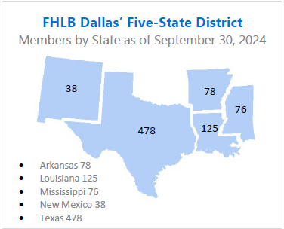
About FHLB Dallas
Who we are
  FHLB Dallas is a member-owned cooperative.
  Members are banks, credit unions, savings and thrifts, CDFIs and insurance companies.
What we do
  We provide members with wholesale lending, credit and related financial services.
  At least 10% of income from the prior year goes to affordable housing.
Why we were created
  To provide capital for mortgage funding during the Great Depression.
Notes:
Who we are:
FHLB Dallas is an independent government sponsored enterprise (no federal appropriations), that is owned by our member financial institutions.
Owned by “Member” financial institutions. We have a Cooperative structure; Members are both owners and customers.
Members are banks, credit unions, savings and thrifts, CDFIs and insurance companies.
What we do:
We provide members with wholesale lending, credit and related financial services to support affordable housing and economic development
Why we were created:
Created by congress in 1932 to reinvigorate a housing market devastated by the Great Depression through housing financing and community development programs and serving as a source of liquidity to our members.

Slide 4
Community Investment Products
Grants
Recoverable Grants
Advances
Affordable Housing Program*
Voluntary
Voluntary
EDP
CIP
Disaster
10% of Income
HAVEN
PGP
Small Business Boost
Competitive
Set-aside
FORTIFIED
Heirs Property
HELP: Home-buyer Equity Leverage Partnership
SNAP: Special Needs Assistance Program
DRA: Disaster Rebuilding Assistance
HAVEN: Housing Assistance for Veterans
PGP: Partnership Grant Program
EDP: Economic Development Program
CIP: Community Investment Program
HELP
Care Award
NAHO
SNAP
DRA
4
*These programs require recipients to be at or below 80% AMI
Notes:
This morning, we are going to focus on the Set-Aside programs which are HELP, SNAP, and DRA. I encourage you to explore our website, fhlb.com, to look through other programs you may find value in.
AHP General Fund provides grants to help finance the purchase, rehabilitation or construction of affordable housing, including owner-occupied and rental housing and housing for homeless individuals and families. Funds are awarded on an annual basis through a competitive application process.
HELP provides down payment and closing cost assistance to first-time homebuyers.
SNAP provides grants to modify or rehabilitate homes for those with special needs.
DRA provides grants to help homeowners repair or rebuild after disasters.

Slide 5

2025 AHP General Fund Owner-Occupied Overview
Application Window Opens April 2 – May 1, 2025

Slide 6
AHP General Fund (Purpose)
These funds strengthen communities by providing funding to members for affordable housing finance that benefits households at or below 80 percent of their area median income.
A Funding source to nudge Affordable Housing projects over the finish line with final funding, as a gap funding source to leverage additional grant monies or for overall financing needs.
The grant is interest free, and if a project remains in compliance with program requirements for specified terms, all funds are forgiven – reducing the amount of debt and other funding needed to complete a project.
Project sponsors must work with an FHLB Dallas member financial institution to submit an application for funding.
2025 Maximum AHP subsidy is $1,750,000 per project.
Application Period-The funding round begins April 2nd and closes on May 1st.
*NOTE: FHLB Dallas does not provide grants directly to project sponsors or to consumers*

Slide 7
Application Evaluation and Eligible Housing
Scoring
Criteria
Eligibility
Eligibility Criteria
Feasibility
Demand
Capacity
Sponsor Capacity
Site Control and Zoning
Financial Feasibility
Use of Fund
Need for Subsidy
Types of Eligible Housing
First Time Homebuyer Programs
Single Family Home (1 to 4 dwelling)
Manufactured Homes
Micro Homes
Owner-Occupied Rehabilitation
Owner-Occupied New Construction
5 Year Deed Restriction for Owner-Occupied AHP Subsidy units involving downpayment assistance

Slide 8
Member or Sponsor
A "Member" for an AHP application is an owner of FHLB Dallas that is willing to apply for AHP funds on behalf of a project owner or developer.
A "Sponsor" is the owner of a rental project or the overseer of an ownership project that will put together the application or coordinate the application and project’s completion.
Although a "Member" might be said to "sponsor" an application by submitting it, be sure to understand these terms, because a "Sponsor" and a "Member" play two different roles in an AHP application.
A sponsor cannot apply without a member

Slide 9
AHP Process
Pre-Application Process
The member and project sponsor meet to discuss the project
Application Process
  The project sponsor completes the application for funding during the annual application period
Approval
  FHLB Dallas scores the applications and recommends projects to receive funding
Funds Disbursement
AHP funds are disbursed as a direct grant to the member institution
Progress Reporting
Sponsors submit annual progress reports until project completion
Monitoring
  Upon completion of the construction or rehabilitation
Five-year Retention for Owner Occupied Downpayment Assistance

Slide 10
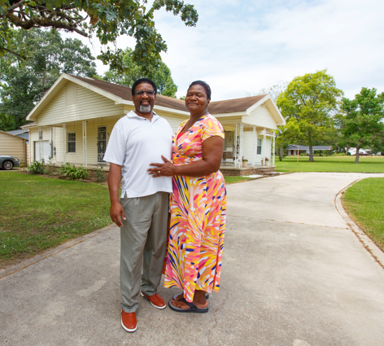
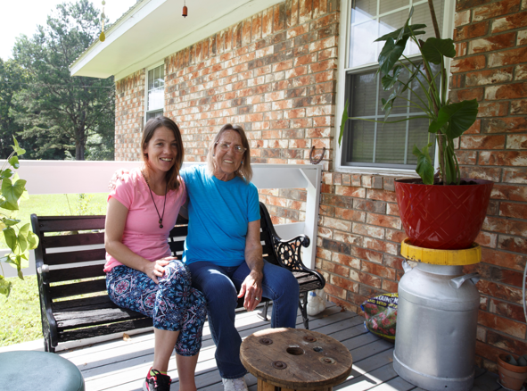
Owner-Occupied Overview
Project Types: Rehabilitation, down payment/closing cost assistance
Project Progress and Completion
Four-year completion timeframe (six years for Native American related projects). Progress should be made within the first year.
Sponsor Capacity
Demonstrated track record with related experience
Disbursement
Completed on a unit-by-unit basis with final documents required for each transaction
Helpful Hint
Contact the Community Investment department to discuss your owner-occupied project

Slide 11
Owner Occupied AHP Eligible Uses of Funds
Rehabilitation (accessibility modifications, roofs, etc.)
Downpayment/Closing Cost Assistance
Developer and Inspection Fees (Rehab Projects only)
Homebuyer Counseling (DPA Projects only)
Notes:
Ineligible Uses: Construction Costs, Contingency, Operational, Administrative, Costs for Empowerment services

Slide 12
Owner-Occupied Feasibility
Criteria | Ranges/Limits | Project Examples
Targeting | Less than 80 percent of AMI | 100 percent of homes targeted to households < 50 percent of AMI
Subsidy Pass-Through | Clearly demonstrated to homebuyer/homeowner | Loan Estimate and Closing Disclosure to be provided on a home-by-home basis with disbursement requests
Mortgage Term and Amortization Term | Not less than 5 years and 15 years respectively | Homebuyers are applying for 30-year fixed rate mortgages
Developer Fee | Not to exceed 10 percent of the FHLB subsidy amount | Project’s fee was 10 percent
Cash Back | Cash back to homebuyer at closing, or as part of the rehab cost, is NOT allowed | Subsidy is based on need and will not result in cash back

Slide 13
Demand – Owner Occupied
Owner-Occupied Waitlist
Provide the number of eligible households that meet application requirements
Provide wait lists of interested households
List size should be 1.5 to 2 times the requested number of units
Describe the relationship of the characteristics of the housing stock to the proposed homeownership program.
Demand for AHP Subsidy requested
How is the project determining the level of subsidy requested at a per unit level?
How the need for rehabilitation proposed in this application was determined
Example Questions
How the project arrived at a budget of $15,517 per home?
How project determined that $10,000 in AHP funds are needed per home?
Notes:
Site Control/Zoning - Site control is not required at application for projects involving scattered site ownership

Slide 14
2025 AHP General Fund Scoring Overview
Scoring Criteria | Points
Donated property* | 5
Not-for-profit or government sponsorship | 5
Targeting - Income groups | 20
Underserved communities and populations* | 15
Creating economic opportunity | 5
Community stability | 15
FHLB Dallas District priority* | 35
Total | 100
100-point scoring system based on 7 criteria
Found in Attachment D of the FHLB Dallas AHP Implementation Plan
* Symbolizes a change from 2024

Slide 15
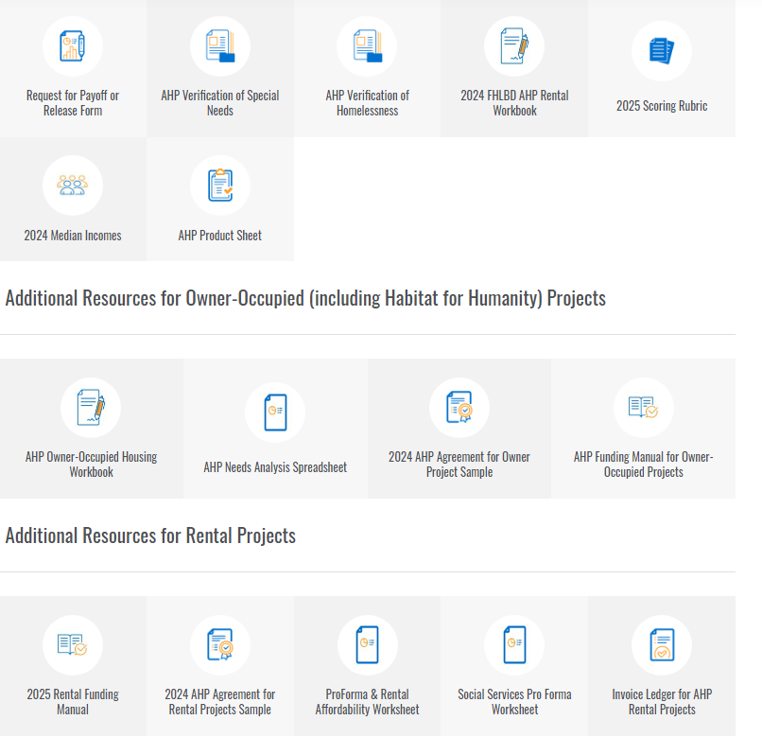
Resources
Additional Resources are located on the
AHP webpage

Slide 16
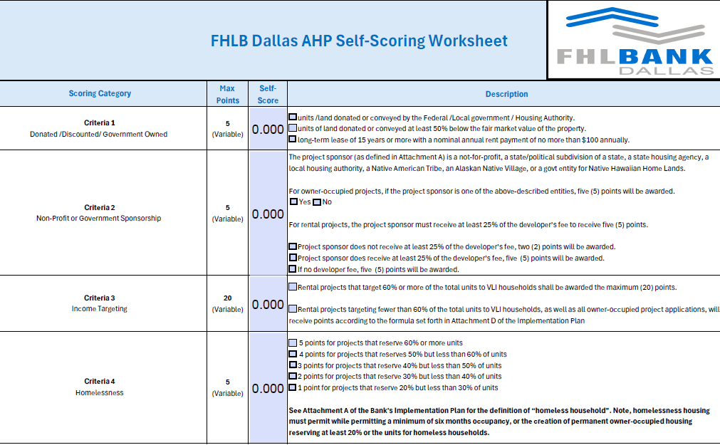
2025 Scoring Rubric (Self- Scoring Worksheet)

Slide 17
Donated / Conveyed Property
Units or land donated/conveyed by the federal government instrumentality or unrelated related (at least 20% of units); or
Property conveyed significantly below market value, meaning it is transferred for 50% or less of fair market value, by an unrelated party
Key Points:
Donated or conveyed by an entity not related to or affiliated with the member, project sponsor or project owner through ownership or control with the exception of property owned and donated by a Housing Authority, City or County and meeting all other conditions of this criterion.
Evidence of donation should be included with application (i.e., transfer deed, purchase agreement or letter of intent)

Slide 18
Not-for-Profit/Government Sponsorship
Project Sponsor means a not-for-profit or for-profit organization or public entity
5 points – All Projects
Housing finance agencies
Housing authorities
Not-for-profit entities
Government agencies
Native American Tribes

Slide 19
Income Targeting
The extent to which a project creates housing for very low- and low- or moderate-income households
  Very low-income (VLI) units (i.e., less than or equal to 50% of the area median income or AMI) will be weighted at five (5) points.
  Low-income (LI) unit (greater than 50% but less than or equal to 60% AMI) will be weighted at three (3) points.
  Moderate-income (MOD) unit (greater than 60% but less than or equal to 80% AMI) will be weighted at one (1) point.
  Maximum = 20 points
The larger the percentage of VLI households within a project…
…the higher the score.

Slide 20
Creating Economic Opportunity
Programs/services assisting residents in attaining life skills or better economic opportunities
Empowerment Services
Employment
Homebuyer Counseling/Education (DPA Projects)
Homeowner Maintenance & Counseling/Education (Rehab projects)
Onsite daycare services (child or adult)
Sweat Equity - New Construction Projects only (minimum of 300 hours per home)
After school or out-of-school services
Workforce preparation and integration
Mental and behavioral health services
1 service = 3 pts
2 services = 5 pts

Slide 21
Underserved Communities and Populations
Special Needs Housing
Households with elderly
Persons with disabilities
Persons recovering from physical/alcohol/drug abuse
Persons with HIV/AIDS
Formerly incarcerated persons
Victims of domestic/dating violence/sexual assault/
Unaccompanied youth
Special Needs points
20% to 29% = 1 pt.
30% to 39% = 2 pts
40% to 49% = 3 pts
50% to 59% = 4 pts
> 60%= 5 pts
Rural Points
Variable points - number of units located in a rural area divided by total number of units
Rural Housing – 5 pts
An area eligible for USDA Rural Development housing programs. USDA property eligibility is provided on the USDA website.

Slide 22
Community Stability
Adaptive Reuse - Converting an existing non-housing structure into housing
New Construction - Project is 100% new construction
Rehabilitating Properties - 50% of the units or square footage are vacant, abandoned or foreclosed and are being rehabilitated
Community/Revitalization Area - located within the geographic boundaries defined by a community revitalization plan adopted by the municipality, county or parish in which the project is located; or, part of an approved resolution from the Governing Body of the municipality, county or parish expressly setting forth that the Governing Body supports the AHP application
Demo of Properties - 20% of the units are new construction in place of demolished structures (do not include ancillary structures)
Projects can receive points for 3 of the top 5 categories for 3 points each (totaling 9)

Slide 23
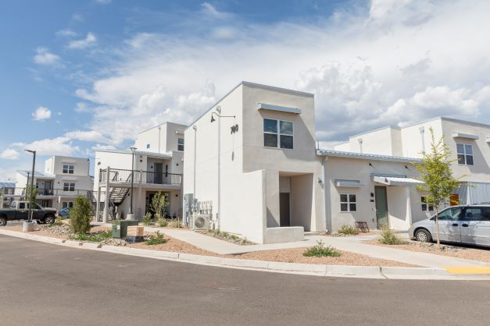
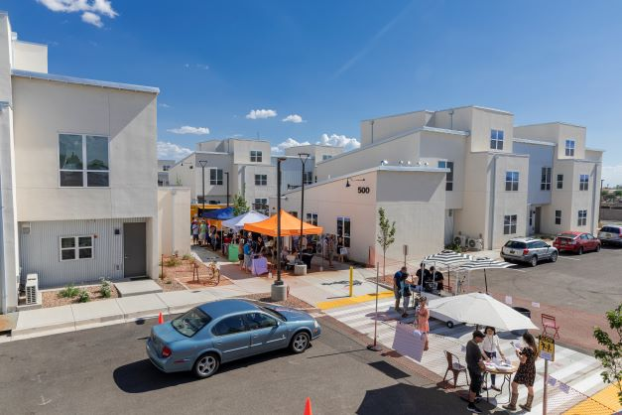
Bank District Priority
First-time homebuyers - 5 pts
50% - 2.5 pts
100% - 5 pts
Units located within District - 8 pts
Units located in Arkansas/New Mexico – 8 pts
Units located in Louisiana/Mississippi/Texas – 5 pts
Units located out of district – 0 pts
Climate resilient building standards- 7 pts
Subsidy Per Targeted Unit – 5 pts
Native housing projects – 5 pts

Slide 24
Bank District Priority – Cont’d
Climate Resilient & Green Housing
Scoring based on the type of resilient housing certification achieved. Emphasis on constructing units that will better withstand potential natural disasters as well as conserve energy and use sustainable materials as required by achieving one of the designations below:
Fortified: Multifamily, Gold (7 Pts)
Fortified: Silver
Enterprise Green Communities Criteria
Leadership in Energy and Environmental Design (LEED)
ICC/ASHRAE ‐ 700 National Green Building Standard (NGBS)
HERS Rating: 65 or less for Rehab; 55 or less for New Construction
Fortified: Roof
Energy Star Certified Home/Building (3 Pts)
(5 Pts)

Slide 25
Grant Connect
Grant Connect is the home of the AHP application

Slide 26
GrantConnect
What is GrantConnect?
The online portal where applications are completed and submitted for consideration for an AHP subsidy
Key Points
GrantConnect is the place where sponsors/consultants must have a User ID and password.
It requires first-time users to register before being able to complete an application.
AHP Application Open from April 2-May 1

Slide 27
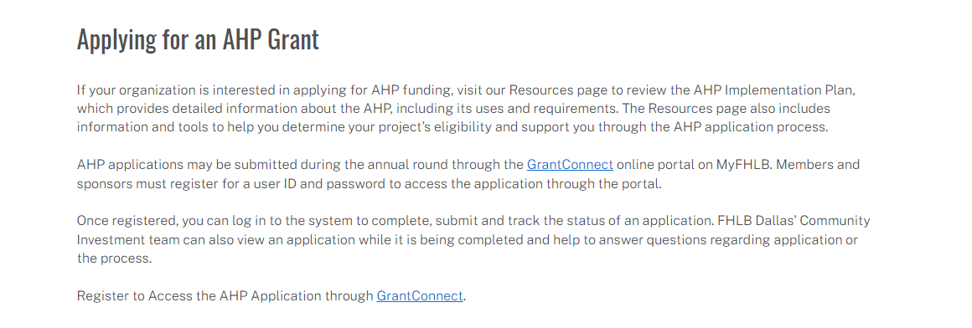
Registration and Access
*GrantConnect is the home of the AHP application
*Go to https://app.fhlb.com/grantconnect to begin

Slide 28
Register through GrantConnect – Key Points
Sponsors
First time users will create a User ID/Password and affiliate with a new or existing organization
If you created a User ID or used AHP Online in previous AHP rounds, do not create a new User ID. Call FHLB Dallas first
Consultant
Members
Applications created by a consultant will need to be approved by the sponsor
Non-Sponsor = Consultant
All non-sponsors need to register as well
Must have a user ID and password
Cannot access application without PIN
After registering, log in to the system with your user ID and password during the application round.
The initiator will create the application PIN. The application PIN will need to be shared with each party to complete, submit and track the status of the application.
The member, sponsor and FHLB Dallas’ Community Investment department can view an application at the same time while it is being completed online.

Slide 29
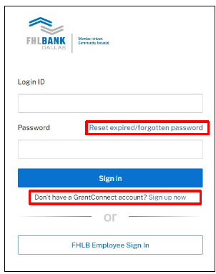
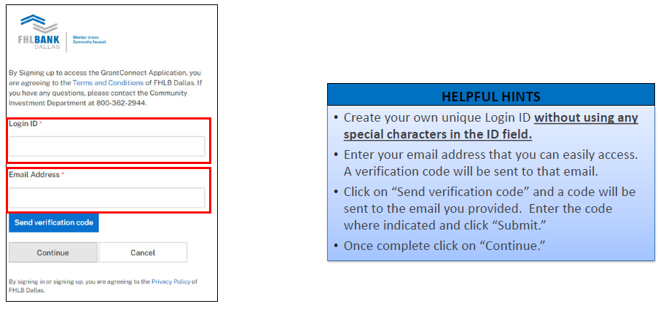
Registering as a Sponsor/Consultant
Use Chrome or Edge Browser
GrantConnect requires multifactor authentication using either a direct-dial phone line phone (cannot be an extension), cell or an authenticator app on your phone.
Registration approval can take up to 24 hours
Call 1-800-362-2944

Slide 30
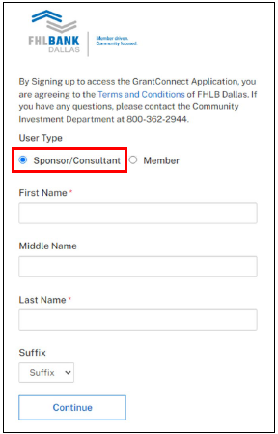
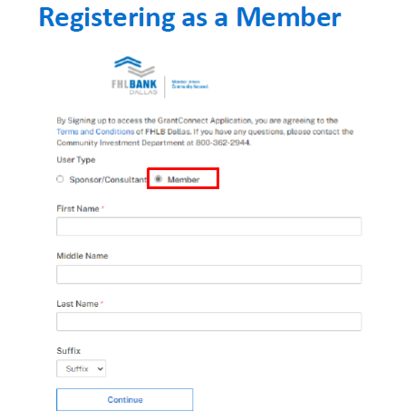
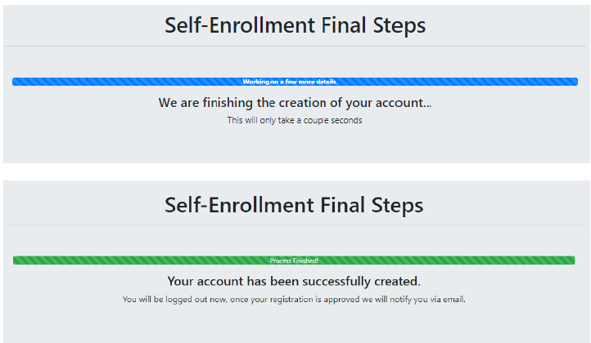
GrantConnect Registration -

Slide 31

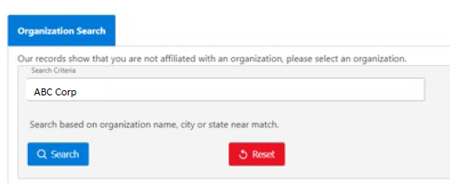
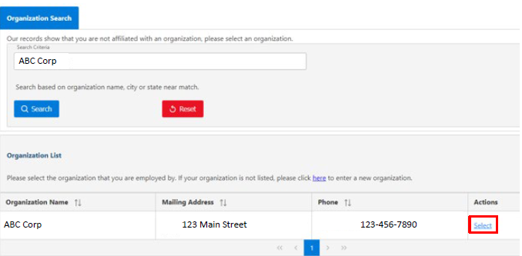
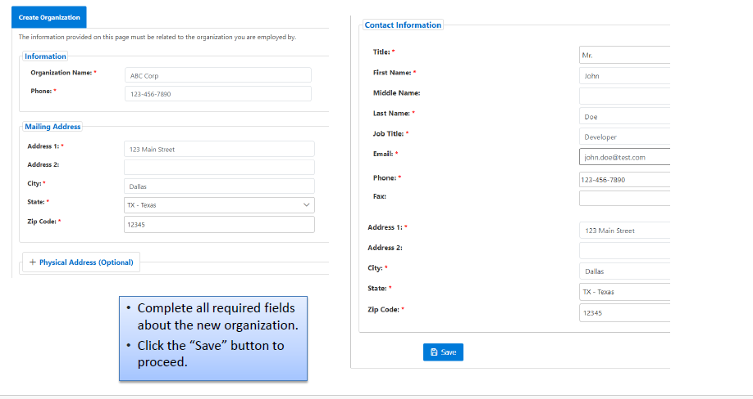
Registering as a Sponsor/Consultant
1-2 business days for processing. Notified Via Email upon completion

Slide 32
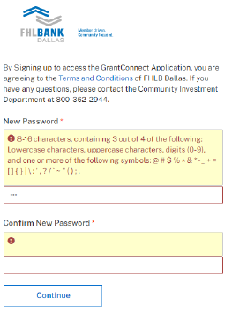
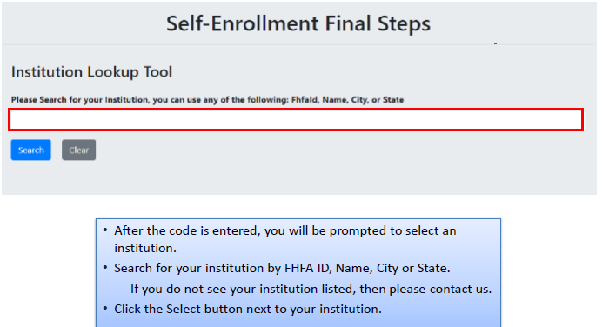
Member Registration
1-2 business days for processing. Notified Via Email upon completion

Slide 33
GrantConnect Program Access
Members
AHP General Fund
HELP
SNAP
DRA
Sponsors, Consultants, Intermediaries
AHP General Fund

Slide 34
GrantConnect - Recap
Consultant
AHP applications created by a consultant will need to be approved by the sponsor
Non-Sponsor = Consultant
All non-sponsors need to register as well
Sponsors
First time users will create a User ID/Password and affiliate with a new or existing organization
If you created a User ID or used AHP Online in previous AHP Rounds, do not create a new User ID call us first
Members
Must have a user ID and password to access the application through the GrantConnect portal.
Everyone
Once you have registered, log on to the system with your user ID and password during the application round. You may use the application PIN to complete, submit and track the status of your application.

Slide 35
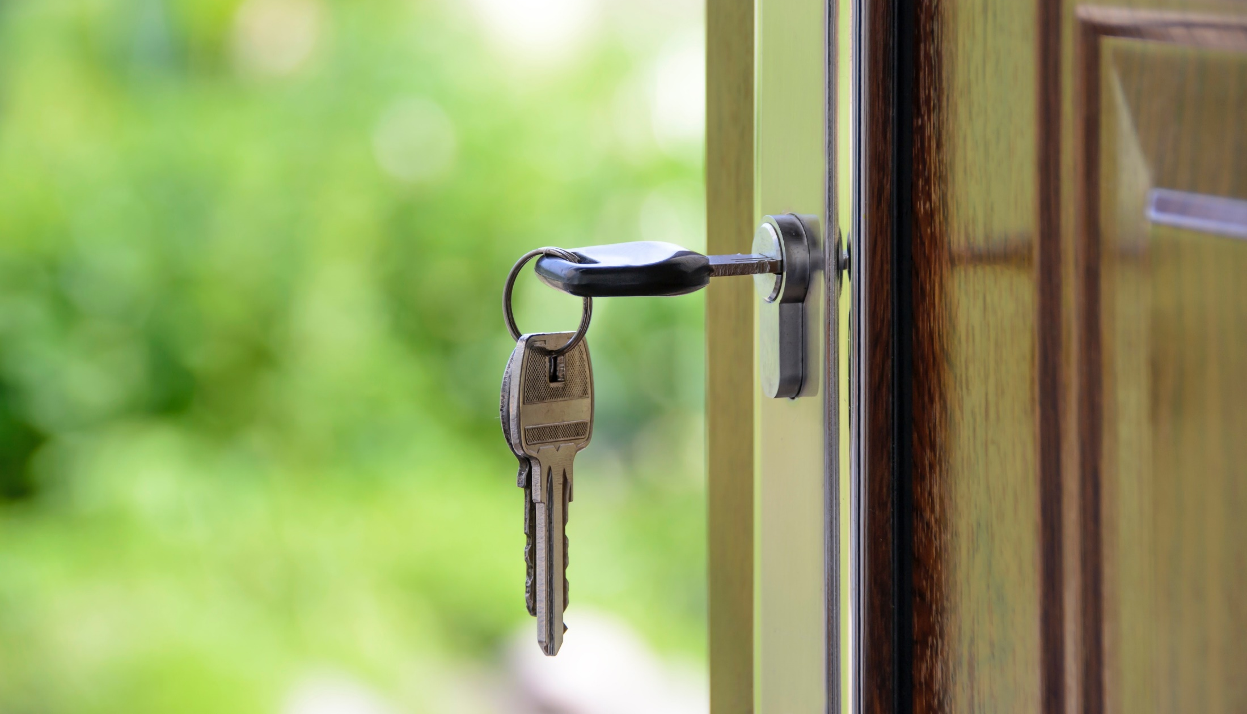

2025 Homebuyer Equity Leverage Partnership (HELP)
Application Window Opened January 2, 2025
Notes:
schedules to listen in and …..

Slide 36
HELP Program Specifics
Provides down payment & closing cost assistance for qualified, first-time homebuyers on a first-come, first-served basis. Households with AMI at or below 80%
2025 HELP Allocation
$17 Million available
until exhausted or
December 31,2025
2025 Allocation Offerings
50% - Jan 1
25% - May 1
25% - Aug 1
Borrower & Member Caps:
Individual homebuyer limits for properties:
$20,000 - AR, LA, MS and outside the Bank’s District
$25,000 - NM and Texas
Member Cap: $850,000
Up to ½ of the member cap may be used outside of the FHLB Dallas District.
All U.S. property locations are eligible

Slide 37
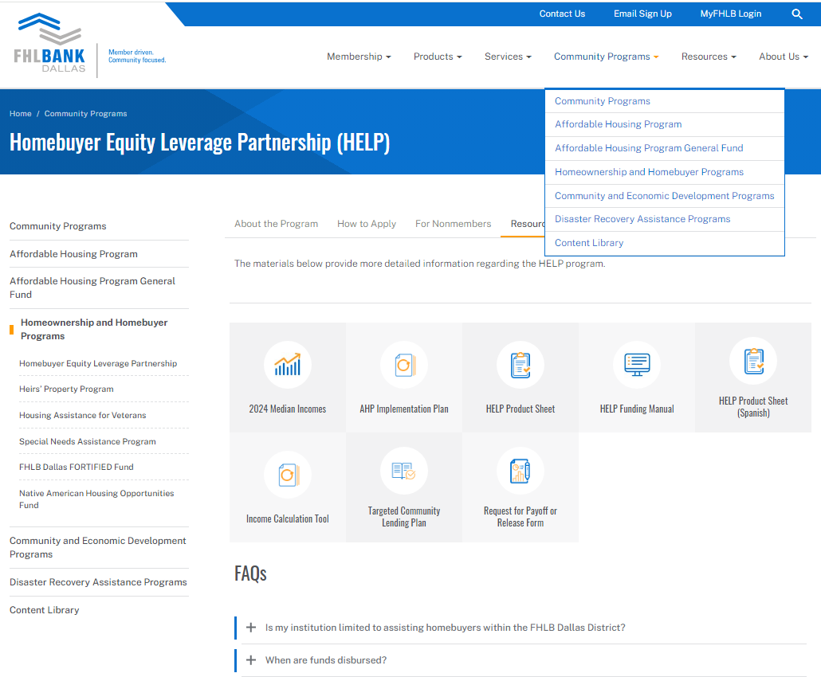
2025 Key documents and resources
The 2025 HELP Funding Manual can be found on fhlb.com

Slide 38
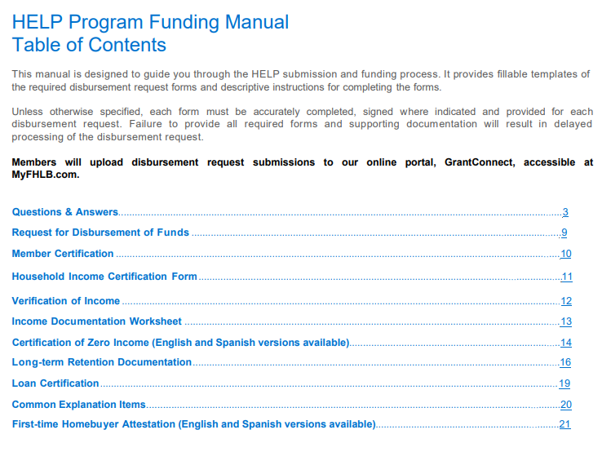
Please note the Q&A section is a great resource for common questions

Slide 39
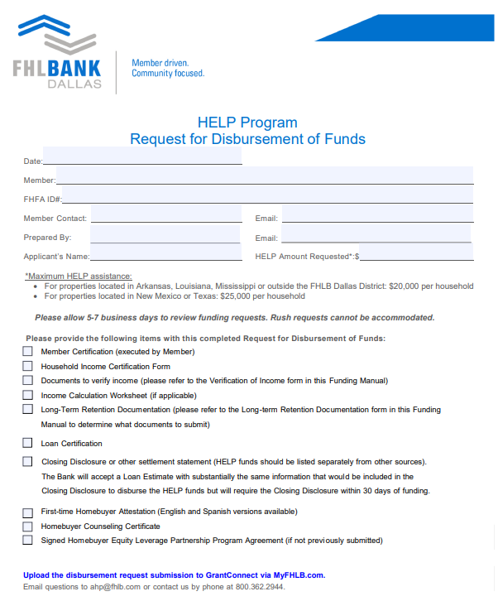
Ensure the amount requested matches the amount listed on the Loan Estimate or Closing Disclosure
Please Note:
The 5-7 business day review times depend on completeness of request.
We cannot guarantee the turnaround time if the request is missing required documentation or has significant deficiencies.

Slide 40
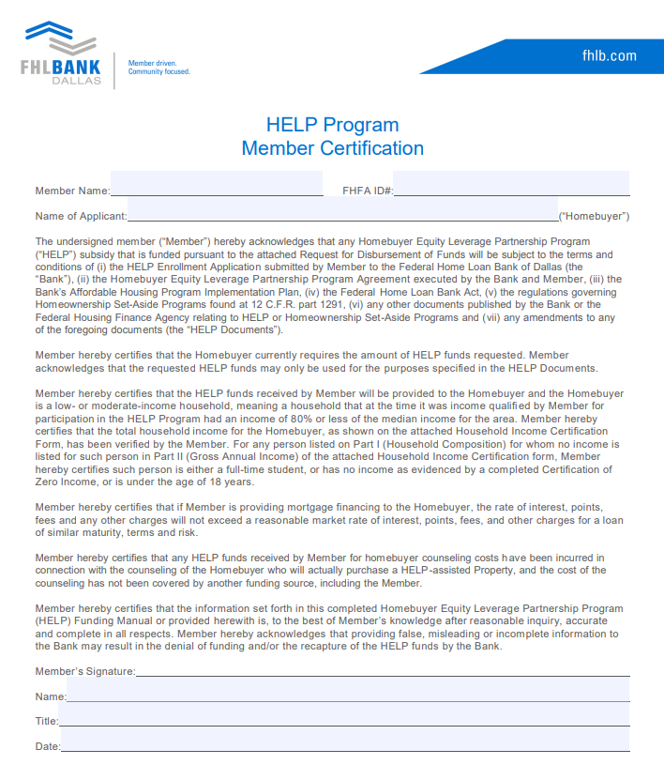
Member signer must have AHP or Advances Authorization

Slide 41
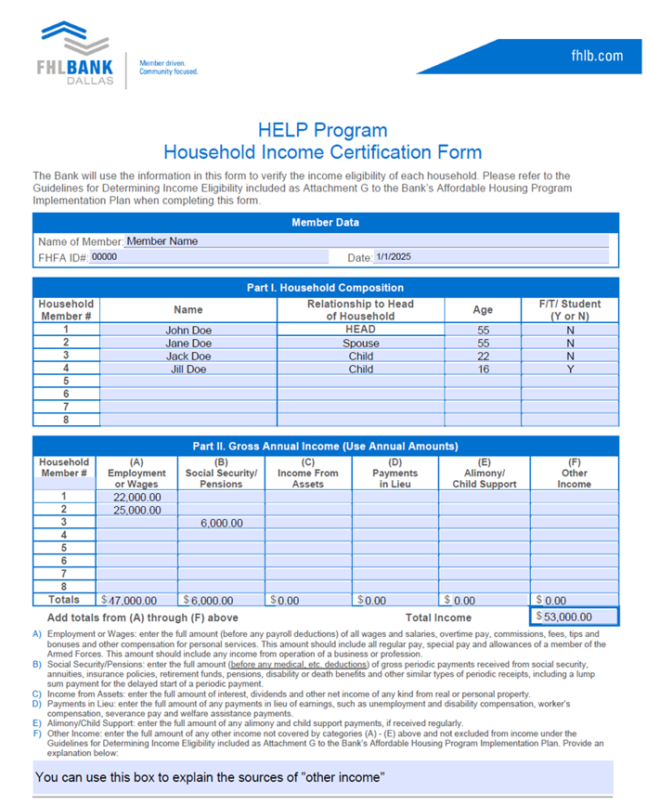
All individuals who will be permanent residents of the household must be included on this form
There must be income documents supporting all adults (18+) listed who are not full-time students
The Household Income Certification Form is a required document for all FHLB Owner Occupied related programs

Slide 42
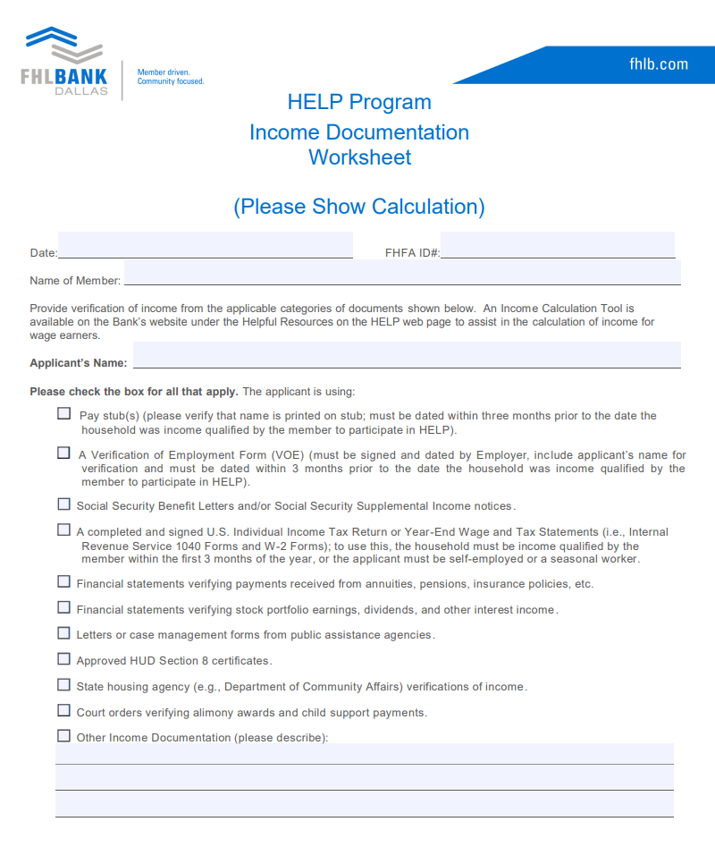
This form highlights the income documentation for each person living in the home
Submit the associated income documentation for us to cross-reference
The Income Documentation Worksheet is a required document for all FHLB Owner Occupied related programs

Slide 43
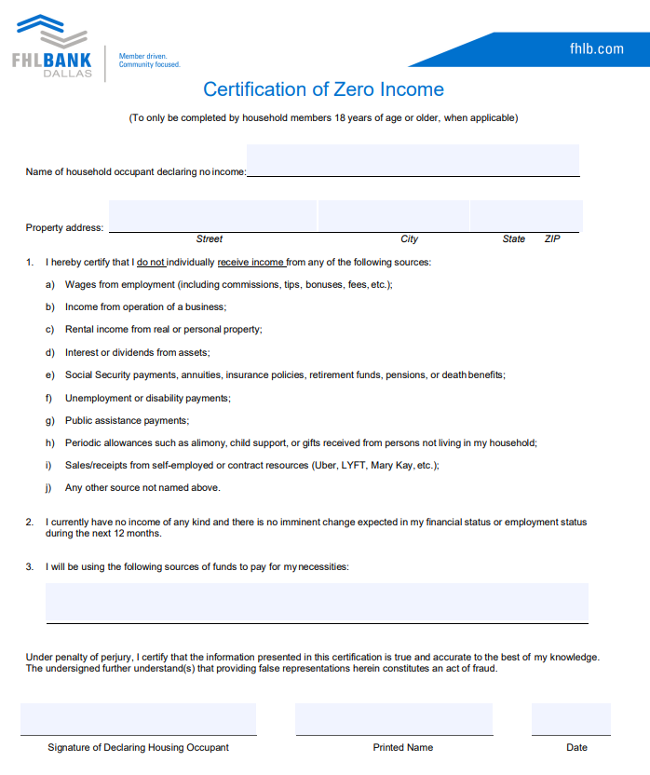
Certification of Zero Income
Submit the fully completed document for each household member with zero income as outlined below:
Individuals of the household:
18 years and older who are not a full-time student
That have no source of income as outlined on the form
Funding Manual includes a version of the document in Spanish

Slide 44
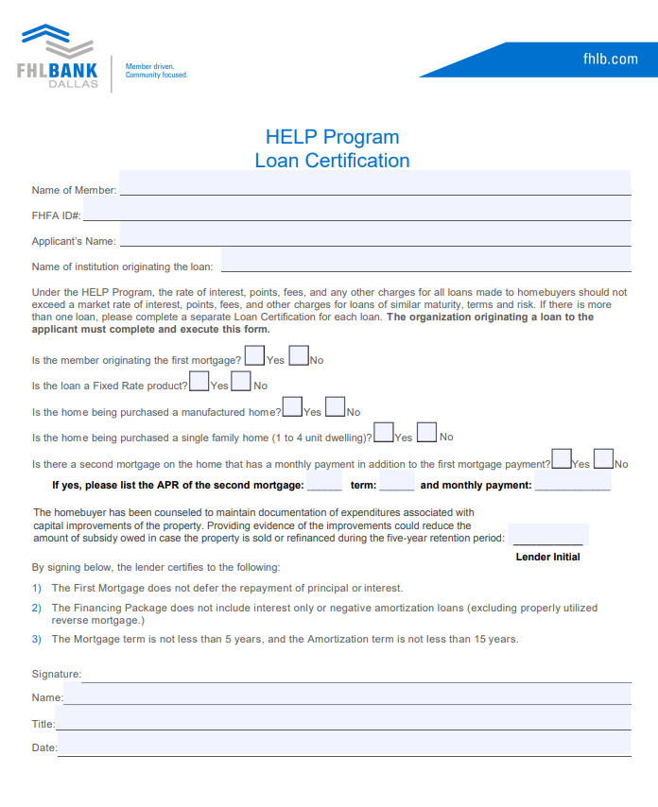
This form should be filled out by a representative from the institution originating the first mortgage (member institution, Habitat for Humanity, etc.)
Please read each line prior to checking the appropriate box and ensure the lender initials are filled out.
Check “Yes” and fill out the applicable information related to a second mortgage only if the second mortgage has a monthly payment in addition to the first mortgage payment.

Slide 45
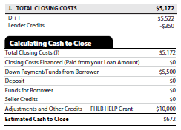
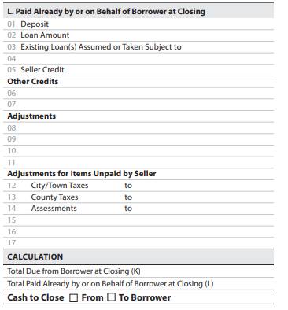
Draft Closing Disclosure/Loan Estimate
Loan Estimate
Closing Disclosure
$107,925.99
$97,700
FHLB HELP Grant
$10,000
01/01/23 08/31/23
$225.99
The FHLB HELP Grant and amount must be clearly labeled
Include all other grants and loans (terms of loans must be included on Loan Certification)
$108,597.80
$107,925.99
X
$671.81
Homebuyer cannot receive cashback at closing
Homebuyer contribution must be at least $500

Slide 46
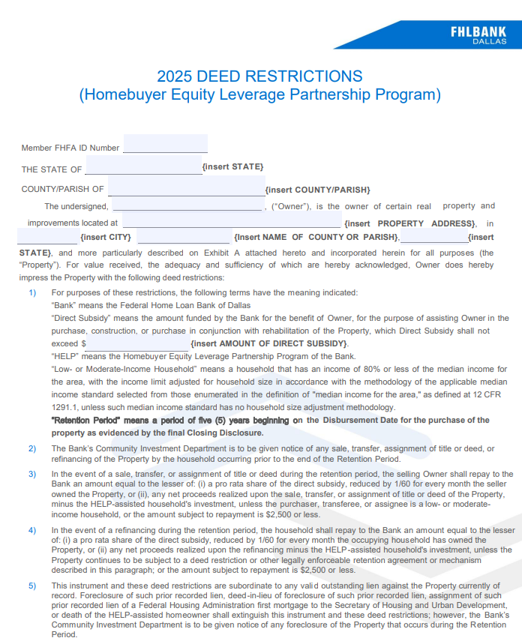
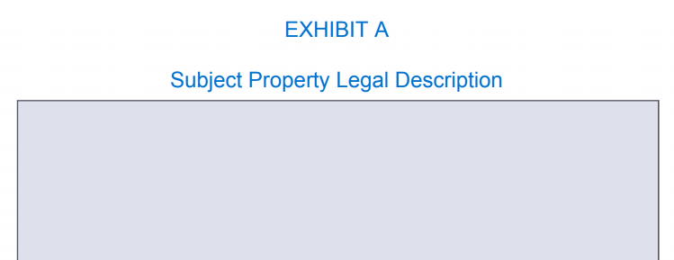
A completed draft of this document must be submitted with the application request
For 2025, we have removed the closing date requirement with the new “Retention Period” language
Remember to fill out page 2 including Exhibit A: Property legal description
Do not record the document prior to receiving the grant
Lot 16, in Block 2, of Hanging Gardens Addition, an addition of the City of Chesterfield, Wailing County, Texas, according to the Map or Plat thereof recorded in/under Volume 857

Slide 47
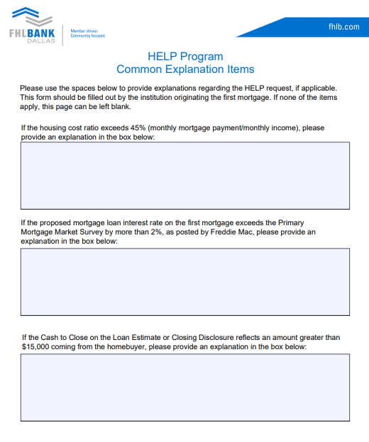
If any of these criteria are met, we will need an explanation provided with the request
Primary Mortgage Market Survey can be found at www.freddiemac.com/pmms
Explanation required if “Cash to Close” greater than $15,000 and not paid by another source

Slide 48
Please ensure at least one of the criteria is checked and the form is signed and dated.
All applicants who are listed on the Closing Disclosure must meet at least one of the criteria and sign this document.
Spanish version also available. You can submit the version the borrower is most comfortable with.

Slide 49

Homeownership Counseling Certificate
Must provide a copy of a homeowner counseling completion certificate from
an industry- accepted curriculum provider
FHLB does not have a preferred counseling program
Please refer to HUD’s approved listing of courses for guidance
Up to $500 of HELP funds may be used for counseling cost
Members can reimburse nonprofits who are providing the counseling
Should be listed on the Closing Disclosure
Up to $500 of HELP funds may be used for counseling costs
Members can reimburse nonprofits who are providing the counseling
Should be listed on the Closing Disclosure
Billy Thompson
HAS SUCCESSFULLY COMPLETED HOMEOWNERSHIP EDUCATION

Slide 50
HELP Final Documents
We require two documents to be submitted after the disbursement of funds and closing of the home
Signed Final Closing Disclosure:
Recorded Deed Restriction:
Due within 60 days of the disbursement of HELP funds to the member's DDA
Due within 30 days of the disbursement of HELP funds to the member's DDA
The deed restriction must be entirely filled out including “legal description”
The HELP Grant and amount must be clearly labeled
The deed restriction must be recorded with the county officials where the property is located
No cash back to the borrower(s)
Homebuyer contribution must be at least $500 (cash to close or as a deposit)
Evidence of recording must be included on the submitted document
Must include Disbursement Date of the loan
Any errors included on the recorded document will require correction/additional cost to be incurred by the member or responsible party.

Slide 51
HELP Summary
Make sure you’re enrolled
Funding available January 2nd, May 1st and August 1st, 2025
Upload fully executed Funding Manual with all supporting documentation to GrantConnect
Funds get disbursed to the Member’s DDA with FHLB Dallas
Within 30 days post-funding, upload the Final CD**
Within 60 days post-funding, upload a copy of recorded Deed Restriction with legal description**
Record the Deed Restriction as a separate & single document. If not, the document will need to be corrected, and additional fees will incur.
**Failure to provide final documents within approximately 30 and 60 days may delay future funding requests.
Notes:
If you are not sure if you are enrolled, please email us at ahp@fhlb.com to confirm

Slide 52
Questions?

Slide 53


Disaster Rebuilding Assistance (DRA)
First offering opened January 2nd, Second offering opens September 1,2025

Slide 54
Program Specifics
Provides funding for the repair, rehabilitation, and reconstruction of owner-occupied housing affected by a federally declared disaster for individual assistance. Household at or below 80% AMI
Each Homeowner can receive up to $15,000
$4 Million split between two offerings in 2025
The property must be in the FHLB Dallas AR, LA, MS, NM, TX
2025
Two Funding Offerings
January 2 & September 1
Each Member may request $300,000/
Offering*
Funds available until exhausted or
Nov. 15, 2025
*Applications can be submitted from 8am CST on the first day of the offering until 5pm CST on the final day of the offering

Slide 55
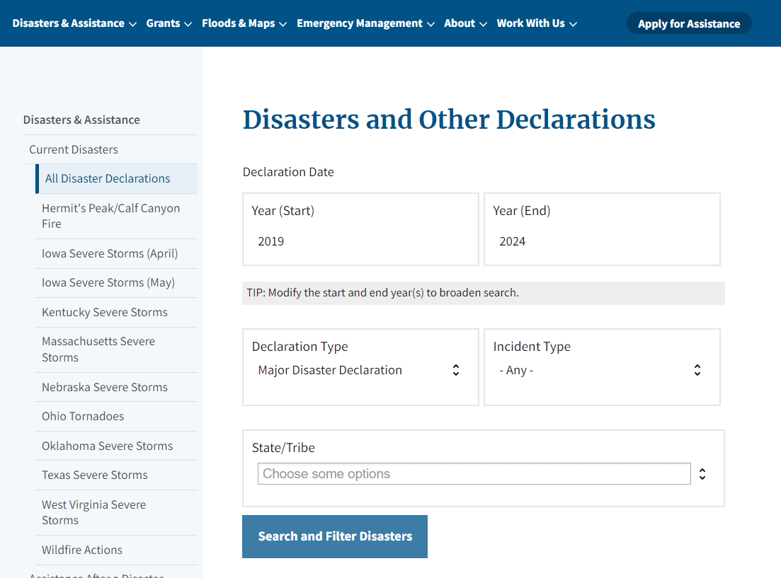
Determining Eligible Disasters
Go to FEMA’s website found here: https://www.fema.gov/disaster/declarations
Choose “Major Disaster Declaration” under Declaration Type and select the appropriate state
Click “Search and Filter Disasters”

Slide 56
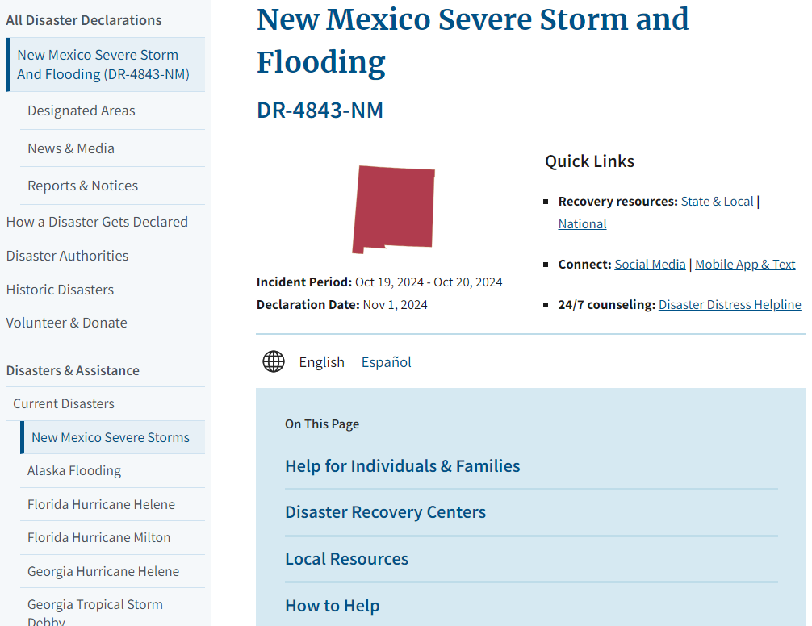
Determining Eligible Disasters
4. Select the disaster that caused the damage
5. Click on “Designated Areas”

Slide 57
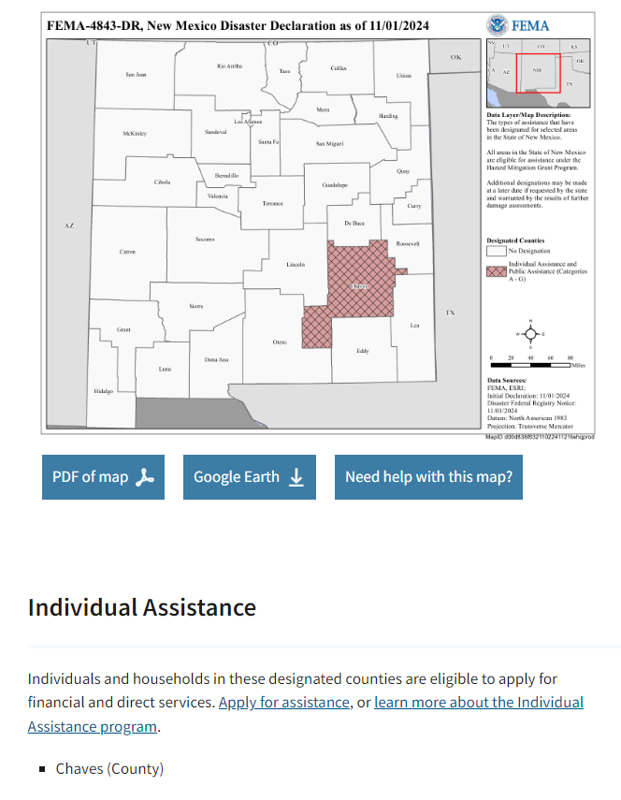
Determining Eligible Disasters
6. Homes in counties designated for “Individual Assistance” are eligible under DRA
Requested repairs must be related to damages caused by the disaster

Slide 58
2025 Key documents and resources
The 2025 DRA Funding Manual can be found on fhlb.com

Slide 59
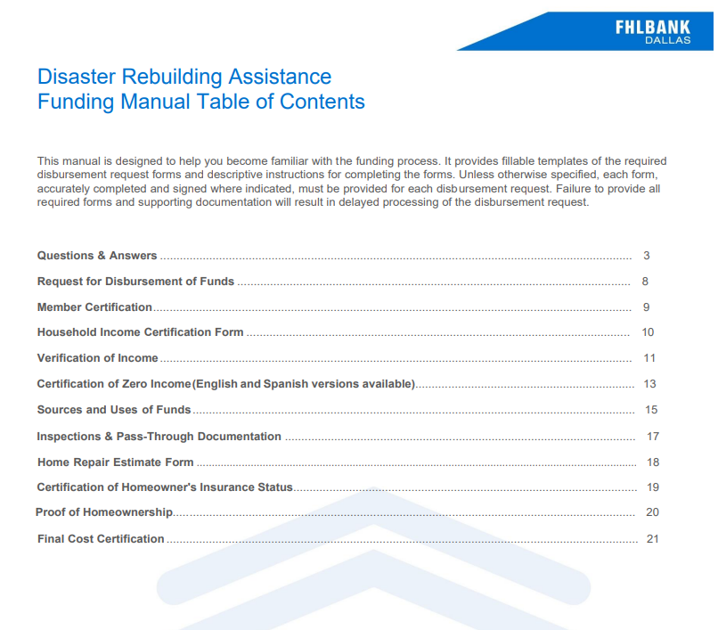
Please note the Q&A section is a great resource

Slide 60
DRA Request for Disbursement of Funds
Please fully execute the Request for Disbursement of Funds. Include the Intermediary Organization, if applicable.
Include the FEMA Disaster ID associated with the request:
https://www.fema.gov/disaster/declarations
Following the checklist will assist in submitting a completed application
*If a developer fee is included in the request, there should be an Intermediary listed on the Request page.

Slide 61
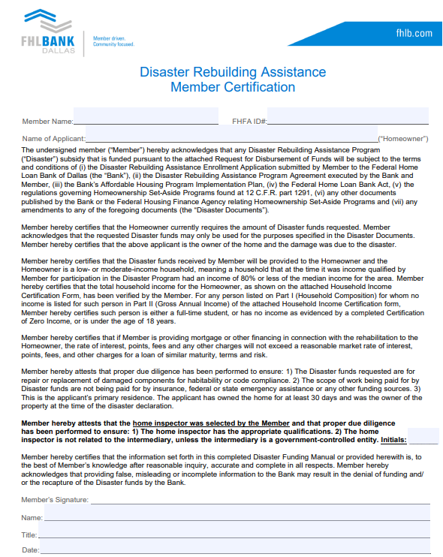
Member MUST initial here to confirm the selection of the inspector
Member signer must have AHP or Advances Authorization

Slide 62
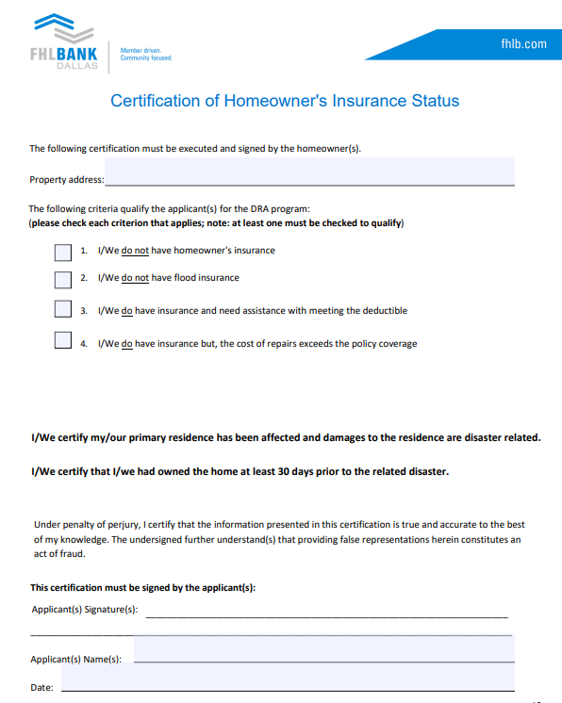
Please ensure the applicant checks the appropriate box/boxes, signs and dates the form.
Please Note:
The rehab work should be related to damages caused by the natural disaster.
The homeowner(s) must have owned the home at least 30 days prior to the occurrence of the disaster.

Slide 63
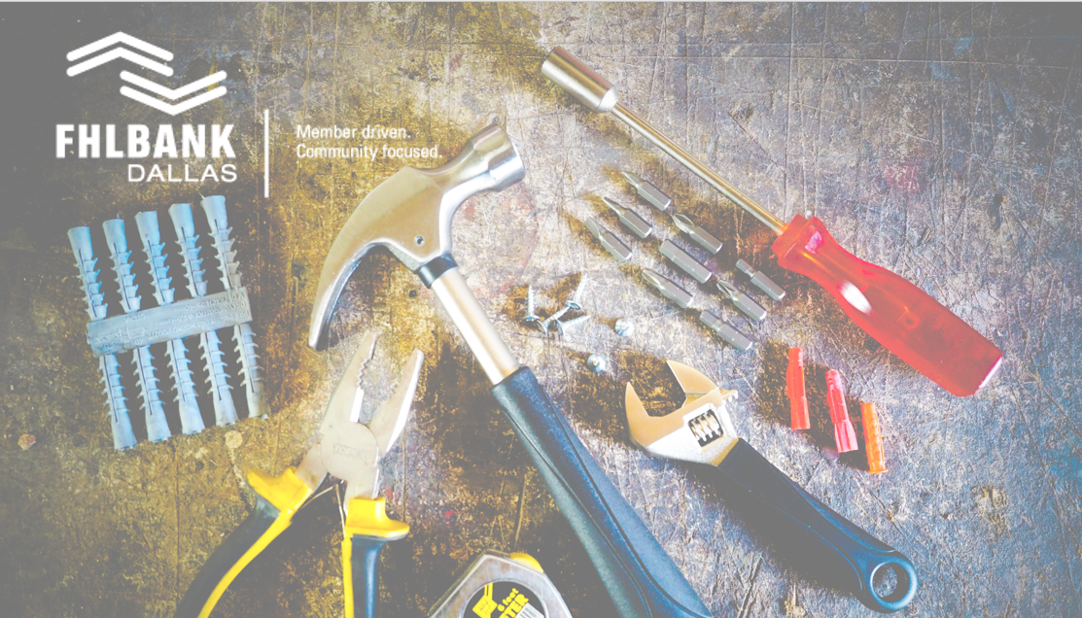
2025 Special Needs Assistance Program (SNAP)
First Offering Application Window February 11-13 and Second Offering June 3-5

Slide 64


Program Specifics
SNAP provides subsidies for the repair and rehabilitation of owner-occupied housing of eligible, special-needs households at or below 80% AMI
The property must be in the FHLB Dallas AR, LA, MS, NM, TX
$4 Million split between two offerings in 2025
Each Homeowner can receive up to $12,000
2025 Offering Windows Feb. 11-13 & Jun. 3-5
Maximum 6 individual submissions per member per year
Each member can submit a maximum of $25,000/Offering
Each intermediary can submit a maximum of $50,000/Offering
*Applications can be submitted from 8am CST on the first day of the offering until 5pm CST on the final day of the offering

Slide 65
SNAP Eligibility Requirements
Special Needs
Eligible Households:
Income at or below 80% AMI
Special needs: households with elderly, persons with disabilities, persons recovering from physical abuse, alcohol, or drug abuse, or persons with HIV/AIDS
Owner-occupied primary residence:In FHLB Dallas’s district: AR, LA, MS, NM, TX
All submissions must be submitted by member financial institutions via GrantConnect
At least one permanent occupant of the household must meet at least one of the special needs criteria.

Slide 66
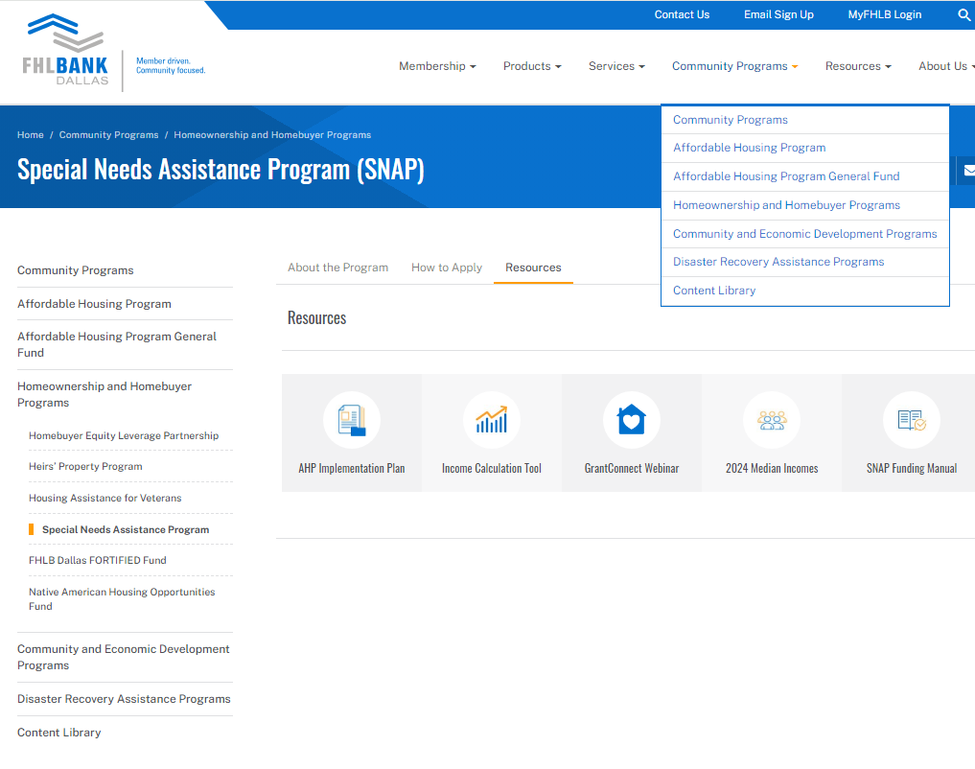
2025 Key documents and resources
The 2025 SNAP Funding Manual can be found on fhlb.com

Slide 67
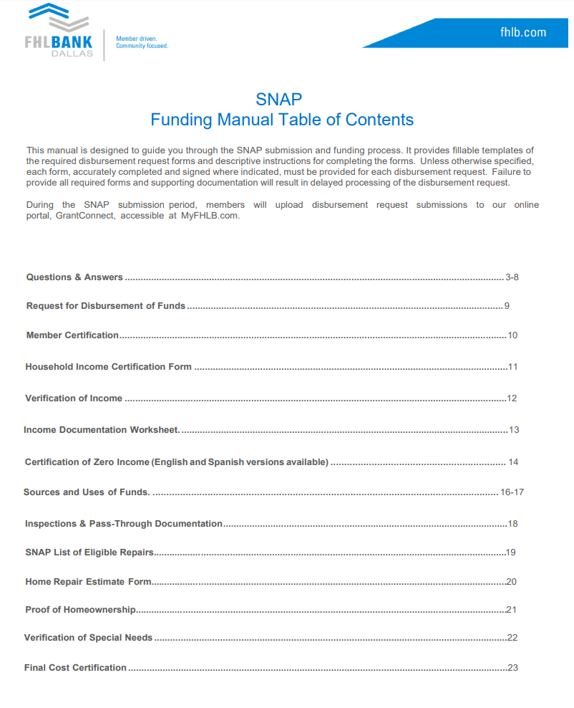
Please note the Q&A section is a great resource

Slide 68
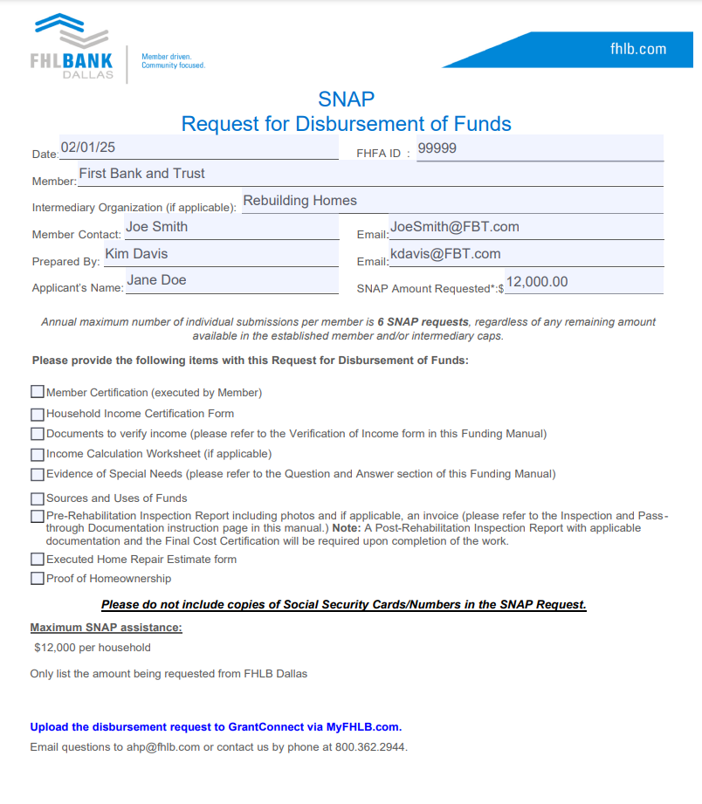
SNAP Request for Disbursement of Funds
Please fully execute the Request for Disbursement of Funds. Include the Intermediary Organization, if applicable*.
Intermediary Organization
Following the checklist will assist in submitting a completed application
Please do not include Social Security Cards/Numbers
.
*If a developer fee is included in the request, there should be an Intermediary listed on the Request page

Slide 69
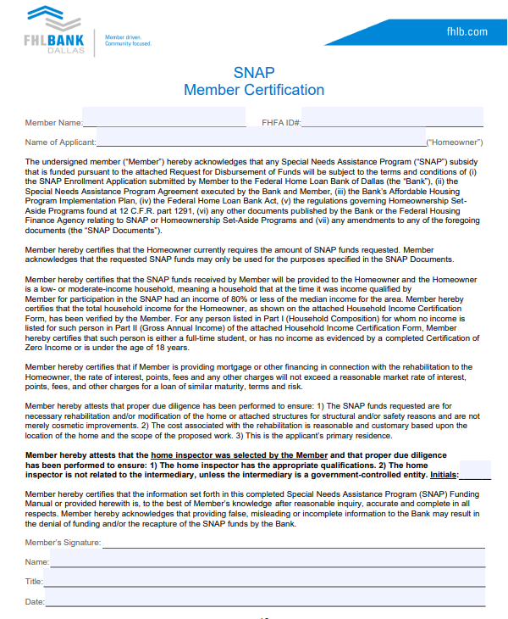
Member MUST initial here to confirm the selection of the inspector
Member signer must have AHP or FHLB Signature Card Advances Authorization

Slide 70
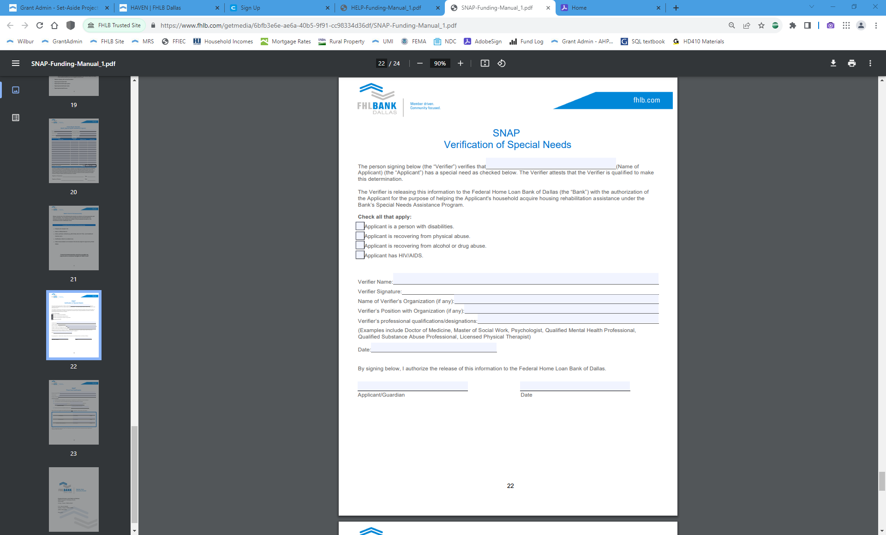
Special Needs Documentation
Driver’s License/State ID
Proof of age (55+)
Social Security Letter
Indicating age and/or disability
Executed Verification of Special Needs
Found in SNAP Funding Manual
Should be executed by an applicable professional (Doctor, etc.)
Should not be executed by an employee of the member institution
Only one method of verification is required

Slide 71
2025 Eligible Repair List
An updated eligible repairs list has been included for 2025. Please double check that the repair is eligible according to this list. Substitutions will not be permitted.

Slide 72
Documentation Requirements - SNAP & DRA

Slide 73
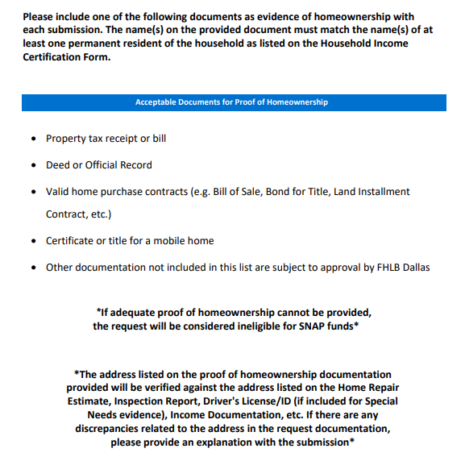
Proof of Homeownership - Required for DRA and SNAP request
*If proof of homeownership cannot be provided, the request will be considered ineligible for SNAP/DRA

Slide 74
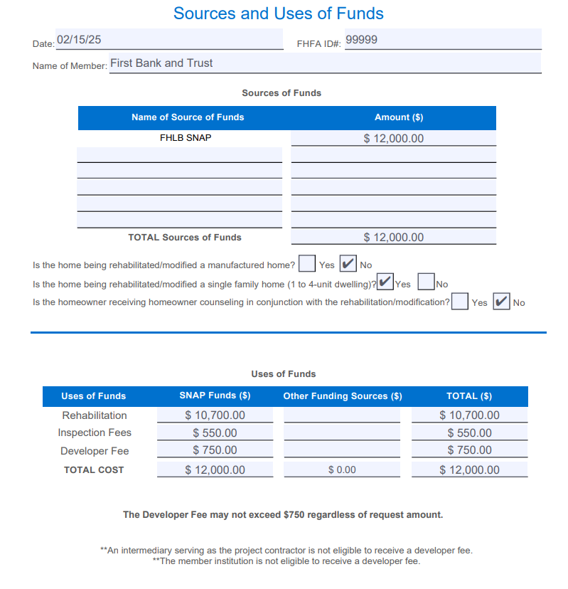
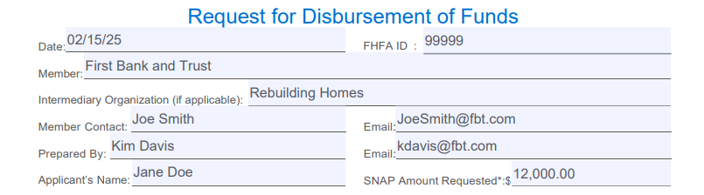
Sources and Uses of Funds
Include all sources of funds (including non-FHLB funds)
The SNAP/DRA amount reflected on the Request for Disbursement of Funds must be supported by the Uses of Funds amount
Total Sources must match the total of Uses
The Developer fee may not exceed $750 for the SNAP/DRA request regardless of amount

Slide 75
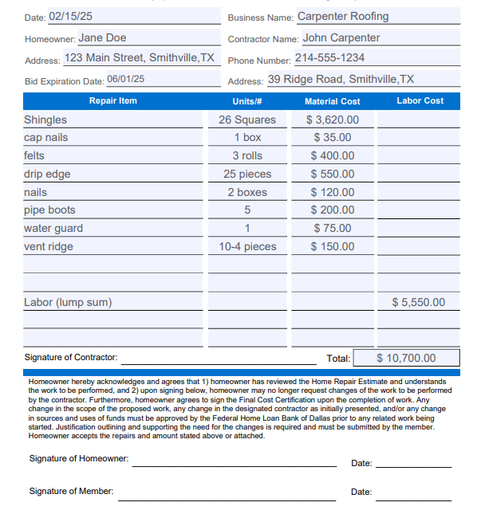
Home Repair Estimate
List out each item being repaired, and the quantity of materials required (such as bundles of shingles).
Make sure each party has signed on the appropriate line.
The Total amount on the Home Repair Estimate must match the Rehabilitation line on the Sources and Uses of Funds.
Contractor Signature
Breakdown of labor and material cost is required.
Homeowner Signature
2/15/2025
Member Signature
2/15/2025

Slide 76
Pre-Inspections
Pre-rehab inspections and “before” photos are required to disburse funds
Inspection report must specify eligible items requiring modification/rehab
Photos must show the need for rehabilitation (SNAP) and/or damages as a result of the natural disaster (DRA)
If applicable, inspection invoice should be included, and the amount listed on the Uses of Funds should be supported by the invoice
Inspections to be conducted by an independent 3rd party
  Approved by member institution
  Must not be related to intermediary, unless the intermediary is a governmental entity
For SNAP: If not submitted in the original request, pre-inspections are due 45 days after the close of the SNAP window
For DRA: Pre-inspections and photos are due prior to disbursement

Slide 77
Final Documentation - SNAP & DRA

Slide 78
Inspection and Pass-Through Documentation
Required evidence of the subsidy passing through from the Member for the benefit of the household.
SNAP/DRA final documentation is required 60 days post-disbursement.
Post Rehabilitation Documentation:
Fully Executed Final Cost Certification(s) - signed and dated by all three parties
Final Rehab work Invoice(s) - listing final cost, date and homeowner address
Post-Rehabilitation Inspection Report with “After” Photos and final invoice
  If a pre-inspection invoice was included with the original request and a cost for inspections was included on the Uses of Funds, a post-inspection invoice is required.
**Contractor/Dates/Address/Costs should match with the original request unless a change order was requested and approved by FHLB Dallas**

Slide 79
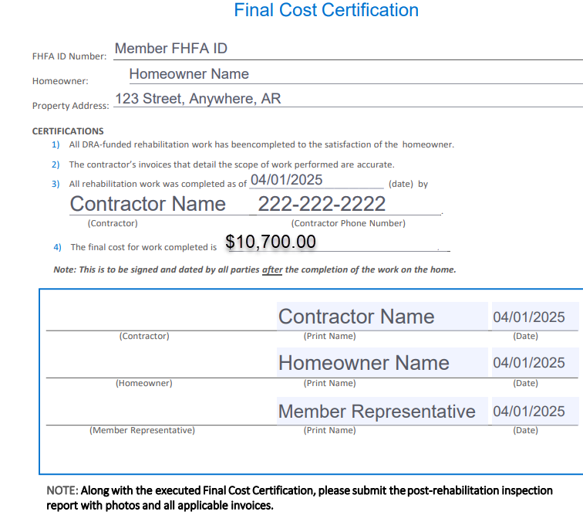
Final Cost Certification & Final Invoice
Contractor Name
Amount listed on the Certification should match the invoice.
Homeowner Name​
Member Representative​
Final Cost Certification should include the date of rehab work completion.
The Post-Inspection should occur and be dated after the work is completed as noted on the Final Cost Certification.
Include a fully executed, signed version of this document along with a final invoice and post-rehab inspection report with photos

Slide 80
Final Invoice
A final invoice is required upon completion of the repairs.
The invoice should include:
  Date
  Contractor information
  Homeowner name and address
  Listing of modifications/repairs
  Multiple contractors requires multiple invoices/Multiple Final Cost Certifications
  Final amount should equal or exceed the SNAP/DRA rehab amount as listed on the Sources and Uses of Funds and match the Final Cost Certification
FINAL
1
2
3
4
Matches Final Cost Cert
Notes:
*If there are multiple contractors, an invoice is required for each one.

Slide 81
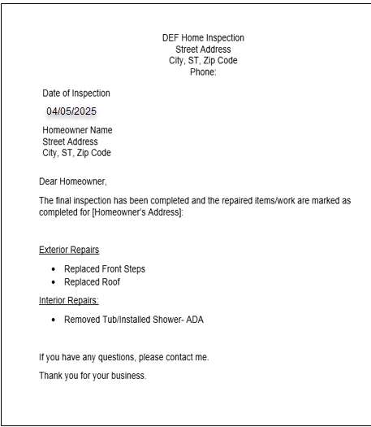

Post-Rehab Inspection Report and Invoice
The final inspection should occur after all rehab work is completed and must confirm that the original scope of work was completed in an acceptable manner.
The report should include:
Confirmation that the work/original scope was completed
Homeowner name
Property address
Photos of completed repairs
Invoice (if applicable)
Pre and Post Inspections should be completed by the same inspector/company to the greatest extent possible. If the Post-Inspection cannot be completed by the same inspector, contact FHLB to request approval of change.

Slide 82




Pre and Post Inspection Photos
Pre-inspection photos:
Capture clear photos of specific items that require modifications or rehab work to be completed.
Photos should align with the Home Repair Estimate and Pre-Inspection Report.
Post-inspection photos:
Photos of work completed validating that the repairs have been made as noted on the Home Repair Estimate/Final Invoice and Post-Inspection Report.
“After” photos should align with “Before” photos.

Slide 83
Funding Process
Complete requests must be submitted through the member institution via GrantConnect
HELP & DRA: 5-7 business days to review and fund requests
SNAP: Variable - most within 3 months from the close of the window
Funding is disbursed to the member institution’s account with FHLB
Member uploads final documentation via GrantConnect
HELP: Final CD – 30 days, Recorded Deed – 60 days
SNAP & DRA: 60 days

Slide 84
Questions?

Slide 85
Income Calculation

Slide 86


Income Calculations / Training Presentation link
1. Obtain current applicable income documentation
2. Calculate annual household income
3. Validate that the Area median total household income Is = or < 80% AMI
Access this QR code to review a complete training presentation on income calculation for all our grant programs:
Or access the video on our website:
Go to FHLB.com
Resources
Video Library
Webinars and Tutorials
Income Calculation Tool
Understanding AMI calculations is a key element of participation in all grant programs.

Slide 87
Program Enrollment and Application Submission Process

Slide 88
First Step to Participate: Member Enrollment Application
Enrollment Process – HELP, SNAP and DRA
Each member must submit a one-time Member Enrollment Application and Agreement to participate in each program.
Email AHP@fhlb.com to confirm prior enrollment or request the Adobe Sign Application.
Member will identify who with Advances authority to sign the application agreement.
FHLB will send the packet via Adobe Sign to the individual for signing.
Once executed by the Member, Adobe Sign will send the application back to FHLB to review, execute and process.
Member will be notified via email with helpful program resources once the enrollment has been finalized by FHLB.
Members can elect to be added to a participating Member list that can be accessed on our website by potential homebuyers and sponsor organizations.
Notes:
First step to be prepared.

Slide 89
Submit Documents via GrantConnect
GrantConnect is the system we use to accept and process Set-Aside applications from members. Registrations for use of the portal will only be approved if the individual is employed by a member institution.
How to Register:
1.
Go to https://app.fhlb.com/GrantConnect
2.
You can create an account by choosing "Sign up now" under the "Sign in" Button
3.
Follow the prompts to create a Login ID* and provide other details we need. Register as a member
4.
Connect your account to your organization & submit
5.
We will review and send an approval over email
*Please do not use special characters in your Login ID

Slide 90
For More Information
Questions?
Contact Us!
By Phone: 800.362.2944
By Email: ahp@fhlb.com
Additional information is available online at fhlb.com/ahp
Notes:
Please utilize the Community Investment department analysts.
We can see your application as soon as it is in the online portal.

Slide 91
Native American Housing Opportunities Fund

Slide 92
Native American Housing Opportunities Fund
Purpose:
The Native American Housing Opportunities (NAHO) Fund is designed to provide grants to Native American tribal nations, Pueblos, Native American Housing Entities and to support housing of tribal members.
Uses:
Provide grants of up to $250,000 to the organizations listed above to help meet the housing needs of their populations.
Advantages:
Grants will assist tribal organizations in meeting the housing needs of their underserved population.
This will be a dedicated source of funds for tribal housing needs offered by the Bank
Provide members with an additional avenue to support the housing related initiatives of tribal populations

Slide 93
Native American Housing Opportunities Fund
Uses for these funds include housing-related activities such as:
Down payment/closing cost assistance for home purchases by tribal members
Repairs to owner-occupied homes for tribal members
Rental assistance for tenants
New construction or rehabilitation of existing housing for tribal members
New program or product development
Enhancements to information technology and systems used for housing programs
Consultant cost (non-employees, separately invoiced)
Predevelopment costs
Ineligible uses include
Any non-housing related expenses or programs
Litigation costs/expenses
Lobbying

Slide 94
Native American Housing Opportunities Fund
Size:
2025 Total Program Allocation: $2,500,000
Individual Grant Size - $50,000 to $250,000
Availability:
Application Period: 6/2/2025 - 7/10/2025
Applications will be reviewed on a first-come, first-served basis
Award Announcement: Fall 2025
Eligibility:
Applications can be submitted on behalf of Federally Recognized Tribes or a Tribally Designated Housing Entity (TDHE).
The grant awardees must provide housing services to Tribal members residing in Arkansas, Louisiana, Mississippi, New Mexico or Texas.
Application must be submitted by, and in partnership, with an FHLB Dallas member institution.
For returning awardees, prior year impact report will be due before new award can be committed

Slide 95




NAHO Grant Process
❶
❷
Member Submits
Application
❸
❹
Provide
Certification & Impact Report
Attend
Webinar
Grant Awards Announced
Webinar to be held in May
June 2nd through
July 10th
Once annual look-back report describing how funds were utilized
First come, first served

Slide 96

Navigate to the NAHO page

Slide 97

Download the application

Slide 98


Member information and signature
Applications must be signed by someone with Advances or AHP Authority

Slide 99


Find a FHLB Dallas Member

Slide 100


Organization information and signature
Organization must be located within the Bank’s District of AR, LA, MS, NM or TX

Slide 101
For More Information
Questions?
Contact Us!
By Phone: 800.362.2944
By Email: NAHO@fhlb.com
Additional information is available online at fhlb.com
Notes:
Please utilize the Community Investment department analysts.
We can see your application as soon as it is in the online portal.

