Slide 1

2026 Affordable Housing Program Workshop
Cultivating Communities

Slide 2
2026 AHP Workshop Agenda
9:00-11:30 AHP General Fund session
Updates for 2026
Preparations for applications
Requirements for eligibility
Capacity of sponsors
Financial feasibility
Q&A and Break
Scoring criteria
Modifications to applications
GrantConnect Portal access
Notes:
Welcome Board Members, Members, Sponsors new & returning & finally emerging developers and individuals that just want more information about our program
Acknowledge the glass blocks

Slide 3
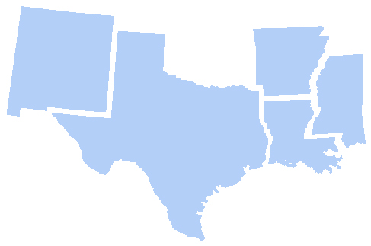
About FHLB Dallas
Who we are
One of 11 District banks in the FHLBank System created by Congress in 1932 as a by product of the Great Depression
A privately held cooperative, composed primarily of Community Financial Institutions located in Arkansas, Louisiana, Mississippi, New Mexico and Texas
Total assets: $108.5 billion
FHLB Dallas’ Five-State District Members by State as December 31, 2025
38
76
72
466
127
How we serve our members and their communities
Providing a stable source of funding to support residential mortgage lending and related community investment
Providing subsidies and favorably priced advance programs targeted specifically to the needs of low- to moderate-income communities
Arkansas 76
Louisiana 127
Mississippi 72
New Mexico 38
Texas 466
Notes:
Who we are , essentially, we are the Bank for Banks as we do nothing direct to consumer

Slide 4
Community Investment Products
Grants
Recoverable Grants
Advances
Affordable Housing Program
Voluntary
Voluntary
EDP
CIP
Disaster
HAVEN
PGP
Small Business Boost
AHP General Fund
Set-aside
NAHO
HELP: Home-buyer Equity Leverage Partnership
SNAP: Special Needs Assistance Program
DRA*: Disaster Rebuilding Assistance
HAVEN: Housing Assistance for Veterans
PGP: Partnership Grant Program
EDP: Economic Development Program
CIP: Community Investment Program
NAHO: Native American Housing Opportunities Fund
FORTIFIED Fund
Pathway Fund
HELP
SNAP
DRA*
4

Slide 5

2026 AHP General Fund - Rental Project Overview
Application Window Opens from March 31–April 30

Slide 6
2026 AHP Key Points
AHP Subsidy
Maximum AHP subsidy is $1,750,000
Maximum AHP subsidy per AHP unit is $45,000 to be eligible for the program
Application Period
The funding round begins March 31 and closes on April 30
Projects targeting Households Experiencing Homelessness
Experienced with working with the target population; or
Provide evidence, such as MOUs/services plan, documenting services, referral sources, and operational subsidies
Need for Subsidy
Based on the development budget, not the 15-year operating proforma
Notes:
Give yourself time to apply

Slide 7
2026 AHP Key Points
Creating economic opportunity
Projects must provide MOUs with rental projects
Project Scope Update
“The project scope must be either 100% new construction or 100% rehabilitation”
AHP GrantConnect
Sponsor registration in the GrantConnect portal
User affiliation for sponsors and consultants
AHP Application Workbooks
Available on the Bank’s AHP webpage here
Standardized Development Budget
Applicants will use a template budget provided by FHLB Dallas as a guide
Development budget is embedded on the Uses of Funds Page

Slide 8
2026 AHP Key Points – Scoring Updates
Scoring Updates
Community Stability
Removal of Community Revitalization Plan scoring criteria
Update to Preservation Definition to include:
“six (6) points if 1) the project will, within one year prior or two years after application deadline, face expiring HUD section 8 project-based rental assistance contracts, reach the end of a tax credit compliance period, or face expiring USDA-RD 515 rental assistance contracts….”
Subsidy Per Unit
Rental projects: Maximum threshold increase for subsidy per unit from $25,000 to $35,000

Slide 9
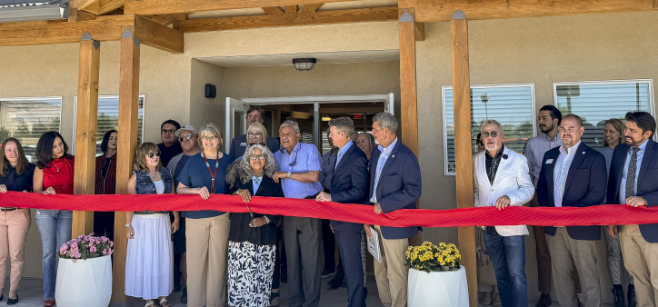
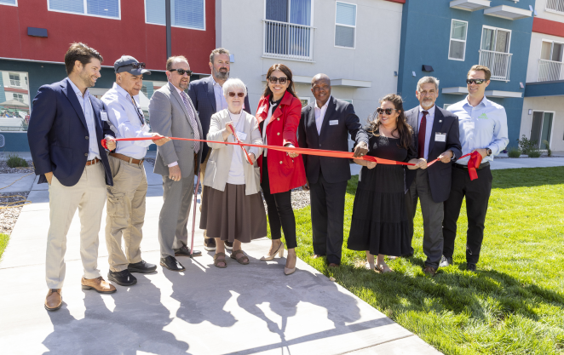
2025 Highlights
Received 126 applications requesting a total of $149 million in AHP subsidies
$73.5 million in AHP subsidies were awarded to 53 projects
53 rental projects approved for 3,777 units of housing
Approval rate of 42% percent
Notes:
Recap of 2025 impact

Slide 10
AHP Subsidies by State
Project Location | Applications Received | Applications Approved |  | Subsidy Awarded | Units
AR | 17 | 5 |  | $6,675,000 | 267
CO | 2 | 1 |  | $1,500,000 | 60
LA | 30 | 11 |  | $10,944,990 | 412
MS | 15 | 3 |  | $3,350,000 | 140
NM | 9 | 4 |  | $5,425,000 | 227
TX | 53 | 29 |  | $45,640,710 | 2,671
Totals | 126 | 53 |  | $73,535,700 | 3,777

Slide 11
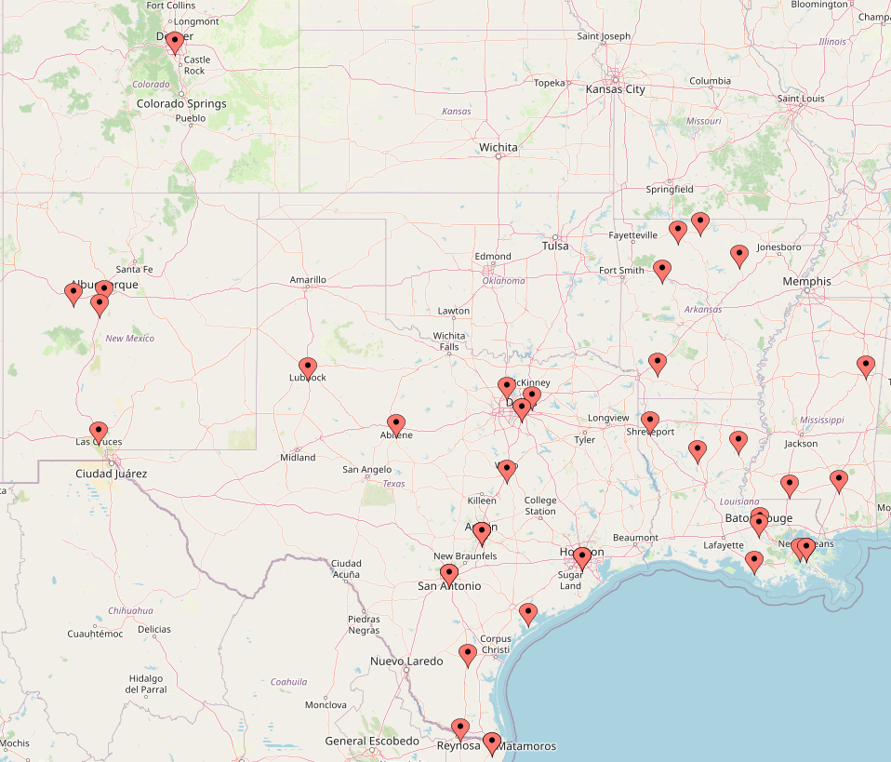
Approved AHP Project Locations

Slide 12
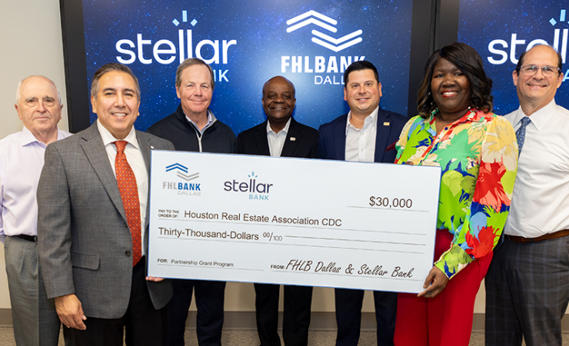
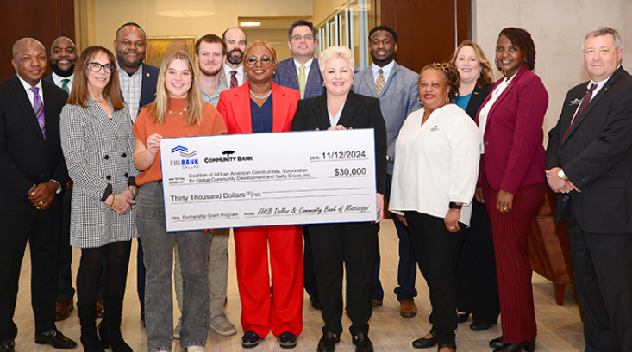
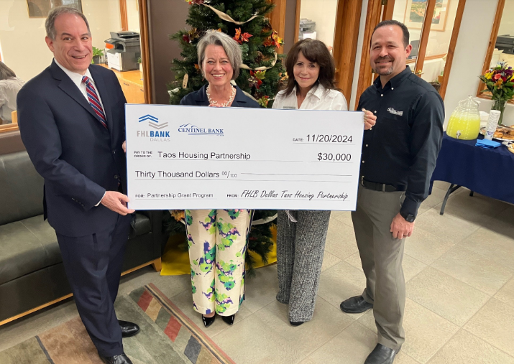
Benefits of AHP to Members
Reputational Benefits
CRA/Community Investment Benefits
New Business/Loan Opportunities
Customer Relationship Benefits
Critical funding for affordable housing
Notes:
Reputational Benefits:
Build your institution’s profile and reputation in the community
Positive public relations
Community Benefits
Provides critical funding for affordable housing projects/ rehabilitate existing housing
Achieve Community Reinvestment Act (CRA) outcomes
Business Benefits:
Construction loans, lines of credit, permanent financing and new consumer/business accounts
Achieve Community Reinvestment Act (CRA) outcomes
Relationship Benefits
Build relationships with housing developers, nonprofit groups and community groups
Create business relationships in your market

Slide 13
Member or Sponsor
A "Member" is willing to apply for AHP funds on behalf of a project sponsor.
A "Sponsor" is the owner of a rental project or the overseer of an ownership project that will put together the application or coordinate the application and project’s completion.
Although a "Member" might be said to "sponsor" an application by submitting it, be sure to understand these terms, because a "Sponsor" and a "Member" play two different roles in an AHP application.
A sponsor cannot apply without a member

Slide 14
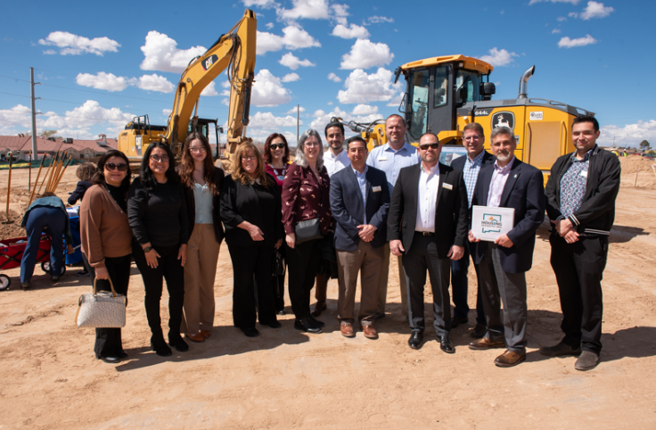
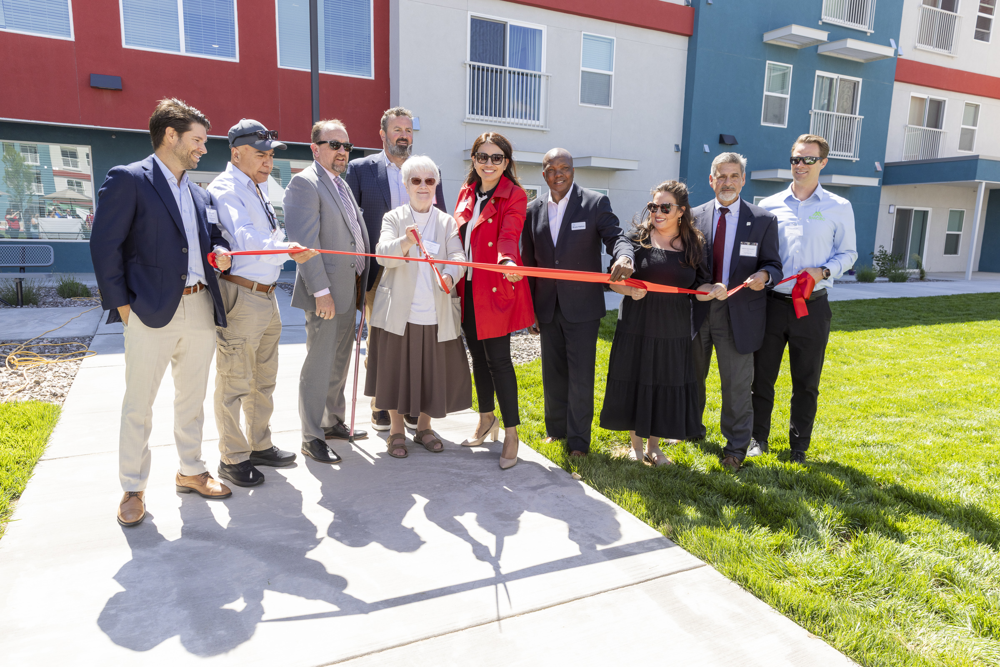
AHP Roles - Members
Evaluate the sponsor and project concept
Set deadline to receive online application to gain necessary approvals
Review and approve applications before submitting to FHLB Dallas
Review/approve compliance reports, disbursement requests and extensions
Maintain project oversight
Discuss expectations for program compliance with sponsors
CC Housing, a subsidiary of Catholic Charities Felician Villa Apartments, a senior housing complex in Rio Rancho, was awarded a $750,000 AHP grant to assist with construction through Wells Fargo.

Slide 15
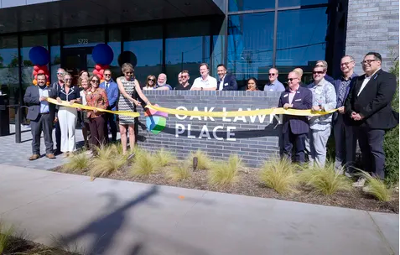
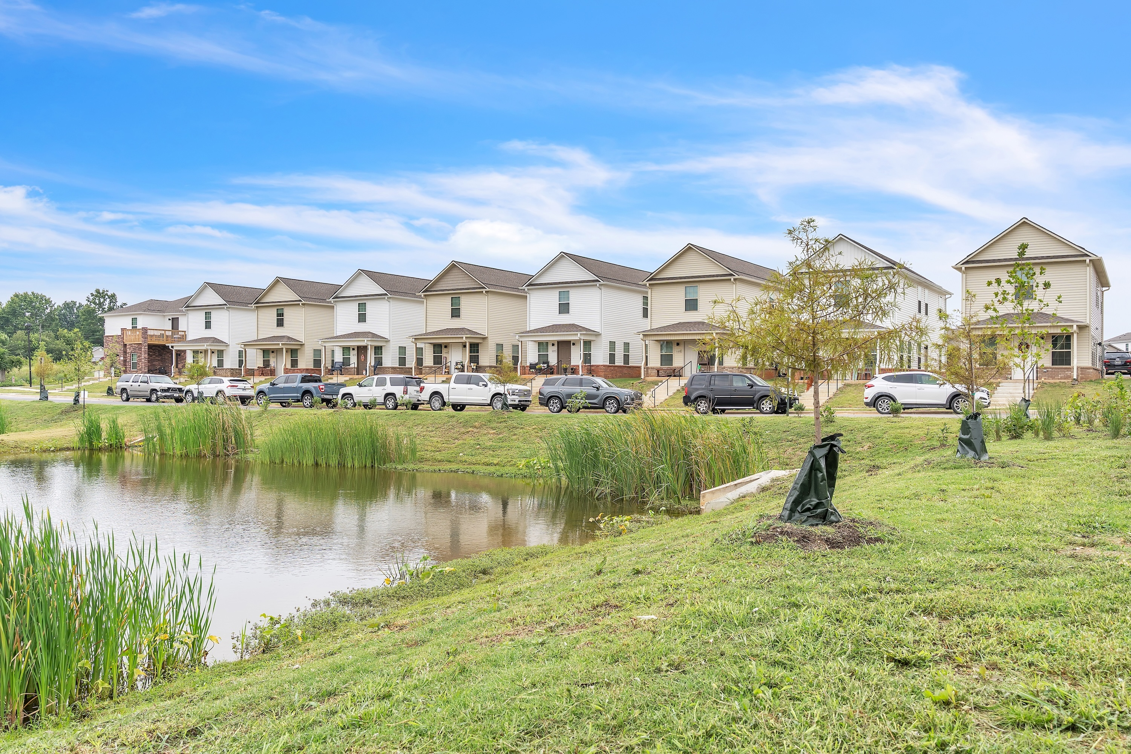
AHP Roles - Sponsors
Create a thorough AHP application with supporting documentation
Understand AHP compliance requirements
Promptly inform the member and FHLB Dallas of changes to the project
Submit documents in a timely manner:
Conditional award requirements
Disbursement requests
Modifications and extensions
Annual progress reports
Restore Hope Arkansas received an $850,000 AHP grant through Arvest Bank for Cobblestone Farm Community in Fayetteville, Arkansas.

Slide 16
https://vimeo.com/1136662089/efdf3711d6
video

Slide 17
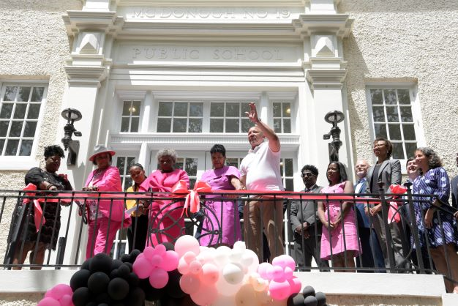
What is Evaluated in the Application
Scoring
Criteria
Eligibility
Project Concept
Feasibility
Demand
Capacity
Sponsor Capacity
Site Control and Zoning
Financial/Developmental Feasibility
Use of Funds
Need for Subsidy
A $250,000 Affordable Housing Program (AHP) subsidy awarded to the Leona Tate Foundation for Change from Home Bank to convert a historical school building in New Orleans, Louisiana’s, lower Ninth Ward into 25 affordable apartments for very low-income seniors and a center for anti-racism training

Slide 18
Project Eligibility
At least 20% of the households must be at or below 50% of area median income - Rental
Acquisition, construction and/or rehabilitation of affordable housing
Demonstrate “Need for subsidy” along with developmental and operational feasibility – the gap between the project’s Sources and Uses of Funds
Some or all of the AHP subsidy must be likely to be drawn down by the project or used by the project to procure other funding within 12 months from the date of award approval
Sponsors must be qualified and have developed similar types of project’s in the past. If not, sponsors must have secured an experienced development team with affordable housing and compliance experience
15- Year Deed Restriction for rental projects and 5 Years for Owner-Occupied
Helpful Hint
Applications can be impacted if there are existing or previous AHP projects not in compliance
Notes:
This slide highlights eligibility criteria a project must meet when applying for a AHP subsidy,
The 6 criteria include:
At least 20% of the households must have incomes at or below 50% of AMI. A project cannot apply if it does not meet this requirement.
The AHP subsidy should be used for either acquiring, constructing or rehabilitating affordable housing.
The project needs to show a “need for subsidy”, that is a gap between its Sources and Uses of Funds.
Project readiness, that is the project should be able to start within one year of application approval. If not, then use the AHP subsidy as leverage to secure the rest of the project’s capital stack
Sponsors must be qualified and have developed similar types of project in past. If not, sponsors must have secured an experienced development team with affordable housing and compliance experience.
All project are subject to a 15-year deed restriction along with a 15-year compliance period

Slide 19
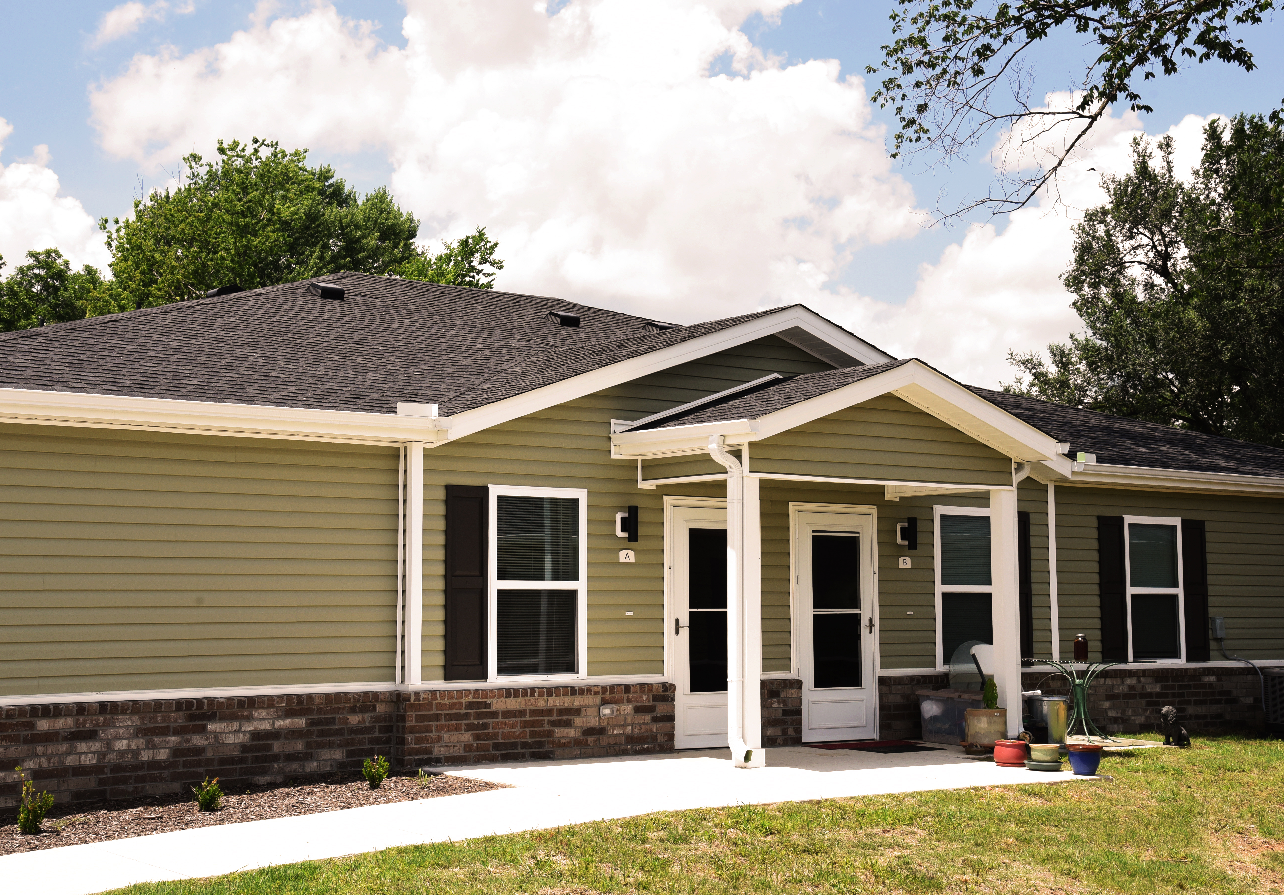
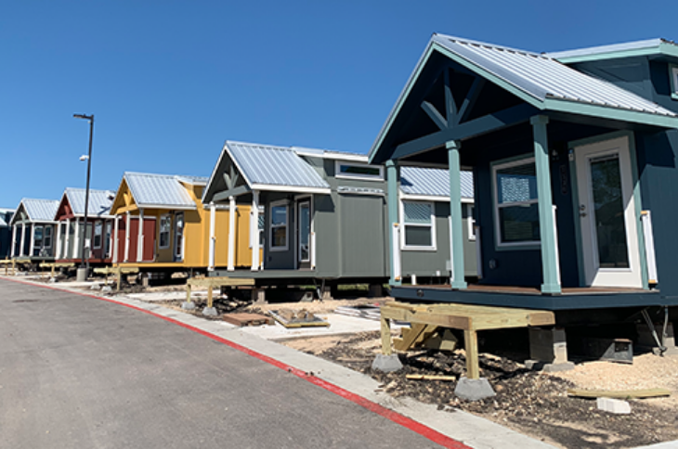
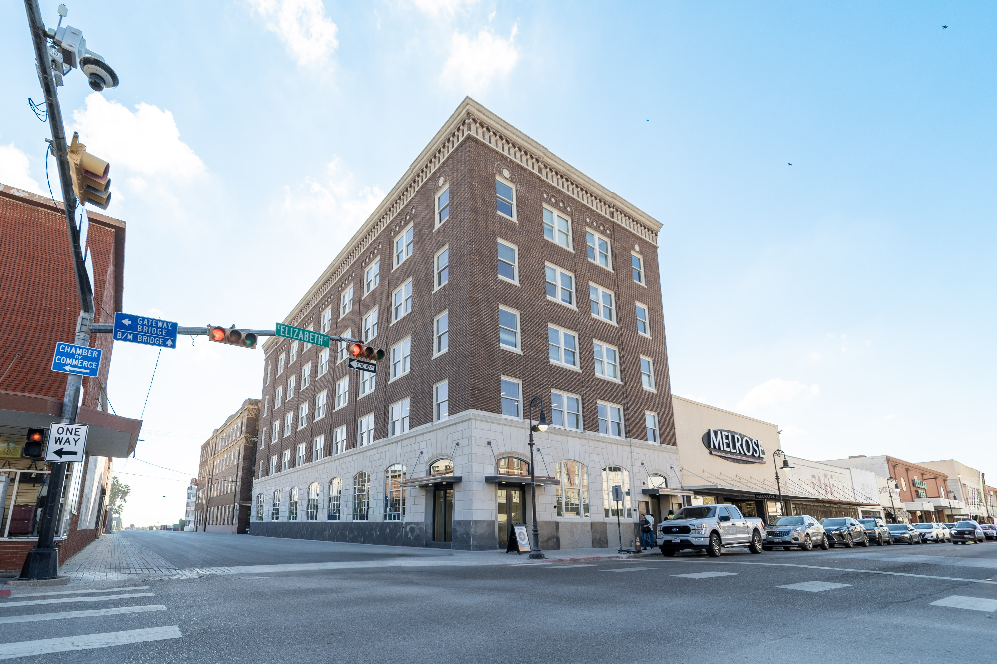
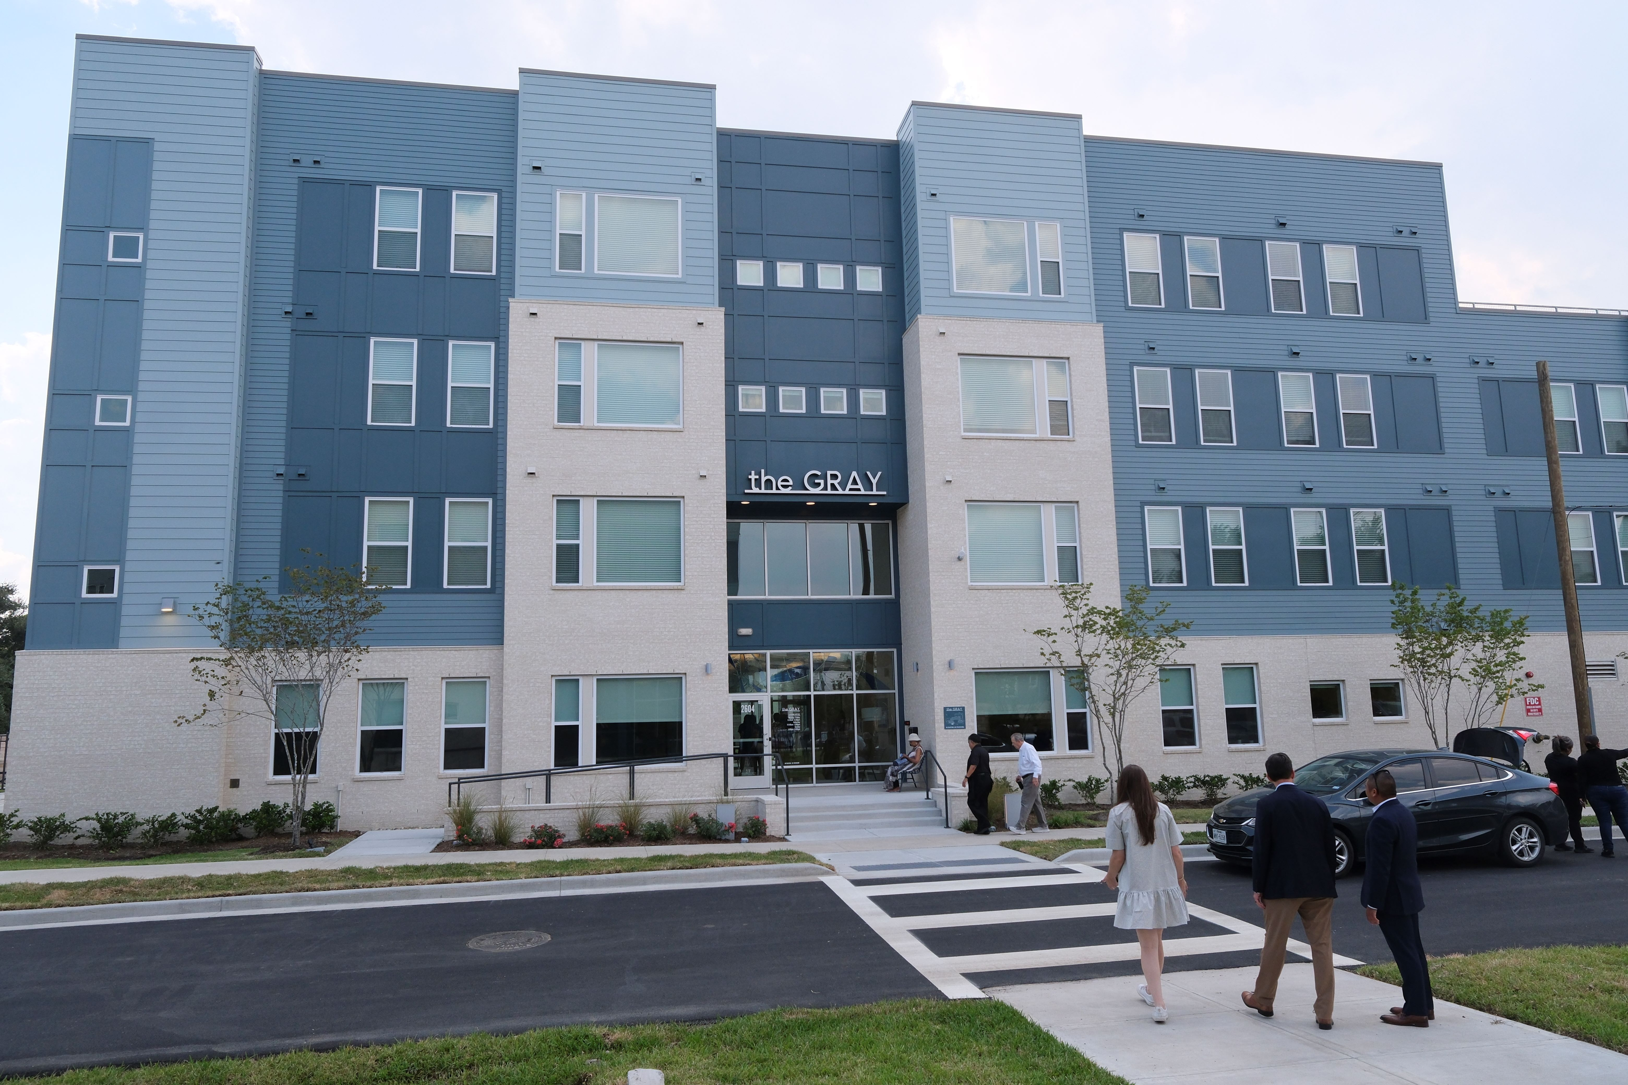
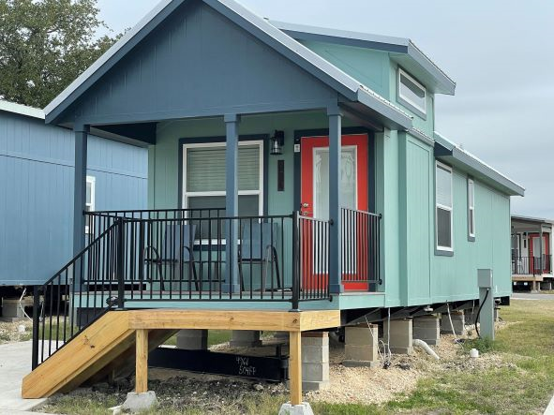
Types of Eligible Housing
Multifamily
Single-Resident Occupancy (SRO)
Manufactured Homes
Micro Homes
Re-entry Housing
Group Homes/Congregate living facilities
Permanent Supportive/Transitional Housing
Adaptive Reuse
Top photo of “Spavinaw Creek Senior Housing”, Gravette, Arkansas. The project received a $1,000,000 AHP Subsidy to construct 40 senior living homes. Bottom photo of “New Hope Housing Gray”, Houston, Texas. The project received a $2,000,000 AHP Subsidy to construct 135 senior living homes.

Slide 20
Uses of Funds - Rental
Eligible Costs
Ineligible Costs
Acquisition
Hard Construction Costs
- New Construction
- Rehabilitation
- Infrastructure and Site Work
Soft Costs
- Architect/Engineering Fees
- Appraisal/Phase 1
- Developer/Consultant Fees
Contingency Funds
Operational Funding/Expenses
Administrative Funding
Supportive Services
Relocation Expenses
Operating Reserves
Replacement Reserves
Notes:
This slide summarizes eligible and non-eligible uses of an AHP subsidy.
The Bank wants the AHP subsidy to fund primarily “hard construction” costs and will cover some of the “soft costs” shown on the slide.
Note, the AHP subsidy cannot fund contingencies, any operating/replacement reserves and/or pay any operational costs.

Slide 21
Demand - Rental
Market study and/or demand data provides information on local housing conditions
Market study and/or demand data analyzes competition by evaluating other affordable rental developments
FHLB Dallas can conclude the proposed rents are affordable and achievable, considering location, design and intended resident population
FHLB Dallas is able to determine the project timeline provides adequate absorption/completion period for the proposed project
Occupancy Data
Local Market Data
Absorption Time
Vacancy Rates of Nearby Properties
Documented Unmet Housing Needs
Notes:
Occupancy Data
Waiting Lists
Vacancy rates of nearby properties
Local market data
Explains how long it will take to absorb

Slide 22
Rental Feasibility – Project Costs
The Bank will review the development budget to determine reasonable projects costs. In general, the Qualified Allocation Plan (QAP) in effect for the project state is used as a benchmark.
In District:
AR, LA, MS, NM: Utilize the State Housing Finance Agencies’ criteria from the QAP
TX: Prior year average total development cost for new construction projects from the State Housing Finance Agency
Out of District:
If a QAP is not available for the project state, then the Bank will utilize the cost guidelines set forth in the implementation plan of the FHLB district which includes the project state
Notes:
For example, if a QAP is not available in CA, then the Bank will use the cost guidelines set forth in the Implementation Plan for FHLB San Francisco.

Slide 23
Sponsor Capacity
FHLB Dallas will review each AHP application, and prior to each AHP subsidy disbursement, for any “covered misconduct” by the project sponsor
‘‘Covered misconduct’’ is defined in the Federal Housing Finance Agency's (FHFA) Suspended Counterparty Program (SCP) regulation (12 CFR Part 1227) – more information can be found using one of the two links below
FHFA Suspended Counterparty Program – Learn more
FHFA Suspended Counterparties – See list
Helpful Hint
A project must continue to demonstrate a need for the AHP subsidy at disbursement

Slide 24
Sponsor Capacity to Complete
Qualified and able to perform its responsibilities throughout the 15-year retention period – includes compliance and monitoring
Demonstrates ability, experience and financial capacity to complete project
Supporting documentation will show
Qualifications of key personnel are provided
Resumes of project leadership and organization fact sheets
Organizational charts if there are multiple entities
Sponsor’s experience with similar developments
A development team was created with experience with similar projects
Compliance in current AHP projects
Helpful Hint
Contact FHLB Dallas if this is your organization’s first housing project!

Slide 25
Sponsor Capacity to Complete
Below is an example of a good exhibit to include with supporting documents.
Also include resumes, short bios, organizational charts, organizational resumes, etc.
Helpful Hint
The charts above SHOULD NOT be the only exhibits provided for Sponsor Capacity

Slide 26
Site Control and Zoning
Sponsor or ownership entity must have site control at time of application
Sponsor must provide one of the following items below:
A copy of the executed deed or long-term lease with a term of at least 15 years
An executed purchase option or long-term lease option; option must be effective after the AHP award date
An executed settlement statement or purchase contract that shows the purchase price
- Contract for Sale
- Warranty Deed
Site location must be properly zoned
- July 31st deadline to submit proper zoning approval
Notes:
-.
- AHP award date.
-
-

Slide 27
2026 Rental Rehab Projects
One independent bid for rehabilitation cost or a physical needs assessment
A detailed scope of the rehabilitation with photos illustrating the project’s condition
If AHP funds represent most of the funding source excluding any owner or charitable contributions than a pre- and post-inspection conducted by a qualified independent third party not related to the owner, sponsor, developer or contractor and approved by the member is required
Important
Please prepare an itemized budget or ledger if you are submitting multiple bids/invoices
General Requirements/Builders Overhead/Builders Profit should be listed on bids/cost estimates
Helpful Hint
Any bid and/or pre-inspection you receive should be detailed enough so a contractor can price out the work required (i.e., good enough to obtain construction cost estimates).

Slide 28
2026 Rental Rehab Projects – Relocation Plan
For projects occupied at the time of application, a relocation plan is required if there is any displacement (temporary or permanent)
The relocation plan may be either:
Any plan approved by any federal, state or local government funder(s) involved in the financing of the project or
A plan approved by FHLB Dallas that at a minimum meets the following:
Minimizes displacement; articulates a resident notification plan
Relocation budget is required and should appear in Total Project Budget
Provides temporary displacement such as: moving within to a fully renovated unit (permanently or temporarily), storage of personal property onsite, or moving to a hotel for a set period of time
Detailed accommodations, if any, are planned for those who elect permanent relocation
Provides a payment for actual reasonable moving/related expenses or a fixed payment for moving expenses
Notes:
Regardless of the type of relocation plan submitted, a relocation budget categorizing the line item relocation costs in total and an anticipated average cost per household is required. In addition, general assumptions articulating how the relocation cost estimates were determined should be narrated within the relocation plan.
minimizes displacement; articulates a resident notification plan;
Provides temporary displacement planning, if applicable, such as: moving within to a fully renovated unit (permanently or temporarily), storage of personal property on-site, or moving to a hotel for a designated period of time,
Details accommodations, if any, are planned for those who elects permanent relocation; and
Provides a payment for actual reasonable moving/related expenses or a fixed payment for moving expenses.

Slide 29
2026 Rental Rehab Projects - Rent Roll
A rent roll is required if the project is currently occupied
The number of units should tie to the application’s income targeting commitments
Report each tenant’s current income
FHLB Dallas will sample a selection of residents for back-up income documentation
Submit as an Excel file with supporting documents
Unit # | Household Name | Move In Date | Current Income | # of Bedrooms | Household Size | Tenant Paid Rent | Federal/State Rental Subsidy | Total Rent | Targeting 50/60/80
Notes:
Submit your Rent Roll as an Excel file

Slide 30
2026 Rental Rehab Projects – Rent Roll Cont’d
LIHTC Project Placed in Service 2011
LIHTC Compliance period ends 2026
2026 AHP Application
Awarded 2026 AHP Subsidy
Project Completed
Existing tenants must be recertified for AHP Eligibility as units completed. (regardless of relocation)
All existing tenants in occupied property will need to be recertified as units are completed
Example
Notes:
Submit your Rent Roll as an Excel file

Slide 31
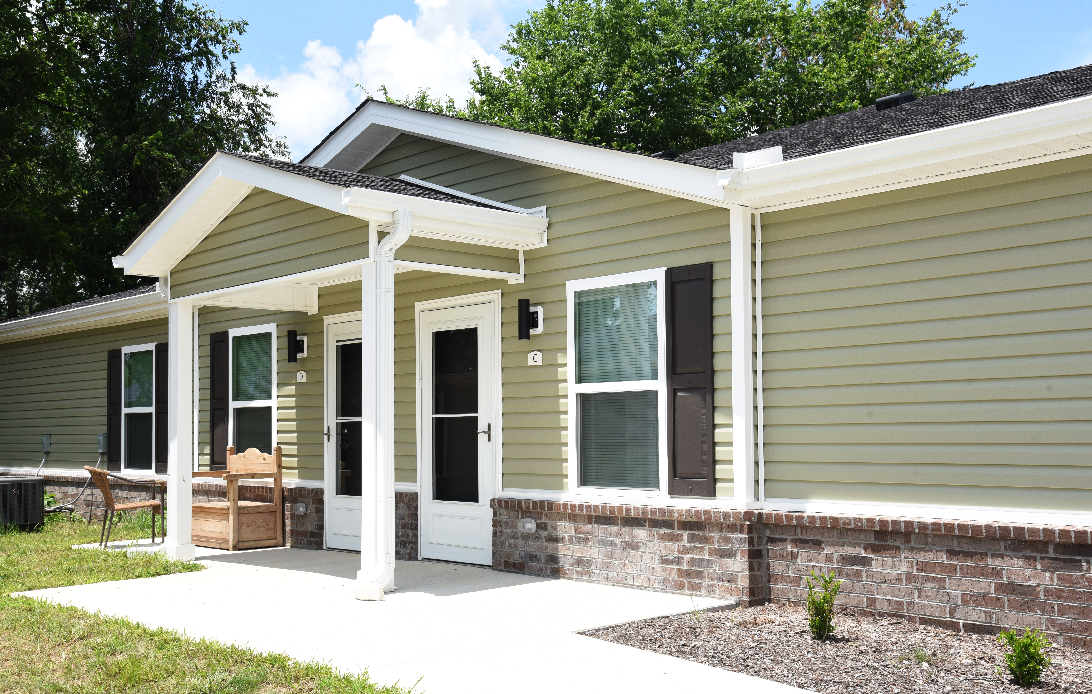
Rental Case Study
Spavinaw Creek Senior Housing
Notes:
Cowan Place Senior Living is a new 174 unit senior living community in the Stop Six neighborhood in Fort Worth.

Slide 32
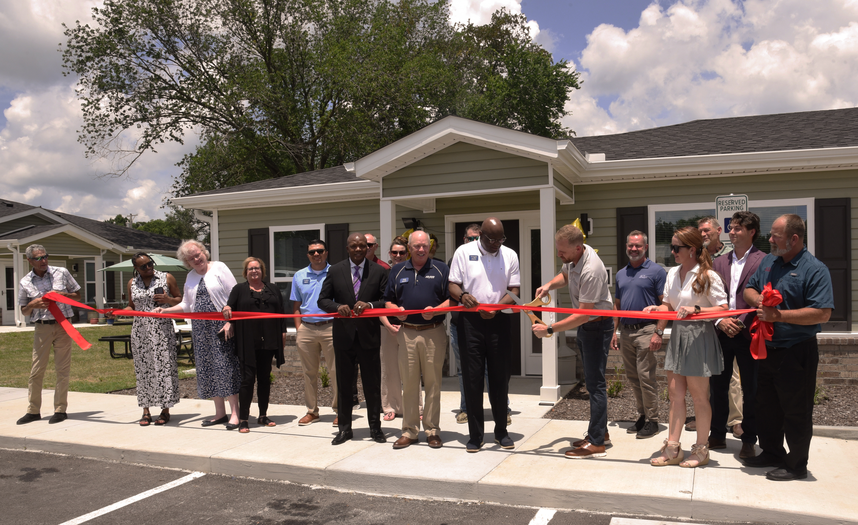
Rental Case Study – Cont’d
— Spavinaw Creek Senior Housing LP was awarded a $1,000,000 AHP subsidy for the $7.3M Spavinaw Creek Senior Housing project in Gravette, AR, Benton County.
New construction of 40 single story fourplex Senior affordable rental units targeted to those age 55+ with an on-site Resident Services Coordinator who will link residents to supportive service providers located through the City of Gravette.

Slide 33
Rental Case Study – Cont’d
Project Overview
Unit mix:
40-unit senior affordable single story fourplex apartment community with on-site residential services coordinator.
Featuring 20 one-bedroom units and 20 two-bedroom units
Targeting:
100% units reserved for Low-Income Senior Households (at or below 60% AMI).
Financing Sources:
ADFA Funds
AHP Grant
Great Southern Bank – Construction Loan
LIHTC
HOME Funds

Slide 34
Rental Feasibility
Criteria | Ranges/Limits | Rental Project
Targeting | At least 20% of the units targeted below 50% of AMI | 24 or 60% of units targeted below 50%
Debt Service Ratio | 1.15 Minimum* | 1.44
Replacement Reserves | New construction: $400/unit/year | $250
 | Rehabilitation: $500/unit/year | NA
Operating Expenses | $2,500 Minimum | $4,343.75
Operating Reserves | Not to exceed 6 months of projected operating expenses, debt service payments, and replacement reserves | <=6 months
* No percentage cap for cash flow for projects that are zero-debt

Slide 35
Rental Feasibility
Criteria | Ranges/Limits | Rental Project
Rents | Not to exceed 30% of AMI | Tenants paying ≤ 30%
General Requirements, Builder Overhead and Builder Profit | 14% of total construction cost – MUST BE LISTED on Invoices/AIA documents | 13.99%
Developers Fee | New Construction or Rehab: 15% of Total Development Cost net of Developers’ Fee Acquisition/Rehabilitation: 15% of Total Development Cost net of Developer’s Fee and Acquisition Cost | 8.71% - New Construction
Hard Cost Contingency | Not to exceed 10% new/15% rehab | 4.68%
Soft Construction Cost | Not to exceed 30% of TDC | 22.52%
Vacancy Ratio | 7.5% (up to 10% for special needs) | 7.00%

Slide 36
Questions?

Slide 37
Competitive AHP Scoring

Slide 38
2026 AHP General Fund Scoring Overview
Scoring Criteria | Points
Donated property | 5
Not-for-profit or government sponsorship | 5
Targeting - Income groups | 20
Underserved communities and populations | 15
Creating economic opportunity | 5
Community stability* | 15
FHLB Dallas District priority* | 35
Total | 100
100-point scoring system based on 7 criteria
Found in Attachment D of the FHLB Dallas AHP Implementation Plan
* Symbolizes a change from 2026

Slide 39
Donated / Conveyed Property
Units or land donated/conveyed by the federal government instrumentality thereof or unrelated related (at least 20% of units); or
Property conveyed significantly below market value, meaning it is transferred for 50% or less of fair market value, by an unrelated party
Key Points:
Donated or conveyed by an entity not related to or affiliated with the member, project sponsor or project owner through ownership or control with the exception of property owned and donated by a Housing Authority, City or County and meeting all other conditions of this criterion
Long term leases of 15 years or more with nominal annual rent payment
(no more than $100 annually) - No upfront payments or additional rents
Evidence of donation should be included with the application (i.e., transfer deed, purchase agreement or letter of intent)

Slide 40
Not-for-Profit/Government Sponsorship
Project Sponsor means a not-for-profit or for-profit organization or public entity
5 points – All Projects
- Housing finance agencies
- Housing authorities
- Not-for-profit entities
- Government agencies
- Native American Tribe
Rental projects with a Developer Fee
2 points if the sponsor receives < 25 percent of Developer Fee
5 points if the sponsor receives ≥ 25 percent of Developer Fee
Rental Projects
The project sponsor is the owner of the rental project
The project sponsor must have an ownership interest or the ability to control the entity that is the project owner

Slide 41
Income Targeting
The extent to which a project creates housing for very low- and low- or moderate-income households
For purposes of this scoring criterion, FHLB Dallas will score rental projects and owner-occupied projects separately
Rental Projects
If at least 60% of units are targeted to families with annual incomes < 50% of AMI, the project receives 20 points
Include any manager’s unit as part of the project’s total number of units. Be sure to indicate as “market-rate” for above 80% of AMI on the income targeting page of the online application
The larger the percentage of VLI households within a project…
…the higher the score.

Slide 42
Creating Economic Opportunity
Programs/services assisting residents in attaining life skills or better economic opportunities
All Projects
Rental Only
Owner-Occupied Only
Employment
Onsite daycare services (child or adult)
After school or out-of-school services
Workforce preparation and integration
Mental and behavioral health services
Financial literacy education
Residential Services Coordinator
Homebuyer Counseling/Education - Purchase/ Construction
Homeowner Maintenance & Counseling/Education - Rehabilitation Projects only
Sweat Equity - New Construction Projects only (minimum of 300 hours per home)
Scoring - Owner
1 service = 3 pts
Scoring - Rental
1 service = 4 pts
2 service = 5 pts
2 services = 5 pts
Memorandum of Understanding (MOU) is required for each empowerment service – format located on Bank’s Website

Slide 43
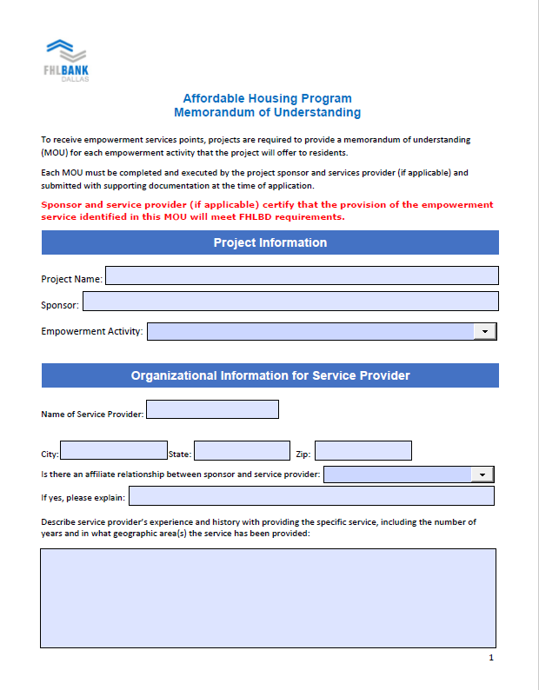
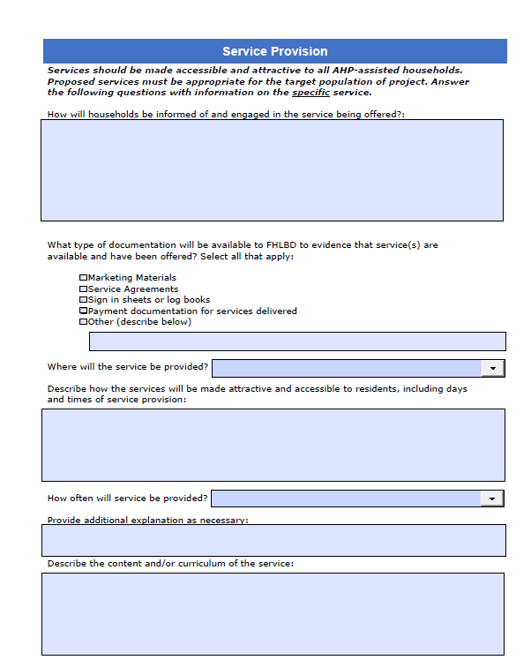
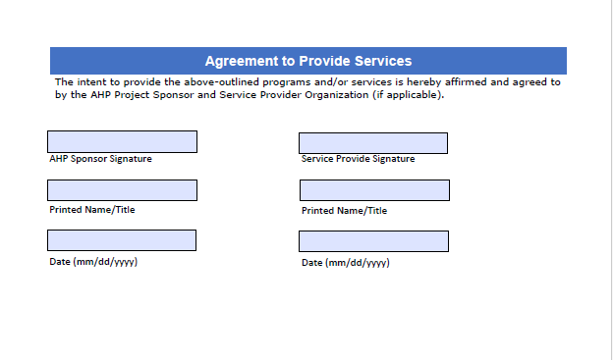
Creating Economic Opportunity - MOU

Slide 44
Underserved Communities and Populations
Homeless Housing – 5 pts
Rental housing reserving at least 20% of the units for homeless
Transitional housing with a minimum six-month stay
Homeless/Special Needs points
20% to 29% = 1 pt
30% to 39% = 2 pts
40% to 49% = 3 pts
50% to 59% = 4 pts
> 60%= 5 pts
Special Needs Housing – 5 pts
Households with elderly
Persons with disabilities
Persons recovering from physical/alcohol/drug abuse
Persons with HIV/AIDS
Formerly incarcerated persons
Victims of domestic/dating violence/sexual assault/
Unaccompanied youth
Rural Housing – 5 pts
USDA property eligibility can be found here
Rural Points
Variable points - number of units located in a rural area divided by total number of units
For special needs and/or homeless, please ensure your supporting documents show how the project will qualify someone meeting CID’s definition
FHLB Dallas template now available
Notes:
Six-month occupancy required to qualify for this category. • Overnight shelters are eligible for AHP funding, but do not qualify for points in this category.

Slide 45
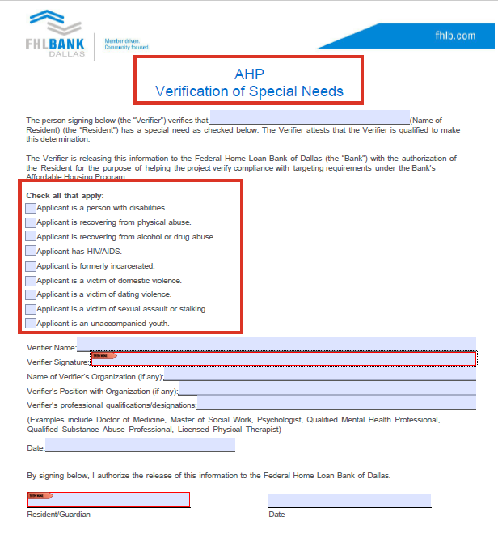
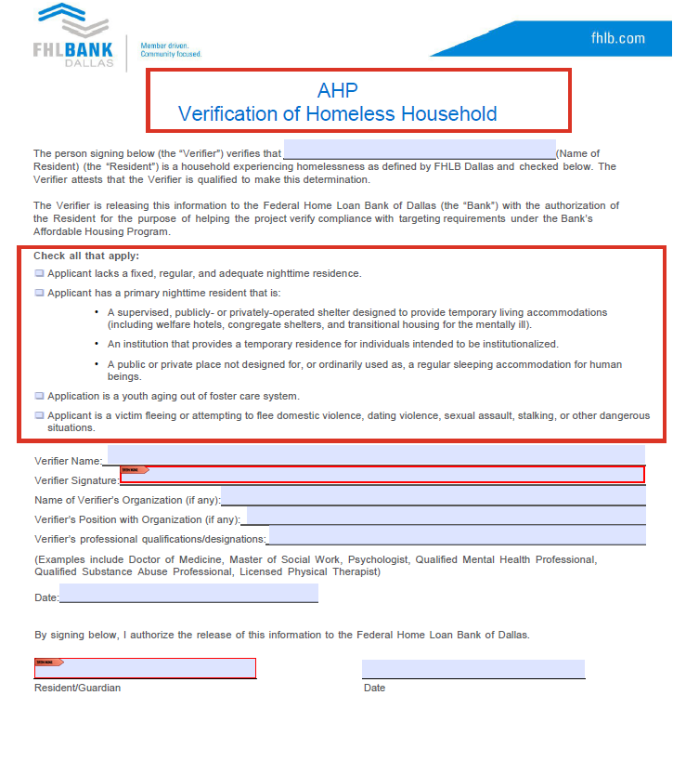
Homelessness and Special Needs Certifications

Slide 46
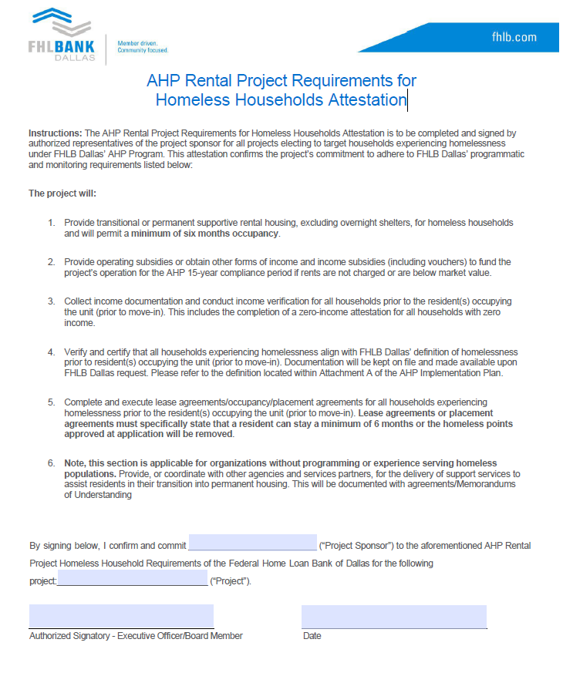
AHP Rental Project Requirements for
Homeless Households Attestation

Slide 47
Community Stability
Adaptive Reuse - Converting an existing non-housing structure into housing
New Construction - Project is 100% new construction
Rehabilitating Properties - 50% of the units or square footage are vacant, abandoned or foreclosed and are being rehabilitated
Demo of Properties - 20% of the units are new construction in place of demolished structures (do not include ancillary structures)
Projects can receive points for 3 of the top 4 categories for 3 points each (totaling 9)
Projects can receive an additional 6 points for preservation
Maximums: Without Preservation = 9 points
With Preservation = 15 points
Preservation - 6 pts - Detailed definition next slide

Slide 48
Community Stability – Cont’d
Preservation
April 30th 2025 - April 30th 2028
1) face expiring (within one year prior to or two years after the AHP application deadline) HUD Section 8 project-based rental assistance contracts, reach the end of a tax credit compliance period, or face expiring USDA-RD 515 rental assistance contracts
and
2) the project commits to preserve all of the affordable rental units after the expiration of such contract or the end of the tax credit compliance period
RAD
Public Housing Development participating in the Rental Assistance Demonstration (RAD) program where the project is replacing the functionally obsolete units with new units or substantially renovated units, as determined by the Bank in its sole discretion
Notes:
Removed the “no less than 1:1 exchange with the new project

Slide 49
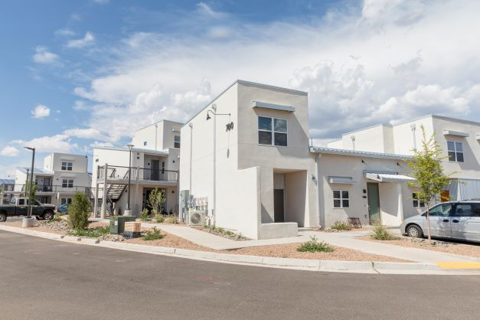
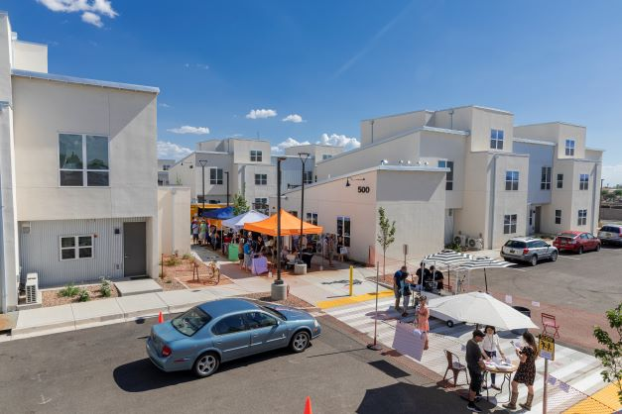
Bank District Priority
First-time homebuyers- 5 pts
- 50% - 2.5 pts
- 100% - 5 pts
Units located within District - 8 pts
Number of rental units – 5 pts
- 10-25 units – 1 pts
- 26-75 units – 3 pts
- >75 units – 5 pts
Climate resilient building standards- 7 pts
Subsidy Per Targeted Unit – 5 pts
New Mexico Inter-Faith Housing received a $650,00 AHP subsidy to construct Siler Yard, a 65-unit project that was New Mexico’s first net-zero energy multi-family project.
Native housing projects – 5 pts

Slide 50
Bank District Priority – Cont’d
A project is located within the states of Arkansas, Louisiana, Mississippi, New Mexico and Texas (the “Bank’s District”). This is a variable point score.
A maximum of eight (8) points is available.
Points are awarded based on the following formulas:
Louisiana, Mississippi and Texas: Bank’s District units / total units * 5
Arkansas and New Mexico: Bank’s District units / total units * 8

Slide 51
Bank District Priority – Cont’d
Subsidy Per Targeted Unit – 5 pts
Rental
Owner-Occupied
If the subsidy per unit is at $35,000 or below…
…the higher the score.
If the subsidy per unit is at $15,000 or below…
…the higher the score.
Every $250 per unit increase over $35,000 decreases score by 0.125 points
Every $250 per unit increase over $15,000 decreases score by 0.125 points

Slide 52
Bank District Priority – Cont’d
Climate Resilient & Green Housing
Scoring based on the type of resilient housing certification achieved. Emphasis on constructing units that will better withstand potential natural disasters as well as conserve energy and use sustainable materials as required by achieving one of the designations below:
Fortified: Multifamily, Gold (7 Pts)
Fortified: Silver
Enterprise Green Communities Criteria
Leadership in Energy and Environmental Design (LEED)
ICC/ASHRAE ‐ 700 National Green Building Standard (NGBS)
HERS Rating: 65 or less for Rehab; 55 or less for New Construction
Fortified: Roof
Energy Star Certified Home/Building (3 Pts)
(5 Pts)

Slide 53
Climate Resilient & Green Housing
Certification Type | Certification | SFO | Rental | Documentation
Enterprise Green Communities | Enterprise | Yes | Yes | Certification @ Pre & Post-Build
LEED-Leadership in Energy & Environmental Design | Independent 3rd Party | Yes | Yes | Certification @ Post-Build
ICC/ASHRAE- 700 NGBS | Independent 3rd Party | Yes | Yes | Prelim Inspection & Final Certification
ENERGY STAR | Independent 3rd Party | Yes | Yes | Signed & Stamped Certification Application
HERS (Home Energy Rating System) | Independent 3rd Party | Yes | Yes | HERS Rating Certificate
FORTIFIED Roof | Independent 3rd Party | Yes | Yes | Certification at Completion and certificate issued by IBHS
FORTIFIED Silver | Independent 3rd Party | Yes | Yes | Certification at Completion and certificate issued by IBHS
FORTIFIED Gold | Independent 3rd Party | Yes | Yes | Certification at Completion and certificate issued by IBHS

Slide 54
Helpful Hints

Slide 55



AHP Planning Steps for Sponsors
Find FHLB Member
Talk with FHLB Dallas
Funding sources project (including AHP subsidy)
Development costs (valid cost estimates)
Organized supporting docs
Complete the AHP application
Enter the correct email address of your member contact
Call member after submitting application
Notes:
Steps before reaching out the member. Have these completed before meeting with a member

Slide 56

Improving Your Application
Provide a detailed “Project Description” and “Financing Summary”
Numbers, dates and addresses match between the application and supporting documents
Help FHLB Dallas understand your required documents with a summary page describing the contents
Review the Implementation Plan, application guides and application workbooks located at the AHP webpage
Meet with FHLB Dallas staff to discuss your application, supporting documents, development budget, cost estimates, operating proformas and unique project features
Have FHLB Dallas do a scoring and documentation review before submitting the application
Note
Make sure your Member Contact is accessible when submitting the application

Slide 57

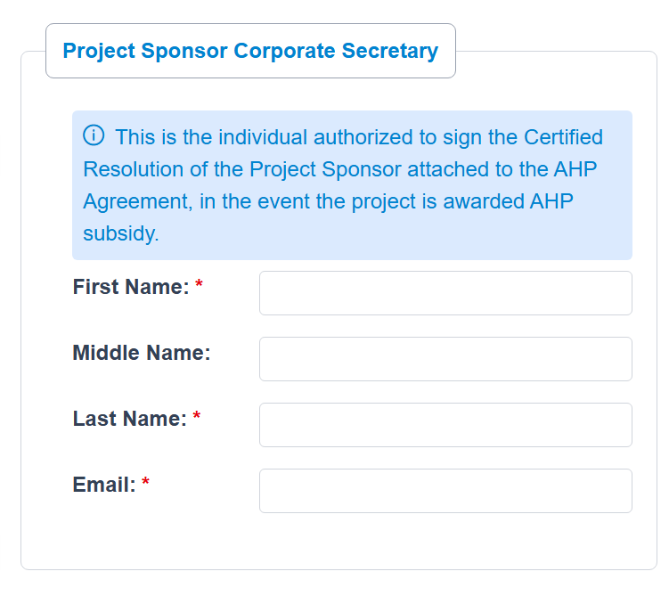
Improving Your Application - Continued
Double check all contact information for correct spelling (including organization names)
Make sure you list the correct corporate secretary for project sponsor and owner secretary as an attachment

Slide 58
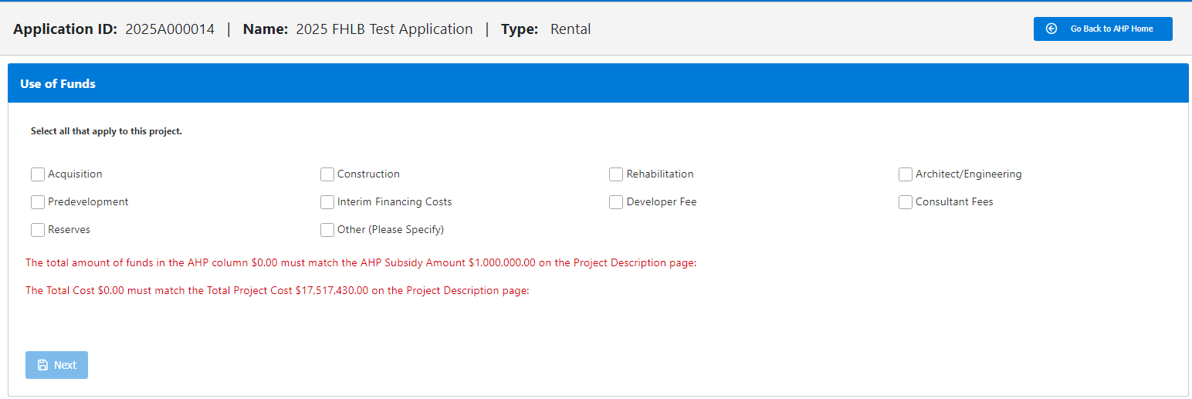
Development Budget – Uses of Funds
The 10 check boxes all correspond to the Bank’s budget template
applicable sub-categories appear once check box selected
Development Budget template is available online
Recommend preparing a budget before starting the application

Slide 59
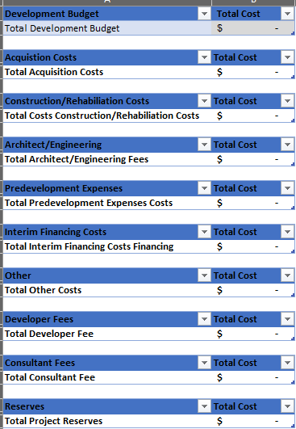
Development Budget – Uses of Funds
The cumulative total shows in the “non-editable” field called “Total Development Budget
Development Budget consists of 10 major cost classifications
Each of the 10 cost categories have their unique categories (next slide)
The “Total” for each category automatic sum based on inputs ”
Required for every project, no exceptions
Template is post on website
Important
Development Budget is now located within the Uses of Funds page
Template available on website

Slide 60
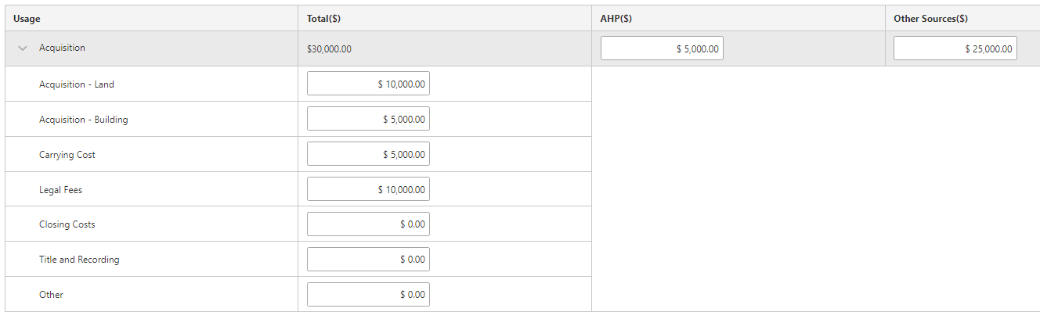
– Expanded sub-categories
Total Costs for each category automatically tabulates
Enter the amount for allocated for AHP and Other Sources
Each item with the “cost category” are editable
Each of the 10 check boxes will display subtotals if selected

Slide 61
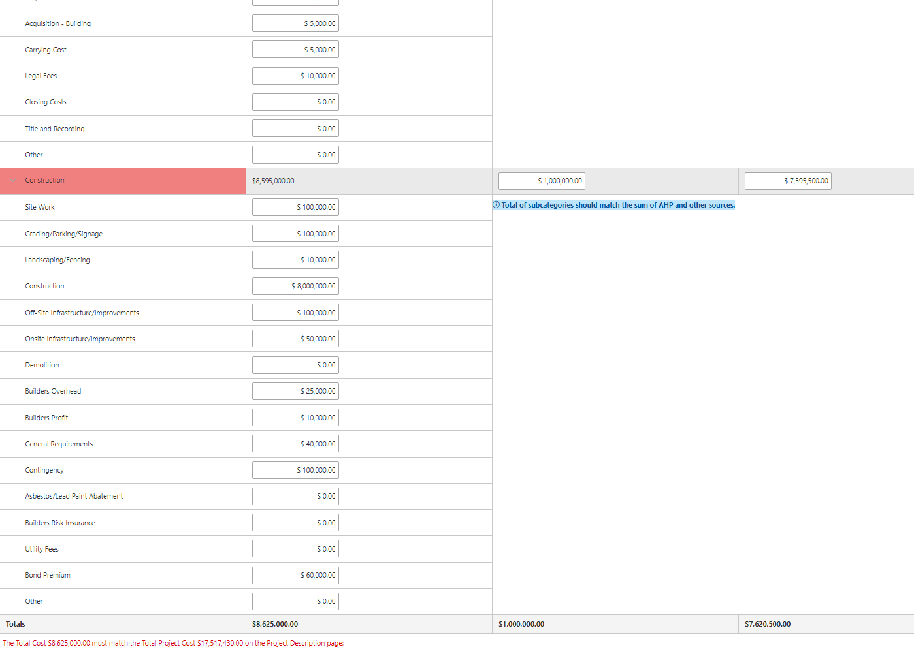
– Expanded sub-categories
Total Costs for each category automatically tabulates
Enter the amount for allocated for AHP and Other Sources
Each item with the “cost category” are editable
Keeps increasing as more information is added
Informs user if totals disagree with Project Cost

Slide 62

Checklists for Errors with Development Budgets
Before submitting my application, I verified the following:
“Sources and Uses” = Total Development Budget
The Acquisition costs on the Development Budget/Uses of Funds = supporting documentation
Total construction/rehabilitation costs on the Uses of Funds = construction estimates and/or cost documentation provided
General Requirements/Builders Overhead/Builders profit and contingencies are shown on the development budget/cost estimates
All major costs including acquisition, construction, contingencies, financing, reserves, developer fee and other soft costs are listed
Helpful Hint
Conceptual design drawings/pre-inspections/Physical Needs Assessments should have sufficient detail to obtain construction cost estimates

Slide 63
Submitting Required Documents – Key Points
All required documents must be uploaded prior to submitting the application to the member
Documentation will be submitted through GrantConnect as individual PDFs
Ask the question, “Will FHLB Dallas understand the documents I am uploading?”
Please include a brief summary page
FHLB Dallas should not have to reconcile conflicting information
Sources of funds on application must match supporting documentation. If not, provide a clarification memo
File name and description of supplemental documents are required and need to be accurate and detailed (provide sufficient time to complete)
Application Technical Assistance Workbooks can be found below:
AHP Rental Housing Workbook
AHP Owner Workbook

Slide 64

Modifications
What is a modification?
A request to change the terms of an approved application and signed agreement
More than just changing a score as a project will have to demonstrate “good cause” and justification for the modification in writing
“Good cause” includes documentation of steps taken by the project sponsor or owner to adhere to its application commitments. Also, explain why these efforts were unsuccessful or attempted – include the emails, correspondence, etc.
Remediation of project noncompliance is NOT in and of itself good cause for a modification
Notes:
The scoring components committed at application must be achieved over the 15-year life cycle of a rental project
only commit to what you know the project can do and can document!

Slide 65
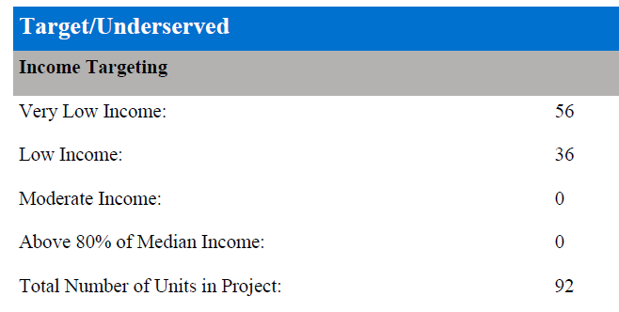
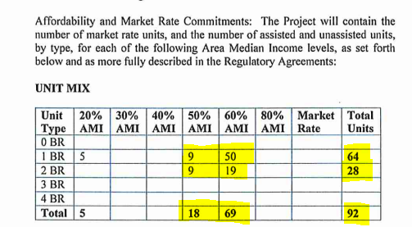
Modifications
Are funding sources compatible, or do they have different requirements?
Talk about your AHP commitments before you apply with other funders before it goes to underwriting
AHP Commitment
Other Funding Commitment
Notes:
The scoring components committed at application must be achieved over the 15-year life cycle of a rental project
only commit to what you know the project can do and can document!

Slide 66
2026 AHP Timeline
Application Process
March 31: 2026 AHP application round opens
Approval
Est. October: FHLB Dallas Board of Directors approves applications
Progress
Annual progress reports (until project completion)
May through September: Community Investment department reviews applications
Award letters are sent
Member/Sponsor/FHLB Dallas AHP Tri-Party Agreement – send in by 12/31/2026
AHP disbursement request submitted (need for subsidy exists)
Monitoring
Before Nov 2030 (or Nov 2032 for Native): Completion of construction or rehabilitation
AHP initial monitoring
April 30: 2026 AHP application round closes
Communicate with your assigned analyst
Long-term monitoring

Slide 67

Where do I Begin?
Attend a training
Call or email CID with questions
Request a scoring review before you submit the application
Utilize FHLB Dallas
Review the following documents:
2026 Implementation Plan
Review the AHP Owner-Occupied/Rental Housing Books
AHP Rental Housing Workbook
AHP Owner Workbook
Study FHLB Dallas Directions
Secure a Member
Find an FHLB Dallas member to support your project, and submit your application

Slide 68
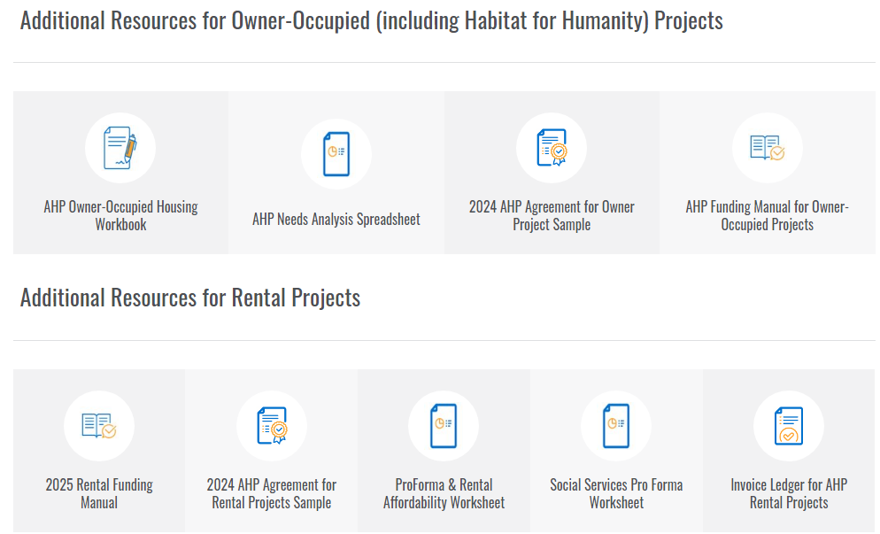
Resources
Additional Resources are located on the
AHP webpage

Slide 69
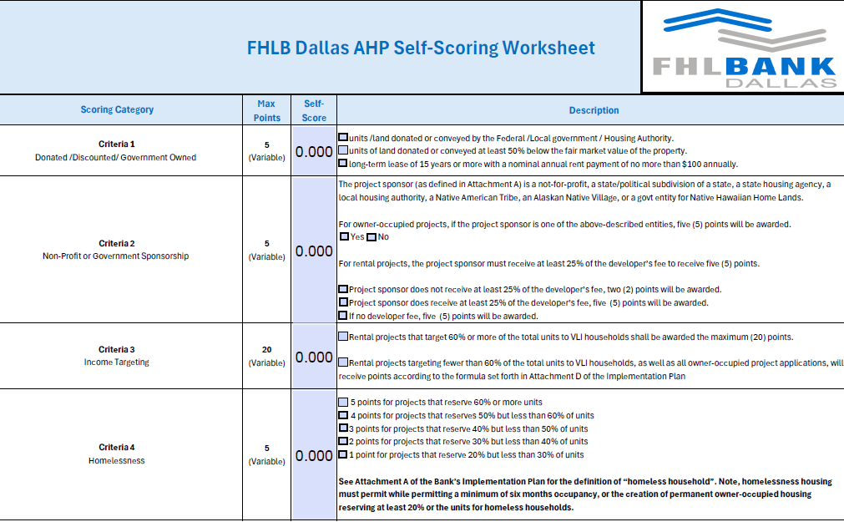
2026 Scoring Rubric (Self- Scoring Worksheet)
Scoring Rubric Link

Slide 70
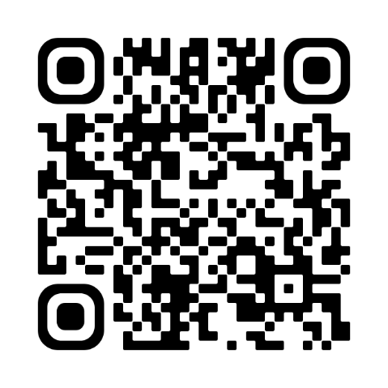

Income Calculations / Training Presentation link
1. Obtain current applicable income documentation
2. Calculate annual household income
3. Validate that the Area median total household income Is = or < 80% AMI
Access this QR code to review a complete training presentation on income calculation for all our grant programs:
Or access the video on our website:
Go to FHLB.com
Resources
Video Library
Webinars and Tutorials
Income Calculation Tool
Understanding AMI calculations is a key element of participation in all grant programs

Slide 71
Grant Connect

Slide 72
GrantConnect
What is GrantConnect?
The online portal where applications are completed and submitted for consideration for an AHP subsidy
Key Points
GrantConnect is the place where sponsors/consultants must have a User ID and password.
It requires first-time users to register before being able to complete an application.
Open from March 31-April 30.

Slide 73
GrantConnect – Registration
Registration Key Points
Notes:
Submit your Rent Roll as an Excel file

Slide 74
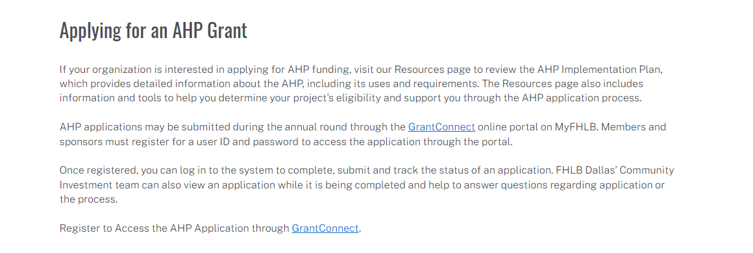
Registration and Access
https://app.fhlb.com/grantconnect/

Slide 75
Register through GrantConnect – Key Points
All Users
Need a username/profile
All users and their profiles need to be affiliated with an organization in our system
It is imperative that all users are affiliated with the correct organization
Sponsors
First time users will create a User ID/Password and affiliate with a new or existing organization
If you created a User ID or used AHP Online in previous AHP rounds, do not create a new User ID. Call FHLB Dallas first
Consultant
Non-Sponsor = Consultant
All first-time non-sponsors users will create a User ID/Password and affiliate with a new or existing organization
If you created a non-sponsor User ID or used AHP Online in previous AHP rounds, do not create a new User ID. Call FHLB Dallas first
All non-sponsors need to be affiliated with their own organization distinct from the sponsor
Members
Must have a user ID and password
Cannot access application without PIN

Slide 76
Register through GrantConnect – Key Points Continued
Grant Connect User Profile Registration
FHLB Review and Approval
Organization Affiliation
Helpful Hints
Make sure to select “Sponsor/Consultant” if not a member when creating a new user profile
Only select “Member” if you are directly employed by one of our member banks when creating a new user profile
New account registration is not complete until you log in and affiliated yourself with a new or existing organization

Slide 77
Application Submission Process– Key Points
Non-Sponsor Initiated Application
Consultant
Initiates Application
Sponsor
Accesses application with PIN
Members
Accesses application with PIN
Submits application to member for review and approval
Submits final application to FHLB Dallas
Completes application
Creates application PIN
Submits application to sponsor for review and approval
Reviews and approves application submitted by consultant
Reviews and approves application submitted by sponsor

Slide 78

Application Submission Process– Key Points
Sponsor Initiated Application
Sponsors
Initiates Application
Members
Review and approve applications submitted by sponsor
Submit final application to FHLB Dallas
Creates application PIN
Completes application
Submits application to member for review and approval
Register and log in with your user ID and password during the application round
The initiator creates an application PIN, which must be shared with all parties to:
Complete the application
Submit the application
Track its status
The member, sponsor, and FHLB Dallas Community Investment department can view the application simultaneously while it is being completed online

Slide 79
GrantConnect – Registration
GrantConnect Tips
Notes:
Submit your Rent Roll as an Excel file

Slide 80
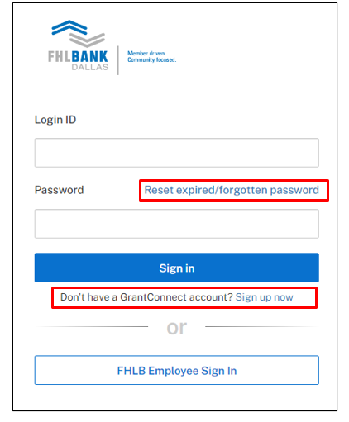
GrantConnect - Tips
GrantConnect location is https://app.fhlb.com/grantconnect
GrantConnect has multifactor authentication, you will need either a direct-dial phone line phone (cannot be an extension), cell or an authenticator app on your phone
If you wait to register, you might not be able to apply because registration approval can take up to 24 hours
Call 1-800-362-2944 for help
Notes:
Submit your Rent Roll as an Excel file

Slide 81
GrantConnect - Previous Registrants
If you created a User ID in the past , do not create a new User ID. Call FHLB Dallas at 800-362-2944.
We will reset your password
You will receive an email
You will be given a two-hour window to complete the Multi-Factor Authentication setup
If you do not complete the process within the two-hour window, you will need to call us again to reset your account.
Helpful Hint
Chrome browser is suggested
DO NOT use Safari, Internet Explorer, or Edge – will generate errors in the registration process

Slide 82
GrantConnect – Registration
GrantConnect Recap
Notes:
Submit your Rent Roll as an Excel file

Slide 83
GrantConnect - Recap
Consultant
Applications created by a consultant will need to be approved by the sponsor
Non-Sponsor = Consultant
All non-sponsors need to register as well
Sponsors
First time users will create a User ID/Password and affiliate with a new or existing organization
If you created a User ID or used AHP Online in previous AHP Rounds, do not create a new User ID call us first
Members
Must have a user ID and password to access the application through the GrantConnect portal
Everyone
Once you have registered, log on to the system with your user ID and password during the application round
You may use the application PIN to complete, submit and track the status of your application

Slide 84
Ready to Apply?
Next Steps
Have a member who supports application
Sponsor (or consultant) completes the application in GrantConnect and submits it to member
Go to https://app.fhlb.com/grantconnect
Call member contact after submitting application
Member reviews and approves the application in GrantConnect and submits it to FHLB Dallas

Slide 85
Questions?

Slide 86
For More Information
Contact Us!
By Phone: 800.362.2944
By Email: ahp@fhlb.com
Additional information is available online at fhlb.com/community programs
Notes:
Please utilize the Community Investment department analysts.
We can see your application as soon as it is in the online portal.

Slide 87
Community Investment Team
Please utilize the Community Investment department for assistance.
Contact Information
AHP Department | 800.362.2944
Email | ahp@fhlb.com
Staff Information
AHP General Fund Manager | Steven Matkovich
Sr. Affordable Housing Analyst | Edgar Burciaga
Sr. Affordable Housing Analyst | Alex Fitzgerald
Sr. Affordable Housing Analyst | Tangela Davis
Additional information is available online at fhlb.com/community-programs

