Slide 1
The Comerica U.S. Economic Outlook Reflation, The Swerve, Reflexivity and The Budget
Robert A. Dye Ph.D. Chief Economist, Comerica Bank
June 2017

Slide 2
Definitions
Reflation
Noun 1. An increase in economic activity and prices
2. An increase in the supply of money and credit designed
to cause such an increase
Swerve
Verb Change or cause to change direction abruptly
Noun An abrupt change of direction.
Reflexivity
Noun A circular relationship between cause and effect, with the cause and the effect affecting one another in a relationship in which neither can be assigned as causes or effects.

Slide 3
The Diagram
Inventories
Bus. Investment
Defense Spending
Housing
Consumer
Other Government
Trade
The Outlook
Reflexivity
Auto Sector
Dollar
Stocks
Oil
Fed Monetary Policy
Fed Budget Constraints
The Trump Swerve
Global Reflation
Expectation of:
Deregulation
Business Friendly Environment
Tax Cuts
Infrastructure Spending
Healthcare Policy
U.S., China, India, Japan
Europe, Commodity Countries
Global Money Surge

Slide 4
U.S. Reflation Metrics Positively Correlated 2016H2-17Q1
M2 pchya, (R)
S&P 500 pchya (L)
GDP pchya (R)
CPI pchya (R)
Credit % (L)
Commodities pchya (L)
Sources: BEA, BLS, Federal Reserve, CRB, S&P

Slide 5
GDP Forecast: Ongoing Moderate Expansion, Weighing the Trump Bump
History
Forecast
2.6 1.6 2.3 2.7
Sources: BEA, Comerica Bank

Slide 6
Labor Metrics Remain Solid
Payroll Employment, avg monthly diff, ths (L)
Unemployment Rate, percent (R)
Sources: BLS, Comerica Bank

Slide 7
More Upward Pressure on Wages to Come
Unemployment Rate
Average Hourly Earnings, percent change year ago
Source: BLS

Slide 8
Moderating Oil Prices Means Less Inflation Ahead
Consumer Price Index, pchya (L)
WTI oil price, pchya (R)
Sources: BLS, EIA

Slide 9
Interest Rate Outlook, Moderate Increases Through 2018
30-Year FRM
10-Year Treasury Bond
Fed Funds
Sources: Federal Reserve, Comerica Bank

Slide 10
2017 Forecast…The 360 View
Downside Risks
Failure of the Trump Agenda
Stock market correction
Global volatility, China, Japan, Eurozone/Brexit, Russia, MENA
Higher interest rates
Housing stalls
Pushback from trade agreements
Strong dollar/weak trade
Terrorist event
Consumer spending slumps
Upside Risks
Tax reform, personal and corporate
Infrastructure program
Consumer/business confidence
Business investment
Wealth effects
Deregulation, including financial
Expansive energy policy w/higher prices
Single-family housing market
Job growth stays strong
Second leg for autos

Slide 11
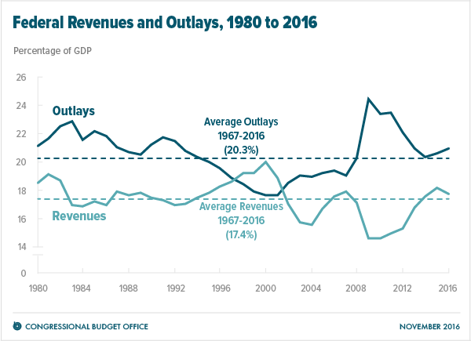
Mind the Gap

Slide 12
A Dire Prediction by the CBO
Source: Congressional Budget Office

Slide 13
Robert A. Dye, Chief Economist
Subscribe
www.comerica.com/economics
Follow on Twitter
@Comerica_Econ

