Slide 1

2025 AHP General Fund
Application Window Opened from April 2 – May 1,2025

Slide 2
2025 AHP Key Points
AHP Subsidy
Maximum AHP subsidy is $1,750,000
Maximum AHP subsidy per AHP unit is $45,000
Application Period
The funding round begins April 2nd and closes on May 1st
Feasibility Thresholds
No maximum DSCR or Cash Flow percentage
      No maximum operating expense limit
      No management fee limit
Scattered Site - must be in the same county or parish

Slide 3
2025 AHP Key Points
Developer/Contractor Affiliation
New calculation: (Developer Fees + Builder’s Profit) / (Total Development Cost – Developer Fees – Builder’s Profit)
Need for Subsidy
Based on the development budget, not the 15-year operating proforma
Development Budget
Do not have split residential and social service space into separate development budgets
Creating economic opportunity
projects must provide MOUs with rental projects.

Slide 4
2025 AHP Key Points
AHP GrantConnect
Sponsor registration in the GrantConnect portal
User affiliation for sponsors and consultants
AHP Application Workbooks
Available on the Bank’s AHP webpage here
Modifications
Project will be held to application commitments
Must attempt to cure/stay in compliance with application commitments
Standardized Development Budget
Applicants will use a template budget provided by as a guide
Development budget will appear on the Uses of Funds Page

Slide 5
2025 AHP Key Points – Scoring Updates
Scoring Updates
Donated Property
  No upfront payments and/or “additional rents”
  No subleases
  Nominal annual rent payment of $100
Subsidy Per Unit
  Rental projects: Maximum threshold decrease for subsidy per unit from $35,000 to $25,000
Native housing projects
  Tribal Government, an agency of a Tribal Government, a Tribally Designated Housing Entity, or an entity incorporated under or otherwise created in accordance with Tribal Law; or
  Located in a Native American Service Area or HUD-designated Indian Housing Block Grant (IHBG) Area.

Slide 6
2025 AHP Key Points - Scoring Updates
Rental Properties
  10 to 25 units – points decreased from 3 to 1
  26 to 75 units – points decreased from 7 to 3
  > 75 units – points decreased from 10 to 5
Demolition – ancillary structures such as barns, sheds, perimeter walls, etc. – do not qualify for points
Homeless Household – now includes victims fleeing or attempting to flee domestic violence, dating violence, sexual assault, stalking, or other dangerous situations
Bank District Priority - Points for Arkansas increased from 6 to 8

Slide 7
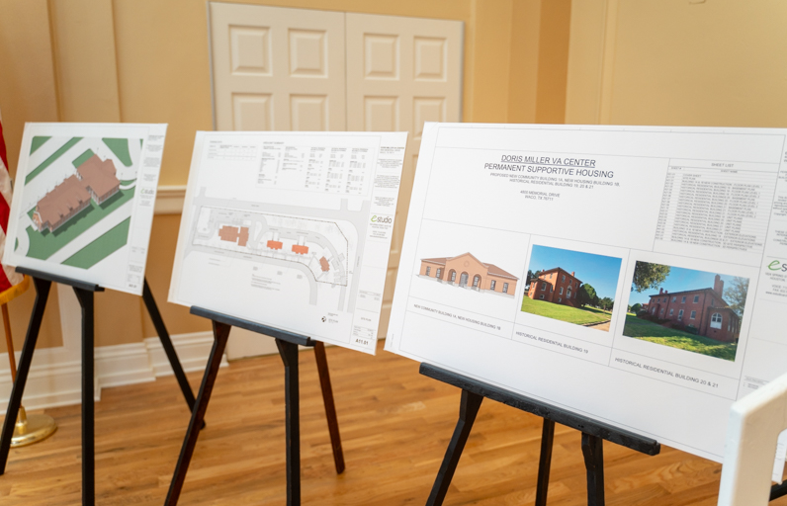
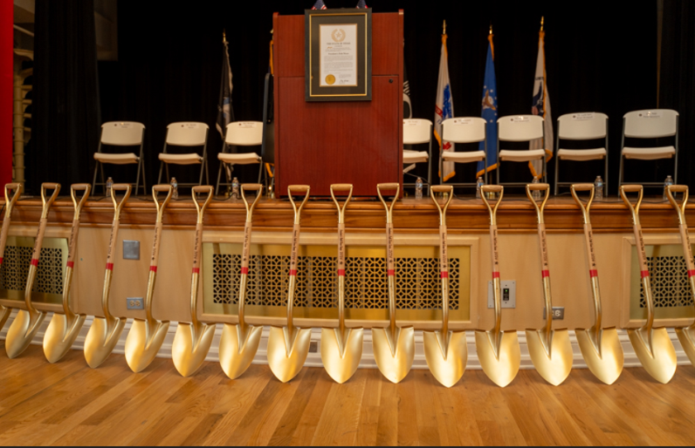
2024 Highlights
Received 266 applications requesting a total of $396 million in AHP subsidies
$78.9 million in AHP subsidies were awarded to 41 projects
41 rental projects approved for 3,571 units of housing
Approval rate of 15% percent
Notes:
Recap of 2023 impact

Slide 8
AHP Subsidies by State
Project Location | Applications Received | Applications Approved |  | Subsidy Awarded | Units
AR | 27 | 1 |  | $1,000,000 | 40
CO | 3 | 0 |  | $0 | 0
LA | 57 | 11 |  | $21,699,844 | 684
MS | 24 | 4 |  | $7,600,000 | 280
NM | 12 | 2 |  | $3,855,000 | 158
TX | 143 | 23 |  | $44,703,572 | 2,409
Totals | 266 | 41 |  | $78,858,416 | 3,571

Slide 9
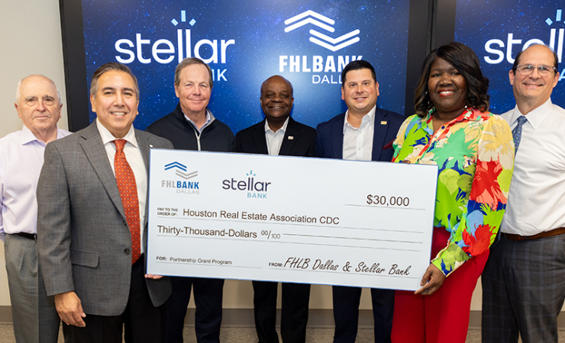
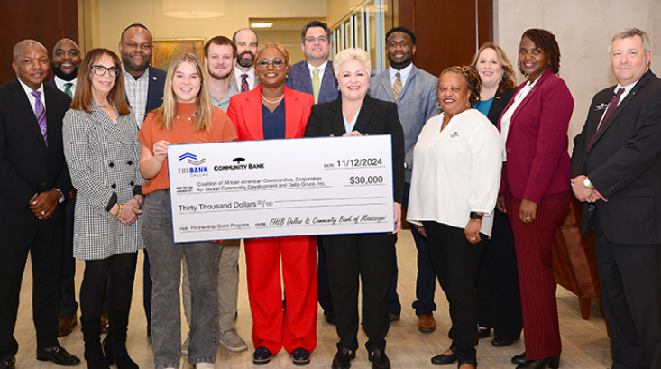
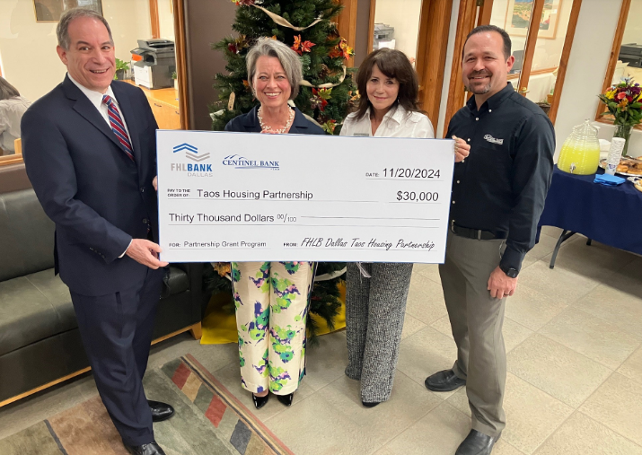
Benefits of AHP to Members
Reputational Benefits
CRA/Community Investment Benefits
New Business/Loan Opportunities
Customer Relationship Benefits
Critical funding for affordable housing
Notes:
Reputational Benefits:
Build your institution’s profile and reputation in the community
Positive public relations
Community Benefits
Provides critical funding for affordable housing projects/ rehabilitate existing housing
Achieve Community Reinvestment Act (CRA) outcomes
Business Benefits:
Construction loans, lines of credit, permanent financing and new consumer/business accounts
Achieve Community Reinvestment Act (CRA) outcomes
Relationship Benefits
Build relationships with housing developers, nonprofit groups and community groups
Create business relationships in your market

Slide 10
Member or Sponsor
A "Member" is willing to apply for AHP funds on behalf of a project sponsor.
A "Sponsor" is the owner of a rental project or the overseer of an ownership project that will put together the application or coordinate the application and project’s completion.
Although a "Member" might be said to "sponsor" an application by submitting it, be sure to understand these terms, because a "Sponsor" and a "Member" play two different roles in an AHP application.
A sponsor cannot apply without a member

Slide 11
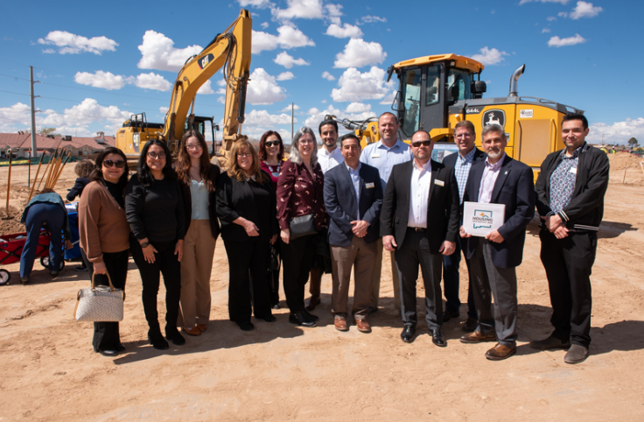
AHP Roles - Members
Evaluate the sponsor and project concept
Set deadline to receive online application to gain necessary approvals
Review and approve applications before submitting to FHLB Dallas
Review/approve compliance reports, disbursement requests and extensions
Maintain project oversight
Discuss expectations for program compliance with sponsors
CC Housing, a subsidiary of Catholic Charities Felician Villa Apartments, a senior housing complex in Rio Rancho, was awarded a $750,000 AHP grant to assist with construction through Wells Fargo.

Slide 12
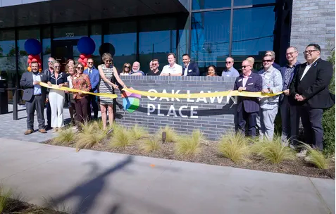
AHP Roles - Sponsors
Create a thorough AHP application with supporting documentation
Understand AHP compliance requirements
Promptly inform the member and FHLB Dallas of changes to the project
Submit documents in a timely manner:
  Conditional award requirements
  Disbursement requests
  Modifications and extensions
  Annual progress reports
Resource Center of Dallas received a $750,000 AHP grant for Oak Lawn Place in Dallas, Texas. The grant was awarded through Veritex Community Bank.

Slide 13
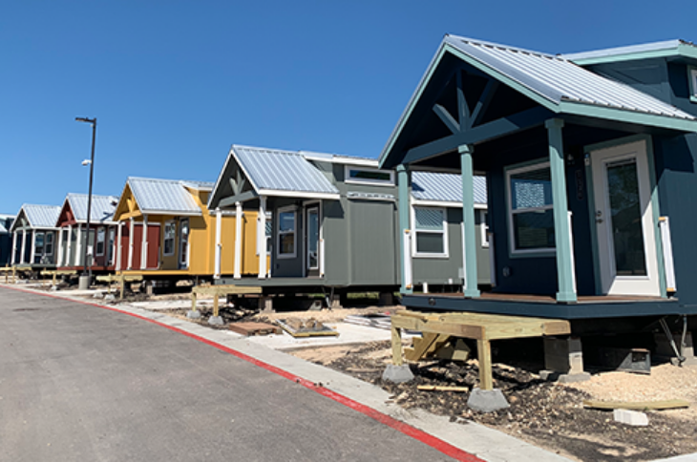
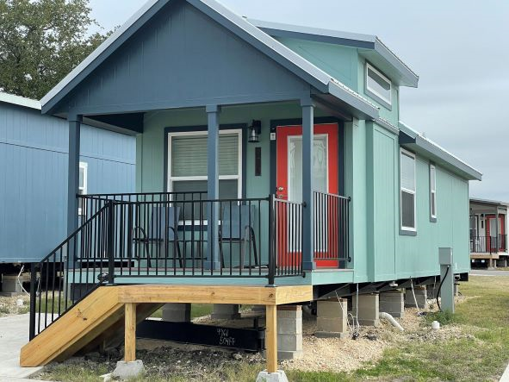
Types of Eligible Housing
Multifamily
Single-Resident Occupancy (SRO)
Manufactured Homes
Micro Homes
Re-entry Housing
Group Homes/Congregate living facilities
Permanent Supportive/Transitional Housing
Adaptive Reuse
Photos above from “Community First Village Phase One”, Austin, Texas. The project received a $750,000 AHP Subsidy to construct 76 micro-homes to serve homeless individuals with a special need through Frost Bank

Slide 14
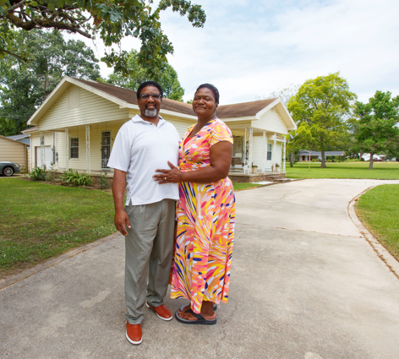
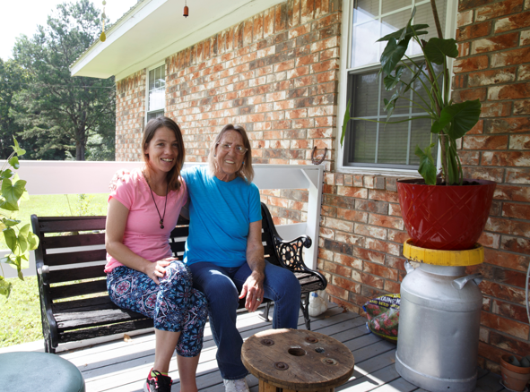
Owner-Occupied Overview
Project Types: Rehabilitation, down payment/closing cost assistance
Project Progress and Completion
Four-year completion timeframe (six years for Native American related projects). Progress should be made within the first year.
Sponsor Capacity
Demonstrated track record with related experience
Disbursement
Completed on a unit-by-unit basis with final documents required for each transaction
Helpful Hint
Contact the Community Investment department to discuss your owner-occupied project

Slide 15
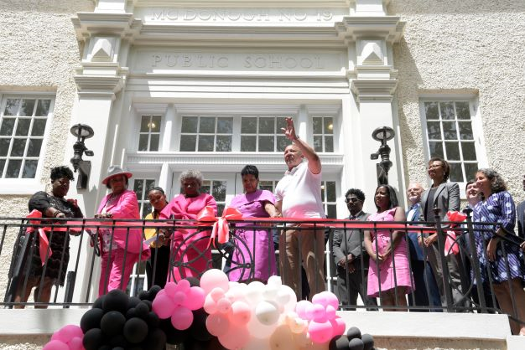
What is Evaluated in the Application
Scoring
Criteria
Eligibility
Eligibility Criteria
Feasibility
Demand
Capacity
Sponsor Capacity
Site Control and Zoning
Financial Feasibility
Use of Funds
Need for Subsidy
A $250,000 Affordable Housing Program (AHP) subsidy awarded to the Leona Tate Foundation for Change from Home Bank to convert a historical school building in New Orleans, Louisiana’s, lower Ninth Ward into 25 affordable apartments for very low-income seniors and a center for anti-racism training

Slide 16
Project Eligibility
At least 20% of the households must be at or below 50% of area median income - Rental
Acquisition, construction and/or rehabilitation of affordable housing
Demonstrate “Need for subsidy” along with developmental and operational feasibility – the gap between the project’s Sources and Uses of Funds
Some or all of the AHP subsidy must be likely to be drawn down by the project or used by the project to procure other funding within 12 months from the date of award approval
Sponsors must be qualified and have developed similar types of project’s in the past. If not, sponsors must have secured an experienced development team with affordable housing and compliance experience
15- Year Deed Restriction for rental projects and 5 Years for Owner-Occupied
Helpful Hint
Applications can be impacted if there are existing or previous AHP projects not in compliance
Notes:
This slide highlights eligibility criteria a project must meet when applying for a AHP subsidy,
The 6 criteria include:
At least 20% of the households must have incomes at or below 50% of AMI. If a project cannot apply if does not meet this requirement.
The AHP subsidy should be used for either acquiring, constructing or rehabilitating affordable housing.
The project needs to show a “need for subsidy”, that is a gap between its Sources and Uses of Funds.
Project readiness, that is the project should be able to start within one year of application approval. If not, then use the AHP subsidy as leverage to secure the rest of the project’s capital stack
Sponsors must be qualified and have developed similar types of project in past. If not, sponsors must have secured an experienced development team with affordable housing and compliance experience.
All project are subject to a 15-year deed restriction along with a 15-year compliance period

Slide 17
Uses of Funds - Rental
Eligible Costs
Ineligible Costs
Acquisition
Hard Construction Costs
- New Construction
- Rehabilitation
- Infrastructure and Site Work
Soft Costs
- Architect/Engineering Fees
- Appraisal/Phase 1
- Developer/Consultant Fees
Contingency Funds
Operational Funding/Expenses
Administrative Funding
Supportive Services
Relocation Expenses
Operating Reserves
Replacement Reserves
Notes:
This slide summarizes eligible and non-eligible uses of an AHP subsidy.
The Bank wants the AHP subsidy to fund primarily “hard construction” costs and will cover some of the “soft costs” shown on the slide.
Note, the AHP subsidy cannot fund contingencies, any operating/replacement reserves and/or pay any operational costs.

Slide 18
Owner Occupied AHP Eligible Uses of Funds
Rehabilitation (accessibility modifications, roofs, etc.)
Downpayment/Closing Cost Assistance
Developer and Inspection Fees (Rehab Projects only)
Homebuyer Counseling (DPA Projects only)
Notes:
Ineligible Uses: Construction Costs, Contingency, Operational, Administrative, Costs for Empowerment services

Slide 19
Demand - Rental
Market study and/or demand data provides information on local housing conditions.
Market study and/or demand data analyzes competition by evaluating other affordable rental developments.
FHLB Dallas can conclude the proposed rents are affordable and achievable, considering location, design and intended resident population.
FHLB Dallas is able to determine the project timeline provides adequate absorption/completion period for the proposed project.
Occupancy Data
Local Market Data
Absorption Time
Vacancy Rates of Nearby Properties
Documented Unmet Housing Needs
Notes:
Occupancy Data
Waiting Lists
Vacancy rates of nearby properties
Local market data
Explains how long it will take to absorb

Slide 20
Demand – Owner Occupied
Owner-Occupied Waitlist
Provide the number of eligible households that meet application requirements
Provide wait lists of interested households
List size should be 1.5 to 2 times the requested number of units
Describe the relationship of the characteristics of the housing stock to the proposed homeownership program.
Demand for AHP Subsidy requested
How is the project determining the level of subsidy requested at a per unit level?
How the need for rehabilitation proposed in this application was determined
Example Questions
How the project arrived at a budget of $15,517 per home?
How project determined that $10,000 in AHP funds are needed per home?
Notes:
Site Control/Zoning - Site control is not required at application for projects involving scattered site ownership

Slide 21
Sponsor Capacity
  FHLB Dallas will review each AHP application, and prior to each AHP subsidy disbursement, for any “covered misconduct” by the project sponsor
    ‘‘Covered misconduct’’ is defined in the Federal Housing Finance Agency's (FHFA) Suspended Counterparty Program (SCP) regulation (12 CFR Part 1227) – more information can be found using one of the two links below
  FHFA Suspended Counterparty Program – Learn more
  FHFA Suspended Counterparties – See list
Helpful Hint
A project must continue to demonstrate a need for the AHP subsidy at disbursement

Slide 22
Sponsor Capacity to Complete
Qualified and able to perform its responsibilities throughout the 15-year retention period – includes compliance and monitoring
Demonstrates ability, experience and financial capacity to complete project
Supporting documentation will show
  Qualifications of key personnel are provided
  Resumes of project leadership and organization fact sheets
  Organizational charts if there are multiple entities
  Sponsor’s experience with similar developments
  A development team was created with experience with similar projects
  Compliance in current AHP projects
Helpful Hint
Contact FHLB Dallas if this is your organization’s first housing project!

Slide 23
Sponsor Capacity to Complete
Below is an example of a good exhibit to include with supporting documents.
Also include resumes, short bios, organizational charts, organizational resumes, etc.
Helpful Hint
The charts above SHOULD NOT be the only exhibits provided for Sponsor Capacity

Slide 24
Site Control and Zoning
Sponsor or ownership entity must have site control at time of application
Sponsor must provide one of the following items below:
A copy of the executed deed or long-term lease with a term of at least 15 years
An executed purchase option or long-term lease option; option must be effective after the AHP award date
An executed settlement statement or purchase contract that shows the purchase price
- Contract for Sale
- Warranty Deed
Site location must be properly zoned
- July 31st deadline to submit proper zoning approval
Notes:
-.
- AHP award date.
-
-

Slide 25
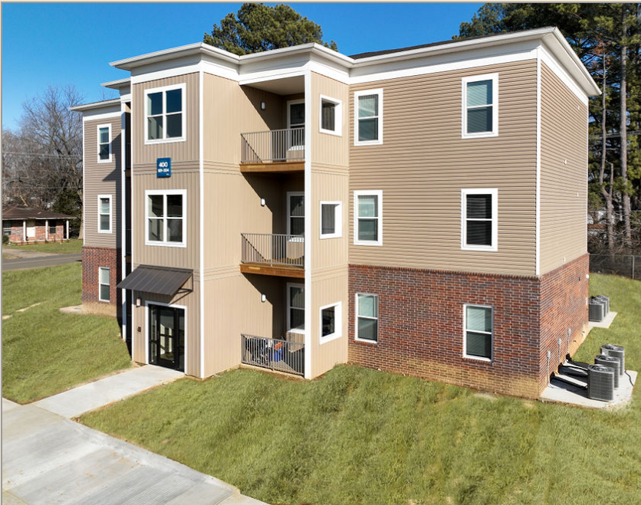
Rental Case Study
SEARCY, ARKANSAS – Searcy Housing Authority/Searcy Housing Solutions was awarded a
$750,000 AHP subsidy for “The South Grove” project, a $12M development.
The project scope involved the demolition of 28 outdated homes to rebuild 60
modernized affordable housing rental units.

Slide 26
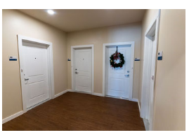
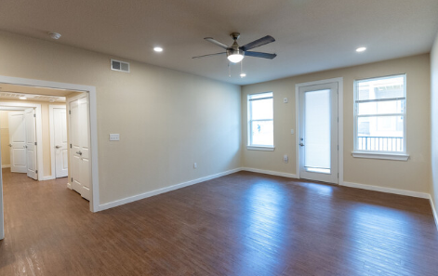
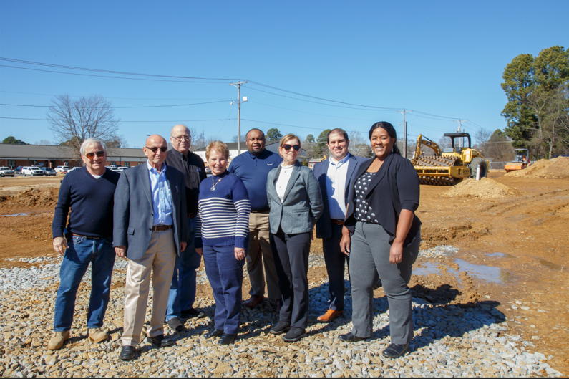
Rental Case Study – Cont’d
Income Targeting
  50 units for households below 50% of AMI
  10 units for households between 51-60% of AMI
  Project has a Section 8 Housing Assistance Payments (HAP) Contract for 12 of the units
Unit Mix
  All 60 units are designed to serve family households with floorplans containing 1-, 2-, and 3-bedroom units
  The Project was designed with larger numbers of bedrooms to target low-income families (or individuals with children).
Funding Sources:
  9% LIHTCs
  HOME Investment Partnerships Program (HOME)
  National Housing Trust Fund (NHTF) from the Arkansas Development Finance Authority (ADFA).
  United States Department of Agriculture (USDA) 538 Loan
AHP subsidy for Avenue J.
$35M project located in the heart of Houston’s Historic East End neighborhood
New construction of 100 rental units targeting families below 80% of AMI
Project had no annual debt
http://www.gchp.net/projects/detail/Village_at_the_Beverly

Slide 27
Rental Feasibility
Criteria | Ranges/Limits | Rental Project
Targeting | At least 20% of the units targeted below 50% of AMI | 50 or 83% of units targeted below 50%
Debt Service Ratio | 1.15 Minimum* | 1.23
Replacement Reserves | New construction: $400/unit/year | $250
 | Rehabilitation: $500/unit/year | NA
Operating Expenses | $2,500 Minimum | $4,382.07
Operating Reserves | Not to exceed 6 months of projected operating expenses, debt service payments, and replacement reserves | >=6 months
* No percentage cap for cash flow for projects that are zero-debt

Slide 28
Rental Feasibility
Criteria | Ranges/Limits | Rental Project
Rents | Not to exceed 30% of AMI | Tenants paying ≤ 30%
General Requirements, Builder Overhead and Builder Profit | 14% of total construction cost – MUST BE LISTED on Invoices/AIA documents | 13.85%
Developers Fee | New Construction or Rehab: 15% of Total Development Cost net of Developers’ Fee Acquisition/Rehabilitation: 15% of Total Development Cost net of Developer’s Fee and Acquisition Cost | 6.94% - New Construction
Hard Cost Contingency | Not to exceed 10% new/15% rehab | 5.00%
Soft Construction Cost | Not to exceed 30% of TDC | 27.81%
Vacancy Ratio | 7.5% (up to 10% for special needs) | 7.00%

Slide 29
Owner-Occupied Feasibility
Criteria | Ranges/Limits | Project Examples
Targeting | Less than 80 percent of AMI | 100 percent of homes targeted to households < 50 percent of AMI
Subsidy Pass-Through | Clearly demonstrated to homebuyer/homeowner | Loan Estimate and Closing Disclosure to be provided on a home-by-home basis with disbursement requests
Mortgage Term and Amortization Term | Not less than 5 years and 15 years respectively | Homebuyers are applying for 30-year fixed rate mortgages
Developer Fee | Not to exceed 10 percent of the FHLB subsidy amount | Project’s fee was 10 percent
Cash Back | Cash back to homebuyer at closing, or as part of the rehab cost, is NOT allowed | Subsidy is based on need and will not result in cash back

Slide 30
2025 Rental Rehab Projects
One independent bid for rehabilitation cost or a physical needs assessment
A detailed scope of the rehabilitation with photos illustrating the project’s condition
If AHP funds represent most of the funding source excluding any owner or charitable contributions than a pre- and post-inspection conducted by a qualified independent third party not related to the owner, sponsor, developer or contractor and approved by the member is required
Important
Please prepare an itemized budget or ledger if you are submitting multiple bids/invoices
General Requirements/Builders Overhead/Builders Profit should be listed on bids/cost estimates
Helpful Hint
Any bid and/or pre-inspection you receive should be detailed enough so a contractor can price out the work required (i.e., good enough to obtain construction cost estimates).

Slide 31
2025 Rental Rehab Projects – Relocation Plan
For projects occupied at the time of application, a relocation plan is required if there is any displacement (temporary or permanent).
The relocation plan may be either:
Any plan approved by any federal, state or local government funder(s) involved in the financing of the project or
A plan approved by FHLB Dallas that at a minimum meets the following:
  Minimizes displacement; articulates a resident notification plan
Relocation budget is required and should appear in Total Project Budget
  Provides temporary displacement such as: moving within to a fully renovated unit (permanently or temporarily), storage of personal property onsite, or moving to a hotel for a set period of time
  Detailed accommodations, if any, are planned for those who elect permanent relocation
  Provides a payment for actual reasonable moving/related expenses or a fixed payment for moving expenses
Notes:
Regardless of the type of relocation plan submitted, a relocation budget categorizing the line item relocation costs in total and an anticipated average cost per household is required. In addition, general assumptions articulating how the relocation cost estimates were determined should be narrated within the relocation plan.
minimizes displacement; articulates a resident notification plan;
Provides temporary displacement planning, if applicable, such as: moving within to a fully renovated unit (permanently or temporarily), storage of personal property on-site, or moving to a hotel for a designated period of time,
Details accommodations, if any, are planned for those who elects permanent relocation; and
Provides a payment for actual reasonable moving/related expenses or a fixed payment for moving expenses.

Slide 32
2025 Rental Rehab Projects – Cont’d
A rent roll is required if the project is currently occupied
The number of units should tie to the application’s income targeting commitments
Report each tenant’s current income
FHLB Dallas will sample a selection of residents for
back-up income documentation
Submit as an Excel file with supporting documents
Unit # | Household Name | Move In Date | Current Income | # of Bedrooms | Household Size | Tenant Paid Rent | Federal/State Rental Subsidy | Total Rent | Targeting 50/60/80
Notes:
Submit your Rent Roll as an Excel file

Slide 33
Questions?

Slide 34
Competitive AHP Scoring

Slide 35
2025 AHP General Fund Scoring Overview
Scoring Criteria | Points
Donated property* | 5
Not-for-profit or government sponsorship | 5
Targeting - Income groups | 20
Underserved communities and populations* | 15
Creating economic opportunity | 5
Community stability | 15
FHLB Dallas District priority* | 35
Total | 100
100-point scoring system based on 7 criteria
Found in Attachment D of the FHLB Dallas AHP Implementation Plan
* Symbolizes a change from 2025

Slide 36
Donated / Conveyed Property
Units or land donated/conveyed by the federal government instrumentality thereof or unrelated related (at least 20% of units); or
Property conveyed significantly below market value, meaning it is transferred for 50% or less of fair market value, by an unrelated party
Key Points:
Donated or conveyed by an entity not related to or affiliated with the member, project sponsor or project owner through ownership or control with the exception of property owned and donated by a Housing Authority, City or County and meeting all other conditions of this criterion.
Long term leases of 15 years or more with nominal annual rent payment
(no more than $100 annually) - No upfront payments or additional rents
Evidence of donation should be included with the application (i.e., transfer deed, purchase agreement or letter of intent)

Slide 37
Not-for-Profit/Government Sponsorship
Project Sponsor means a not-for-profit or for-profit organization or public entity
5 points – All Projects
- Housing finance agencies
- Housing authorities
- Not-for-profit entities
- Government agencies
- Native American Tribe
Rental projects with a Developer Fee
2 points if the sponsor receives < 25 percent of Developer Fee
5 points if the sponsor receives ≥ 25 percent of Developer Fee
Rental Projects
The project sponsor is the owner of the rental project
The project sponsor must have an ownership interest or the ability to control the entity that is the project owner

Slide 38
Income Targeting
The extent to which a project creates housing for very low- and low- or moderate-income households
For purposes of this scoring criterion, FHLB Dallas will score rental projects and owner-occupied projects separately
Rental Projects
If at least 60% of units are targeted to families with annual incomes < 50% of AMI, the project receives 20 points
Include any manager’s unit as part of the project’s total number of units. Be sure to indicate as “market-rate” for above 80% of AMI on the income targeting page of the online application
The larger the percentage of VLI households within a project…
…the higher the score.

Slide 39
Creating Economic Opportunity
Programs/services assisting residents in attaining life skills or better economic opportunities
All Projects
Rental Only
Owner-Occupied Only
Employment
Onsite daycare services (child or adult)
After school or out-of-school services
Workforce preparation and integration
Mental and behavioral health services
Financial literacy education
Residential Services Coordinator
Homebuyer Counseling/Education - Purchase/ Construction
Homeowner Maintenance & Counseling/Education - Rehabilitation Projects only
Sweat Equity - New Construction Projects only (minimum of 300 hours per home)
Scoring - Owner
1 service = 3 pts
Scoring - Rental
1 service = 4 pts
2 service = 5 pts
2 services = 5 pts
Memorandum of Understanding (MOU) is required for each empowerment service – format located on Bank’s Website

Slide 40
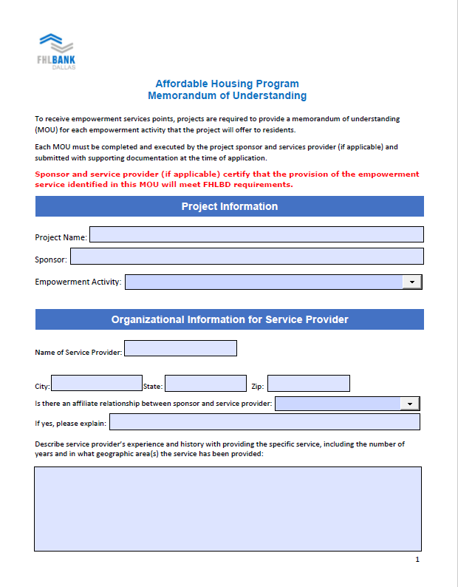
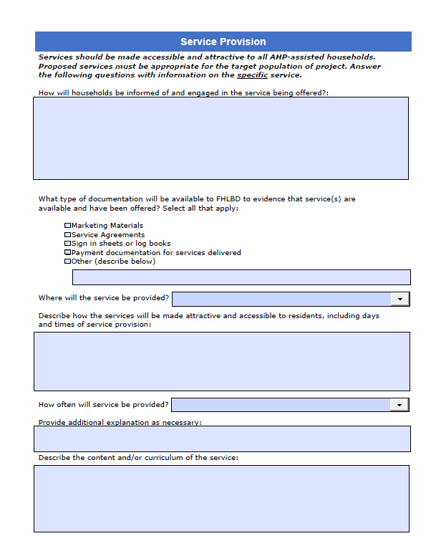
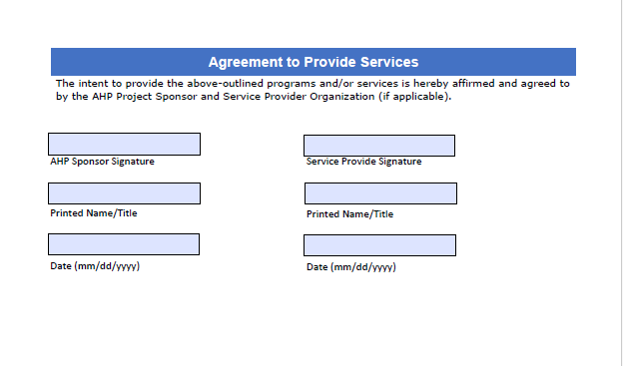
Creating Economic Opportunity - MOU

Slide 41
Underserved Communities and Populations
Homeless Housing – 5 pts
Rental housing reserving at least 20% of the units for homeless
Transitional housing with a minimum six-month stay
Homeless/Special Needs points
20% to 29% = 1 pt
30% to 39% = 2 pts
40% to 49% = 3 pts
50% to 59% = 4 pts
> 60%= 5 pts
Special Needs Housing – 5 pts
Households with elderly
Persons with disabilities
Persons recovering from physical/alcohol/drug abuse
Persons with HIV/AIDS
Formerly incarcerated persons
Victims of domestic/dating violence/sexual assault/
Unaccompanied youth
Rural Housing – 5 pts
USDA property eligibility can be found here
Rural Points
Variable points - number of units located in a rural area divided by total number of units
For special needs and/or homeless, please ensure your supporting documents show how the project will qualify someone meeting CID’s definition.
FHLB Dallas template now available
Notes:
Six-month occupancy required to qualify for this category. • Overnight shelters are eligible for AHP funding, but do not qualify for points in this category.

Slide 42
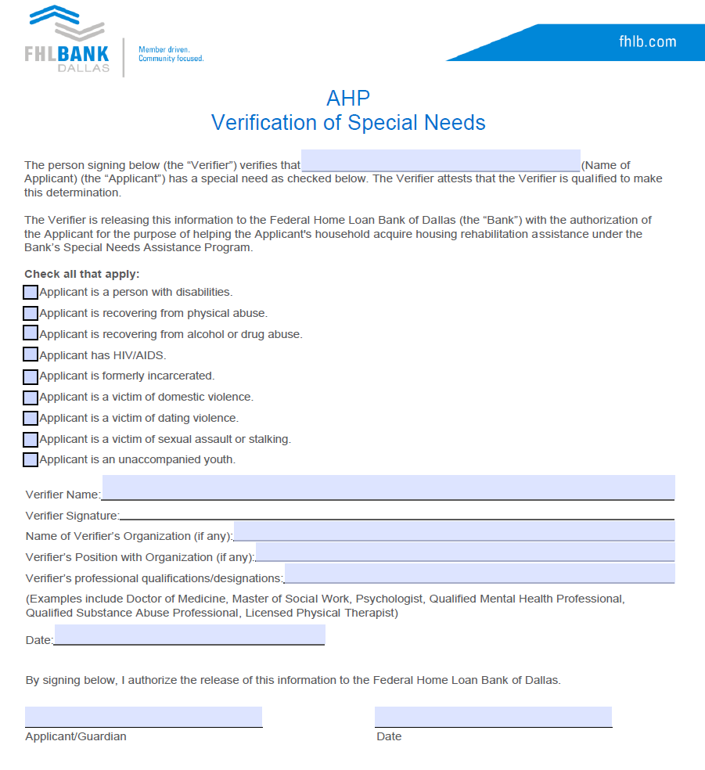
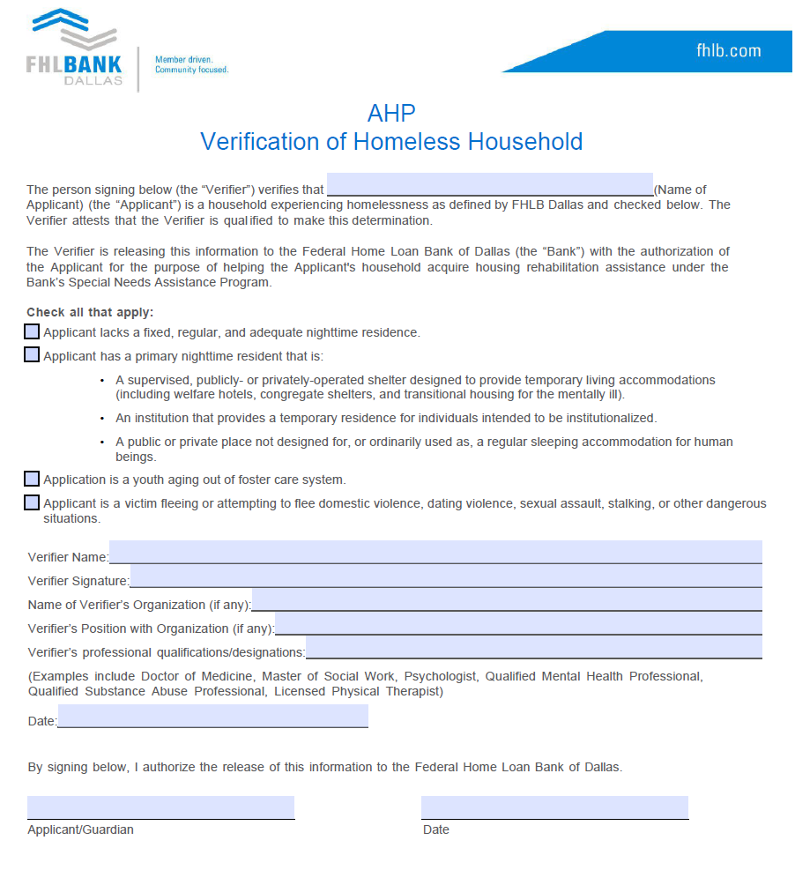
Homelessness and Special Needs Certifications

Slide 43
Community Stability
Adaptive Reuse - Converting an existing nonhousing structure into housing
New Construction - Project is 100% new construction
Rehabilitating Properties - 50% of the units or square footage are vacant, abandoned or foreclosed and are being rehabilitated
Community/Revitalization Area - Located within geographic boundaries
Demo of Properties - 20% of the units are new construction in place of demolished structures (do not include ancillary structures)
Projects can receive points for 3 of the top 5 categories for 3 points each (totaling 9)
Projects can receive an additional 6 points for preservation
Maximums: Without Preservation = 9 points
With Preservation = 15 points
Preservation - 6 pts - Detailed definition next slide

Slide 44
Community Stability – Cont’d
Community/Revitalization Points Project choose from two options
located within the geographic boundaries defined by a community revitalization plan adopted by the municipality, county or parish in which the project is located; note, does not include City/Local plans stating the need for affordable
part of an approved resolution from the Governing Body of the municipality, county or parish expressly setting forth that the Governing Body supports the AHP application
Preservation – within two years after AHP application deadline
May 1st, 2027
1) face expiring HUD Section 8 project-based rental assistance contracts, reach the end of a tax credit compliance period, or face expiring USDA-RD 515 rental assistance contracts
and
2) the project commits to preserve all of the affordable rental units after the expiration of such contract or the end of the tax credit compliance period.
RAD
Public Housing Development participating in the Rental Assistance Demonstration (RAD) program where the project is replacing the functionally obsolete units with new units or substantially renovated units, as determined by the Bank in its sole discretion.
Notes:
Removed the “no less than 1:1 exchange with the new project

Slide 45
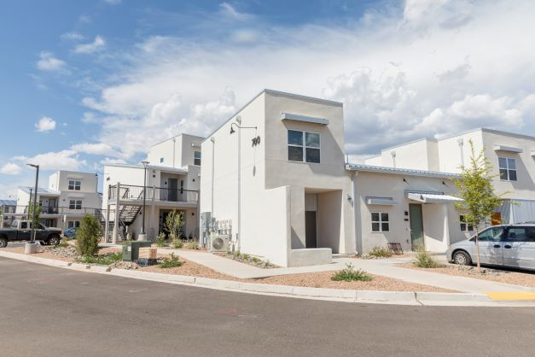
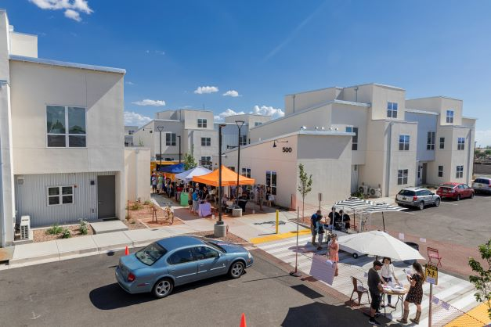
Bank District Priority
First-time homebuyers- 5 pts
- 50% - 2.5 pts
- 100% - 5 pts
Units located within District - 8 pts
Number of rental units – 5 pts
- 10-25 units – 1 pts
- 26-75 units – 3 pts
- >75 units – 5 pts
Climate resilient building standards- 7 pts
Subsidy Per Targeted Unit – 5 pts
New Mexico Inter-Faith Housing received a $650,00 AHP subsidy to construct Siler Yard, a 65-unit project that was New Mexico’s first net-zero energy multi-family project.
Native housing projects – 5 pts

Slide 46
Bank District Priority – Cont’d
A project is located within the states of Arkansas, Louisiana, Mississippi, New Mexico and Texas (the “Bank’s District”). This is a variable point score.
A maximum of eight (8) points is available.
Points are awarded based on the following formulas:
Louisiana, Mississippi and Texas: Bank’s District units / total units * 5
Arkansas and New Mexico: Bank’s District units / total units * 8

Slide 47
Bank District Priority – Cont’d
Subsidy Per Targeted Unit – 5 pts
Rental
Owner-Occupied
If the subsidy per unit is at $25,000 or below…
…the higher the score.
If the subsidy per unit is at $15,000 or below…
…the higher the score.
Every $250 per unit increase over $25,000 decreases score by 0.125 points
Every $250 per unit increase over $10,000 decreases score by 0.125 points

Slide 48
Bank District Priority – Cont’d
Climate Resilient & Green Housing
Scoring based on the type of resilient housing certification achieved. Emphasis on constructing units that will better withstand potential natural disasters as well as conserve energy and use sustainable materials as required by achieving one of the designations below:
Fortified: Multifamily, Gold (7 Pts)
Fortified: Silver
Enterprise Green Communities Criteria
Leadership in Energy and Environmental Design (LEED)
ICC/ASHRAE ‐ 700 National Green Building Standard (NGBS)
HERS Rating: 65 or less for Rehab; 55 or less for New Construction
Fortified: Roof
Energy Star Certified Home/Building (3 Pts)
(5 Pts)

Slide 49
Climate Resilient & Green Housing
Certification Type | Certification | SFO | Rental | Documentation
Enterprise Green Communities | Enterprise | Yes | Yes | Certification @ Pre & Post-Build
LEED-Leadership in Energy & Environmental Design | Independent 3rd Party | Yes | Yes | Certification @ Post-Build
ICC/ASHRAE- 700 NGBS | Independent 3rd Party | Yes | Yes | Prelim Inspection & Final Certification
ENERGY STAR | Independent 3rd Party | Yes | Yes | Signed & Stamped Certification Application
HERS (Home Energy Rating System) | Independent 3rd Party | Yes | Yes | HERS Rating Certificate
FORTIFIED Roof | Independent 3rd Party | Yes | Yes | Certification at Completion and certificate issued by IBHS
FORTIFIED Silver | Independent 3rd Party | Yes | Yes | Certification at Completion and certificate issued by IBHS
FORTIFIED Gold | Independent 3rd Party | Yes | Yes | Certification at Completion and certificate issued by IBHS

Slide 50
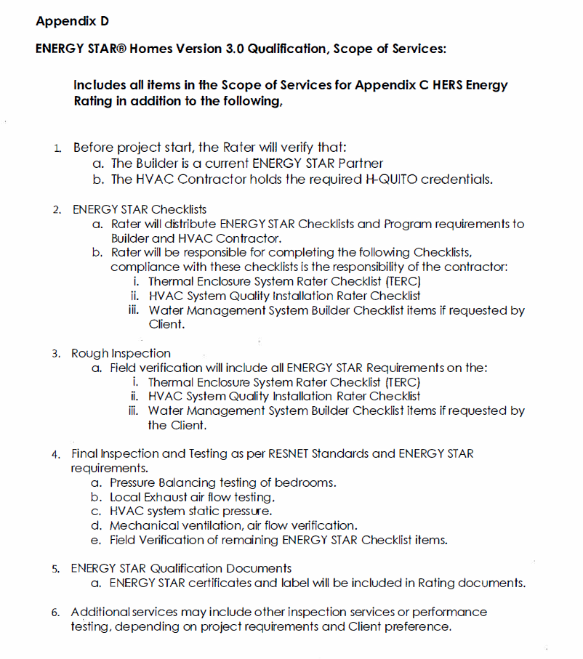
Application Documentation of Energy Star Certified
Step by Step certification instructions available here

Slide 51
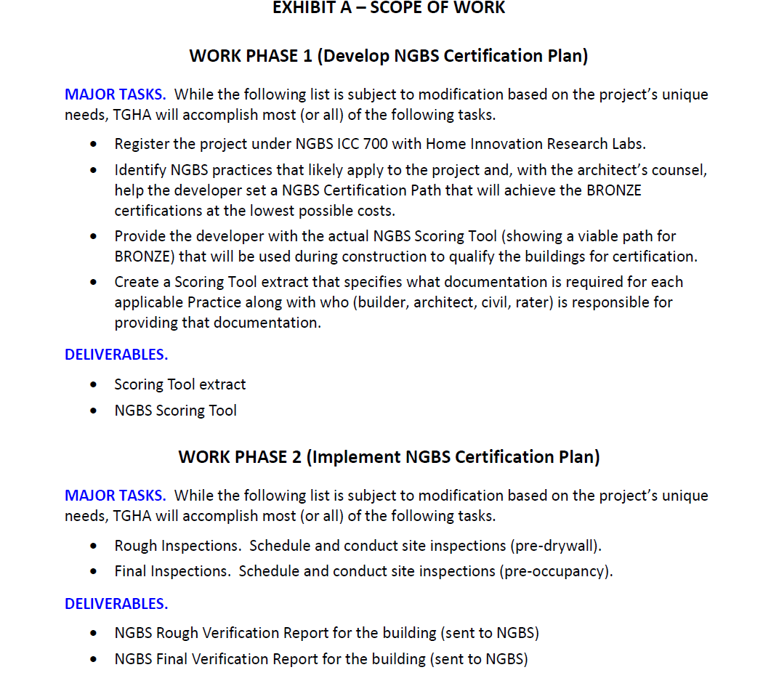
Application Documentation of NGBS Certification
Provides grant funds for the repair and rehabilitation of special needs owner-occupied households
Step by Step certification instructions available here

Slide 52
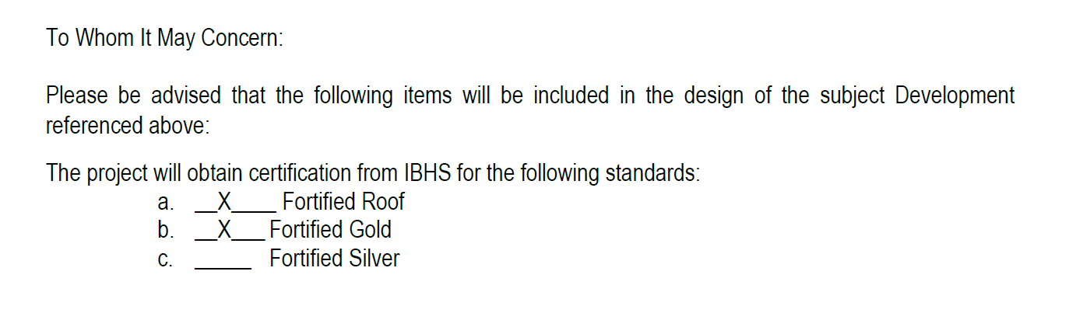
Application Documentation of Fortified Certification
Provides grant funds for the repair and rehabilitation of special needs owner-occupied households
Step by Step certification instructions available here

Slide 53
Helpful Hints

Slide 54



AHP Planning Steps for Sponsors
Find FHLB Member
Talk with FHLB Dallas
Funding sources project (including AHP subsidy)
Development costs (valid cost estimates)
Organized supporting docs
Complete the AHP application
Enter the correct email address of your member contact
Call member after submitting application
Notes:
Steps before reaching out the member. Have these completed before meeting with a member

Slide 55

Improving Your Application
Provide a detailed “Project Description” and “Financing Summary”
Numbers, dates and addresses match between the application and supporting documents
Help FHLB Dallas understand your required documents with a summary page describing the contents
Review the Implementation Plan, application guides and application workbooks located at the AHP webpage
Meet with FHLB Dallas staff to discuss your application, supporting documents, development budget, cost estimates, operating proformas and unique project features
Have FHLB Dallas do a scoring and documentation review before submitting the application
Note
Make sure your Member Contact is accessible when submitting the application

Slide 56
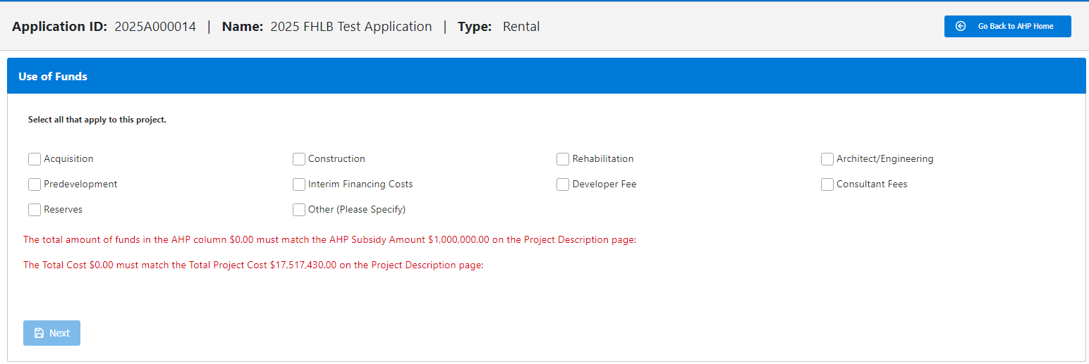
Development Budget – Uses of Funds
The 11 check boxes all correspond to the Bank’s budget template
applicable sub-cagatories appear once check box selected
Development Budget template is available online
Recommend preparing a budget before starting the application

Slide 57
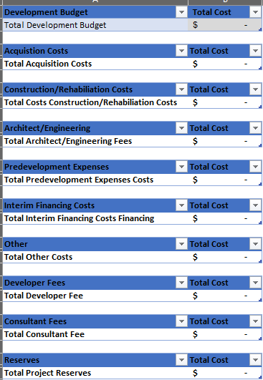
Development Budget – Uses of Funds
The cumulative total shows in the “non-editable” field called “Total Development Budget
Development Budget consists of 10 major cost classifications
Each of the 10 cost categories have their unique categories (next slide)
The “Total” for each category automatic sum based on inputs ”
Required for every project, no exceptions
Template is post on website
Important
Development Budget is now located within the Uses of Funds page
Template available on website

Slide 58
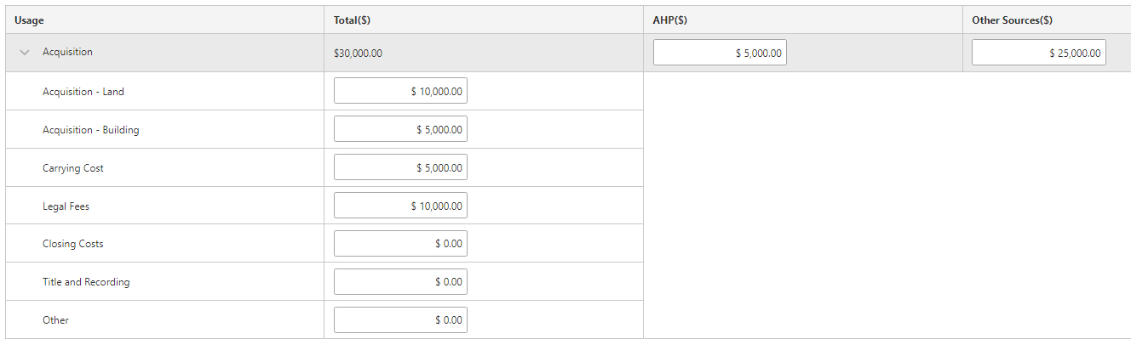
– Expanded sub-categories
Total Costs for each category automatically tabulates
Enter the amount for allocated for AHP and Other Sources
Each item with the “cost category” are editable
Each of the 11 check boxes will display subtotals if selected

Slide 59
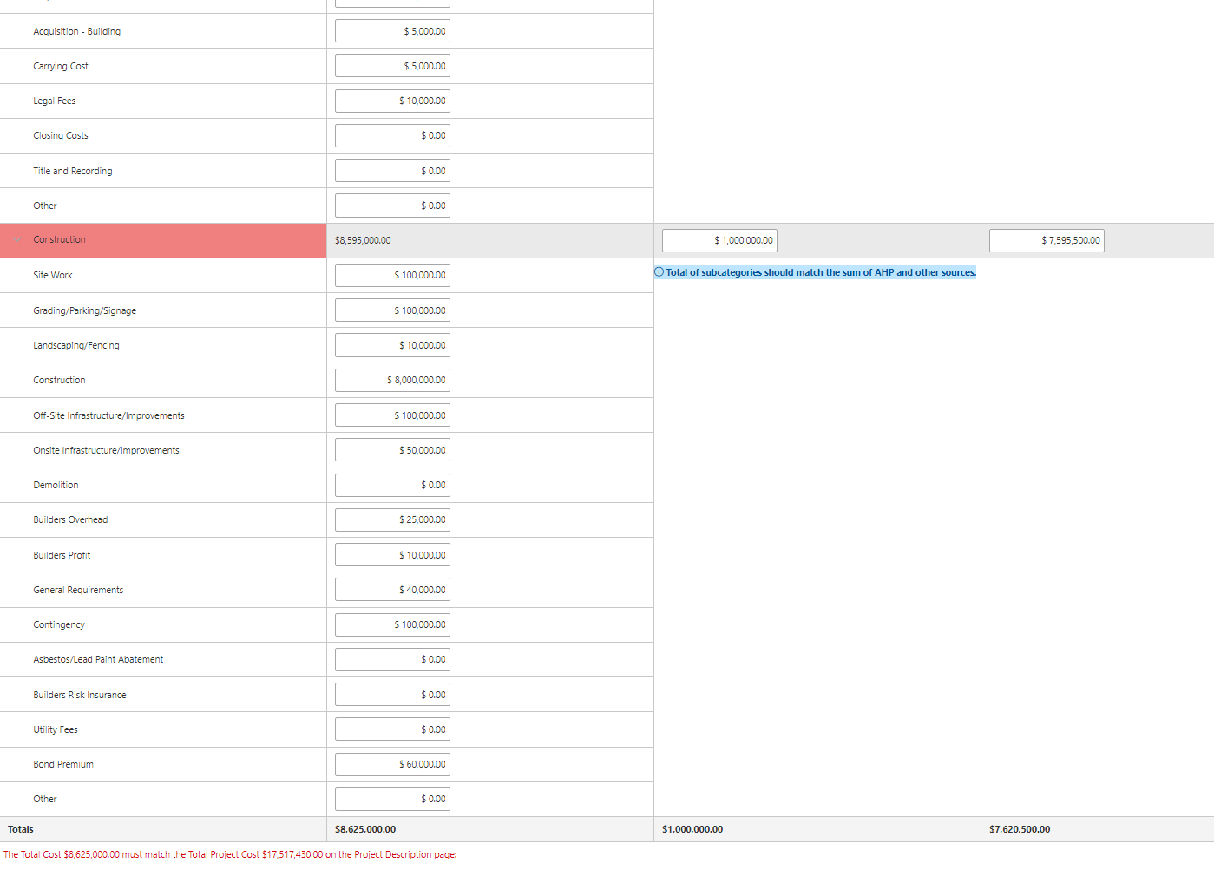
– Expanded sub-categories
Total Costs for each category automatically tabulates
Enter the amount for allocated for AHP and Other Sources
Each item with the “cost category” are editable
Keeps increasing as more information is added
Informs user if totals disagree with Project Cost

Slide 60

Modifications
What is a modification?
A request to change the terms of an approved application and signed agreement
More than just changing a score as a project will have to demonstrate “good cause” and justification for the modification in writing
“Good cause” includes documentation of steps taken by the project sponsor or owner to adhere to its application commitments. Also, explain why these efforts were unsuccessful or attempted – include the emails, correspondence, etc.
Remediation of project noncompliance is NOT in and of itself good cause for a modification
Notes:
The scoring components committed at application must be achieved over the 15-year life cycle of a rental project
only commit to what you know the project can do and can document!

Slide 61
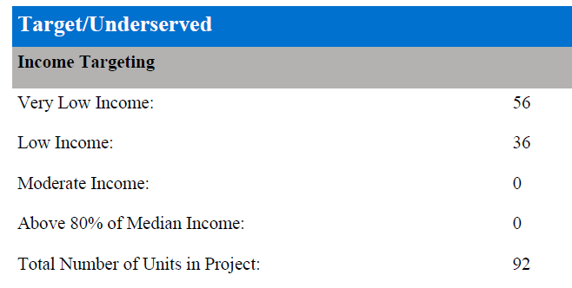
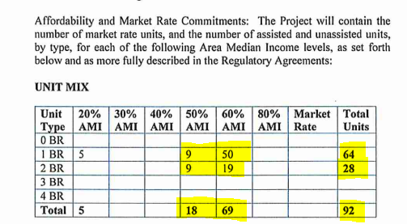
Modifications
Are funding sources compatible, or do they have different requirements?
Talk about your AHP commitments before you apply with other funders before it goes to underwriting
AHP Commitment
Other Funding Commitment
Notes:
The scoring components committed at application must be achieved over the 15-year life cycle of a rental project
only commit to what you know the project can do and can document!

Slide 62
2025 AHP Timeline
Application Process
April 2: 2025 AHP application round opens
Approval
Est. October: FHLB Dallas Board of Directors approves applications
Progress
Annual progress reports (until project completion)
May through September: Community Investment department reviews applications
Award letters are sent
Member/Sponsor/FHLB Dallas AHP Tri-Party Agreement – send in by 12/31/ 2025
AHP disbursement request submitted (need for subsidy exists)
Monitoring
Before Nov 2029 (or Nov 2031 for Native): Completion of construction or rehabilitation
AHP initial monitoring
May 1: 2025 AHP application round closes
Communicate with your assigned analyst
Long-term monitoring

Slide 63
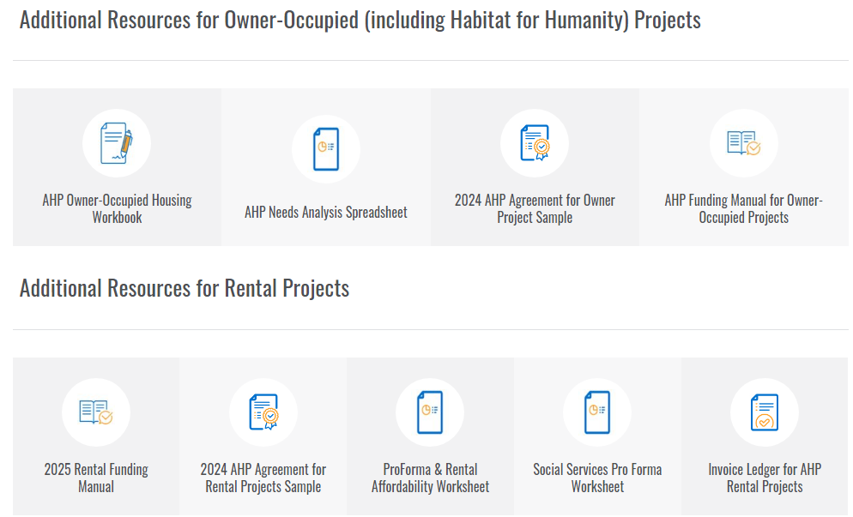
Resources
Additional Resources are located on the
AHP webpage

Slide 64
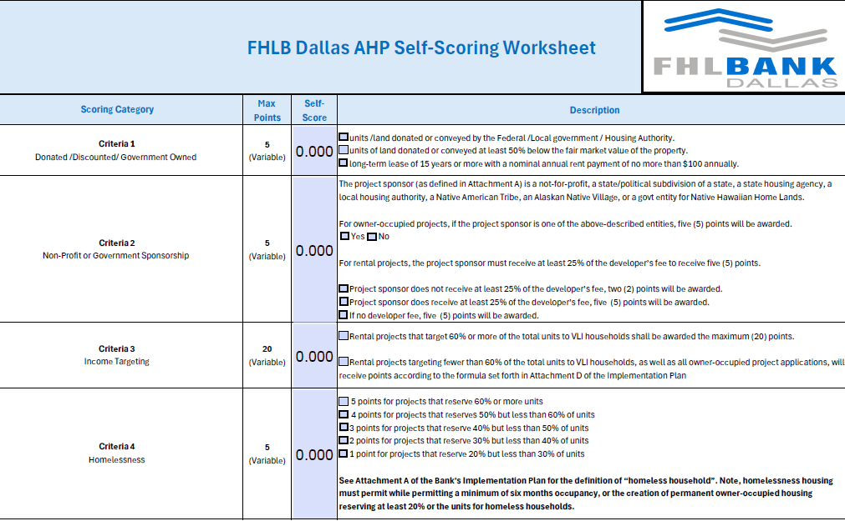
2025 Scoring Rubric (Self- Scoring Worksheet)
Scoring Rubric Link

Slide 65
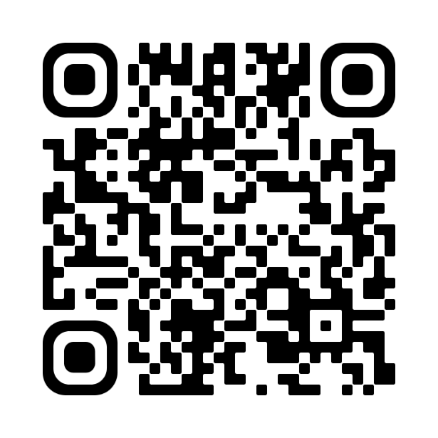

Income Calculations / Training Presentation link
1. Obtain current applicable income documentation
2. Calculate annual household income
3. Validate that the Area median total household income Is = or < 80% AMI
Access this QR code to review a complete training presentation on income calculation for all our grant programs:
Or access the video on our website:
Go to FHLB.com
Resources
Video Library
Webinars and Tutorials
Income Calculation Tool
Understanding AMI calculations is a key element of participation in all grant programs.

Slide 66
Grant Connect

Slide 67
GrantConnect
What is GrantConnect?
The online portal where applications are completed and submitted for consideration for an AHP subsidy
Key Points
GrantConnect is the place where sponsors/consultants must have a User ID and password.
It requires first-time users to register before being able to complete an application.
Open from April 2-May 1.

Slide 68
GrantConnect – Registration
Registration Key Points
Notes:
Submit your Rent Roll as an Excel file

Slide 69
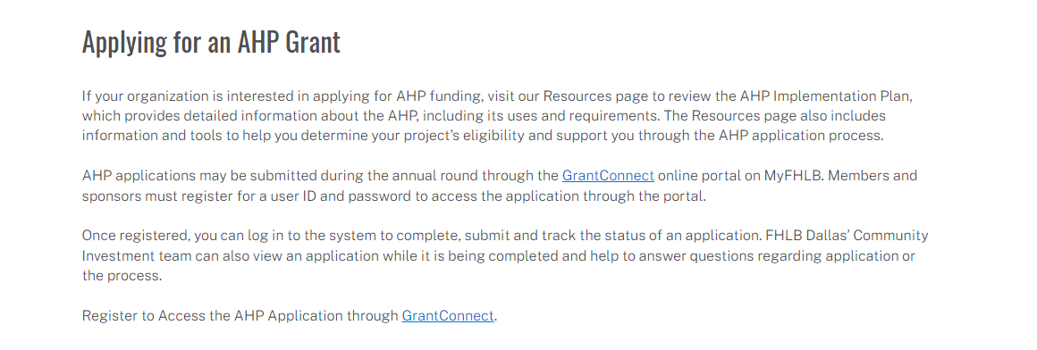
Registration and Access
https://app.fhlb.com/grantconnect/

Slide 70

Register through GrantConnect – Key Points
Sponsors
First time users will create a User ID/Password and affiliate with a new or existing organization
If you created a User ID or used AHP Online in previous AHP rounds, do not create a new User ID. Call FHLB Dallas first
Consultant
Members
Applications created by a consultant will need to be approved by the sponsor
Non-Sponsor = Consultant
All non-sponsors need to register as well
Must have a user ID and password
Cannot access application without PIN
After registering, log in to the system with your user ID and password during the application round.
The initiator will create the application PIN. The application PIN will need to be shared with each party to complete, submit and track the status of the application.
The member, sponsor and FHLB Dallas’ Community Investment department can view an application at the same time while it is being completed online.

Slide 71
GrantConnect – Registration
GrantConnect Tips
Notes:
Submit your Rent Roll as an Excel file

Slide 72
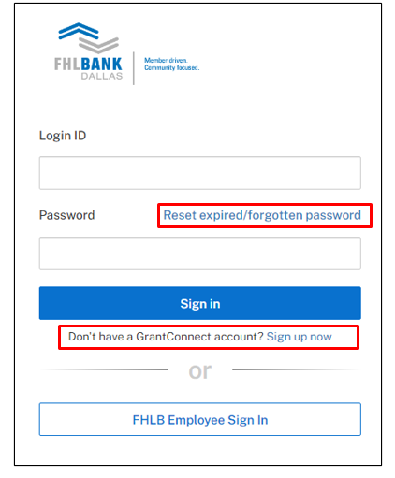
GrantConnect - Tips
GrantConnect location is https://app.fhlb.com/grantconnect
GrantConnect has multifactor authentication, you will need either a direct-dial phone line phone (cannot be an extension), cell or an authenticator app on your phone.
If you wait to register, you might not be able to apply because registration approval can take up to 24 hours.
Call 1-800-362-2944 for help
Notes:
Submit your Rent Roll as an Excel file

Slide 73
GrantConnect - Previous Registrants
If you created a User ID in the past , do not create a new User ID. Call FHLB Dallas at 800-362-2944.
  We will reset your password
  You will receive an email
  You will be given a two-hour window to complete the Multi-Factor Authentication setup
  If you do not complete the process within the two-hour window, you will need to call us again to reset your account.
If you registered prior to 2021, please go through the self-registration process at https://app.fhlb.com/grantconnect
Helpful Hint
Chrome browser is suggested
DO NOT use Safari, Internet Explorer, or Edge – will generate errors in the registration process

Slide 74
GrantConnect – Registration
GrantConnect Recap
Notes:
Submit your Rent Roll as an Excel file

Slide 75
GrantConnect - Recap
Consultant
Applications created by a consultant will need to be approved by the sponsor
Non-Sponsor = Consultant
All non-sponsors need to register as well
Sponsors
First time users will create a User ID/Password and affiliate with a new or existing organization
If you created a User ID or used AHP Online in previous AHP Rounds, do not create a new User ID call us first
Members
Must have a user ID and password to access the application through the GrantConnect portal.
Everyone
Once you have registered, log on to the system with your user ID and password during the application round. You may use the application PIN to complete, submit and track the status of your application.

Slide 76
Questions?

Slide 77
For More Information
Contact Us!
By Phone: 800.362.2944
By Email: ahp@fhlb.com
Additional information is available online at fhlb.com/community programs
Notes:
Please utilize the Community Investment department analysts.
We can see your application as soon as it is in the online portal.

Slide 78
Community Investment Team
Please utilize the Community Investment department for assistance.
Contact Information
AHP Department | 800.362.2944
Email | ahp@fhlb.com
Staff Information
AHP General Fund Manager | Steven Matkovich
Sr. Affordable Housing Analyst | Edgar Burciaga
Sr. Affordable Housing Analyst | Alex Fitzgerald
Additional information is available online at fhlb.com/community-programs

