Slide 1

2026 Affordable Housing Program Workshop
Homeownership and Homebuyer Programs
Notes:
programs.

Slide 2
Learning Objectives
1
Affordable Housing Program (Owner Occupied)
Homebuyer Equity Leverage Partnership (HELP)
Income Calculations
FORTIFIED Fund
Partnership Grant Program (PGP)
Disaster Rebuilding Assistance (DRA)
Special Needs Assistance Program (SNAP)
Program Enrollment and Application Submission Process
2
3
4
5
6
7
8

Slide 3
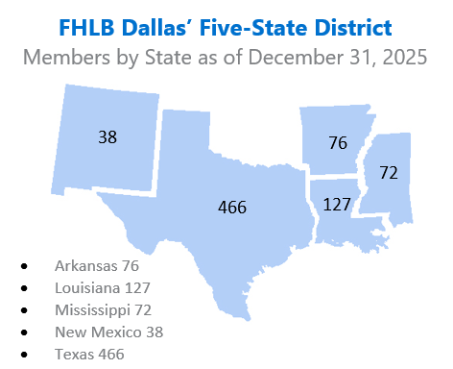
About FHLB Dallas
Who we are
One of 11 District banks in the FHLBank System created by Congress in 1932.
A privately held cooperative, composed primarily of Community Financial Institutions located in Arkansas, Louisiana, Mississippi, New Mexico and Texas.
What we do
We provide members with wholesale lending, credit and related financial services.
At least 10% of income from the prior year goes to affordable housing.
Why we were created
To provide capital for mortgage funding during the Great Depression.
Notes:
Who we are:
FHLB Dallas is an independent government sponsored enterprise (no federal appropriations), that is owned by our member financial institutions.
Owned by “Member” financial institutions. We have a Cooperative structure; Members are both owners and customers.
Members are banks, credit unions, savings and thrifts, CDFIs and insurance companies.
What we do:
We provide members with wholesale lending, credit and related financial services to support affordable housing and economic development
Why we were created:
Created by congress in 1932 to reinvigorate a housing market devastated by the Great Depression through housing financing and community development programs and serving as a source of liquidity to our members.

Slide 4
Community Investment Products
Grants
Recoverable Grants
Advances
Affordable Housing Program*
Voluntary
Voluntary
EDP
CIP
Disaster
10% of Income
HAVEN
PGP
Small Business Boost
Competitive
Set-aside
FORTIFIED
Pathway Fund
Care Award
NAHO
HELP: Home-buyer Equity Leverage Partnership
SNAP: Special Needs Assistance Program
DRA: Disaster Rebuilding Assistance
HAVEN: Housing Assistance for Veterans
PGP: Partnership Grant Program
NAHO: Native American Housing Opportunities Fund
EDP: Economic Development Program
CIP: Community Investment Program
HELP
SNAP
State HFA Education Grant
DRA
4
*These programs require recipients to be at or below 80% AMI
Notes:
This morning, we are going to focus on the Set-Aside programs which are HELP, SNAP, and DRA. I encourage you to explore our website, fhlb.com, to look through other programs you may find value in.
AHP General Fund provides grants to help finance the purchase, rehabilitation or construction of affordable housing, including owner-occupied and rental housing and housing for homeless individuals and families. Funds are awarded on an annual basis through a competitive application process.
HELP provides down payment and closing cost assistance to first-time homebuyers.
SNAP provides grants to modify or rehabilitate homes for those with special needs.
DRA provides grants to help homeowners repair or rebuild after disasters.

Slide 5

2026 AHP General Fund Owner-Occupied Overview
Application Window Opened from March 31st – April 30th

Slide 6
AHP General Fund (Purpose) These funds strengthen communities by providing funding to members for affordable housing finance that benefits households at or below 80 percent of their area median income.
A Funding source to nudge Affordable Housing projects over the finish line with final funding, as a gap funding source to leverage additional grant monies or for overall financing needs.
If a project remains in compliance with program requirements for specified terms, all funds are forgiven, depending on project type.
Project sponsors must work with an FHLB Dallas member financial institution to submit an application for funding.
2026 Maximum AHP subsidy is $1,750,000 per project.
2026 Maximum AHP subsidy per AHP unit is $45,000.
Application Period-The funding round begins March 31st and closes on April 30th .
*NOTE: FHLB Dallas does not provide grants directly to project sponsors or to consumers

Slide 7
2026 AHP Key Updates
Scoring Updates
Community Stability
Removal of Community Revitalization Plan scoring criteria (Owner and Rental projects)
Update to Preservation Definition to include (Rental projects):
“six (6) points if 1) the project will, within one year prior or two years after application deadline, face expiring HUD section 8 project-based rental assistance contracts, reach the end of a tax credit compliance period, or face expiring USDA-RD 515 rental assistance contracts….”
AHP Application Workbooks
Available on the Bank’s AHP webpage
Standardized Development Budget (Rental projects)
Applicants will use a template budget provided as a guide
Development budget will appear on the Uses of Funds Page

Slide 8
Application Evaluation and Eligible Housing
Scoring
Criteria
Eligibility
Eligibility Criteria
Feasibility
Demand
Capacity
Sponsor Capacity
Site Control
Financial/Developmental Feasibility
Use of Fund
Need for Subsidy
Types of Eligible Housing
First Time Homebuyer Programs
Single Family Home (1 to 4 dwelling)
Manufactured Homes
Owner-Occupied Rehabilitation
Owner-Occupied New Construction
5 Year Deed Restriction for Owner-Occupied AHP Subsidy units involving downpayment assistance

Slide 9
Member or Sponsor
A "Member" for an AHP application is a financial institution member of FHLB Dallas that is willing to apply for AHP funds on behalf of a project sponsor or developer.
A "Sponsor" is the owner of a rental project or the overseer of an ownership project that will put together the application or coordinate the application and project’s completion.
Although a "Member" might be said to "sponsor" an application by submitting it, be sure to understand these terms, because a "Sponsor" and a "Member" play two different roles in an AHP application.
A sponsor cannot apply without a member

Slide 10
AHP Process
Pre-Application Process
The member and project sponsor meet to discuss the project
Application Process
The project sponsor completes the application for funding during the annual application period
Approval
FHLB Dallas scores the applications and recommends projects to receive funding
Funds Disbursement
AHP funds are disbursed as a direct grant to the member institution
Progress Reporting
Sponsors submit annual progress reports until project completion
Monitoring
Upon completion of the construction or rehabilitation
Five-year Retention for Owner Occupied Downpayment Assistance

Slide 11
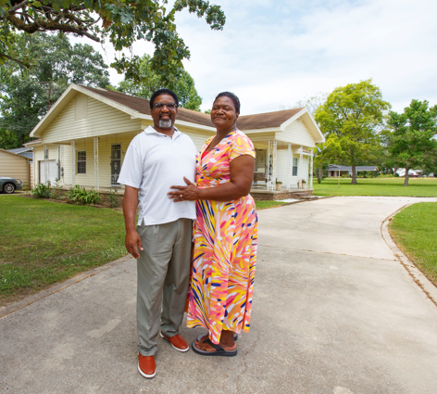
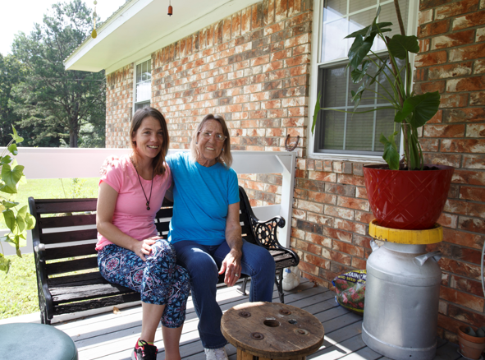
Owner-Occupied Overview
Project Types: Rehabilitation, down payment/closing cost assistance
Project Progress and Completion
Four-year completion timeframe (six years for Native American related projects). Progress should be made within the first year.
Sponsor Capacity
Demonstrated track record with related experience
Disbursement
Completed on a unit-by-unit basis with final documents required for each transaction
Helpful Hint
Contact the Community Investment department to discuss your owner-occupied project

Slide 12
Owner Occupied AHP Eligible Uses of Funds
Rehabilitation (accessibility modifications, roofs, etc.)
Downpayment/Closing Cost Assistance
Developer and Inspection Fees (Rehab Projects only)
Homebuyer Counseling (DPA Projects only)
Notes:
Ineligible Uses: Construction Costs, Contingency, Operational, Administrative, Costs for Empowerment services

Slide 13
Owner-Occupied Feasibility
Criteria | Ranges/Limits | Project Examples
Targeting | Less than 80 percent of AMI | 100 percent of homes targeted to households < 50 percent of AMI
Subsidy Pass-Through | Clearly demonstrated to homebuyer/homeowner | Loan Estimate and Closing Disclosure to be provided on a home-by-home basis with disbursement requests
Mortgage Term and Amortization Term | Not less than 5 years and 15 years respectively | Homebuyers are applying for 30-year fixed rate mortgages
Developer Fee | May not exceed 10% of the FHLB Subsidy | Project’s fee was 8%
Cash Back | Cash back to homebuyer at closing, or as part of the rehab cost, is NOT allowed | Subsidy is based on need and will not result in cash back

Slide 14
Demand – Owner Occupied
Owner-Occupied Waitlist
Provide the number of eligible households that meet application requirements
Provide wait lists of interested households
List size should be 1.5 to 2 times the requested number of units
Describe the relationship of the characteristics of the housing stock to the proposed homeownership program.
Demand for AHP Subsidy requested
How is the project determining the level of subsidy requested at a per unit level?
How the need for rehabilitation proposed in this application was determined
Example Questions
How the project arrived at a budget of $15,517 per home?
How project determined that $10,000 in AHP funds are needed per home?

Slide 15
2026 AHP General Fund Scoring Overview
Scoring Criteria | Points
Donated property | 5
Not-for-profit or government sponsorship | 5
Targeting - Income groups | 20
Underserved communities and populations | 15
Creating economic opportunity | 5
Community stability | 15
FHLB Dallas District priority | 35
Total | 100
100-point scoring system based on 7 criteria
Found in Attachment D of the FHLB Dallas AHP Implementation Plan

Slide 16
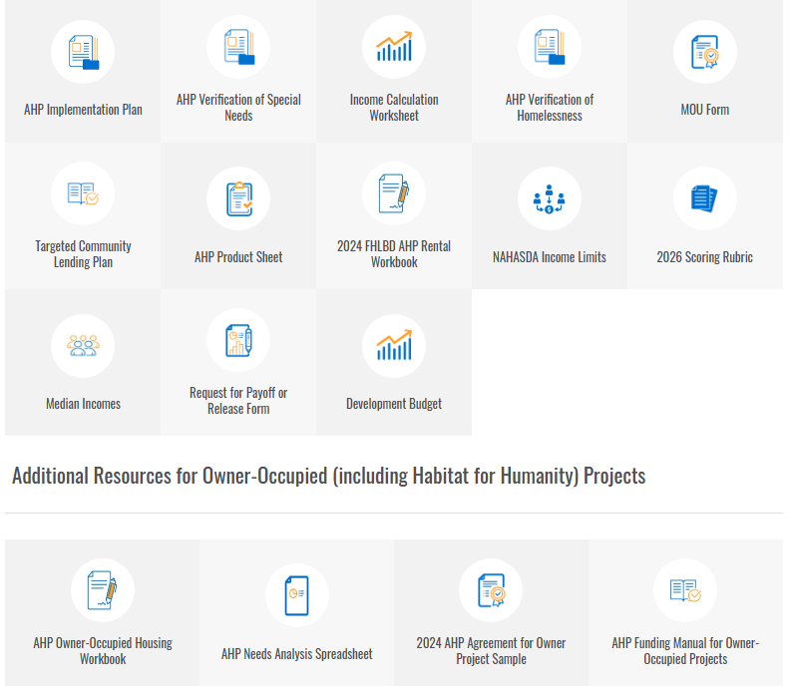
Resources
Additional Resources are located on the
AHP webpage

Slide 17
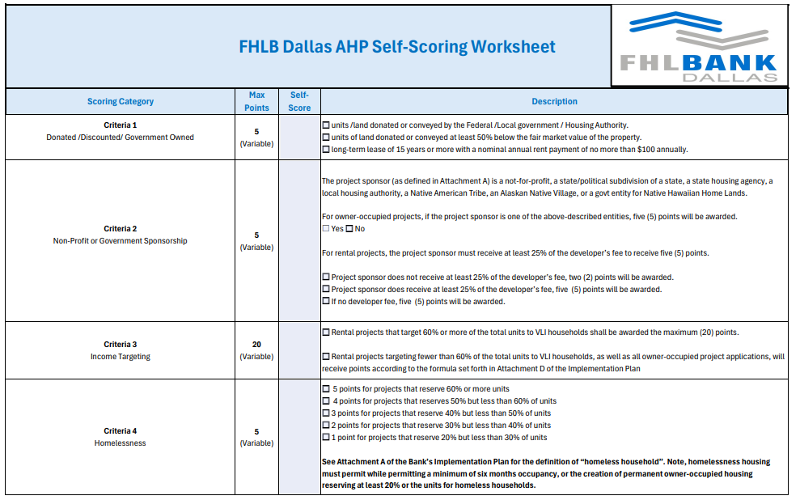
2026 Scoring Rubric (Self- Scoring Worksheet)

Slide 18
Donated / Conveyed Property
Units or land donated/conveyed by the federal government instrumentality or unrelated entity (at least 20% of units); or
Property conveyed significantly below market value, meaning it is transferred for 50% or less of fair market value, by an unrelated party
Key Points:
Donated or conveyed by an entity not related to or affiliated with the member, project sponsor or project owner through ownership or control with the exception of property owned and donated by a Housing Authority, City or County and meeting all other conditions of this criterion.
Evidence of donation should be included with application (i.e., transfer deed, purchase agreement or letter of intent)

Slide 19
Not-for-Profit/Government Sponsorship
Project Sponsor means a not-for-profit or for-profit organization or public entity that is integrally involved in an owner-occupied project.
5 points – All Projects
Housing finance agencies
Housing authorities
Not-for-profit entities
Government agencies
Native American Tribes

Slide 20
Income Targeting
The extent to which a project creates housing for very low- and low- or moderate-income households
Very low-income (VLI) units (i.e., less than or equal to 50% of the area median income or AMI) will be weighted at five (5) points.
Low-income (LI) unit (greater than 50% but less than or equal to 60% AMI) will be weighted at three (3) points.
Moderate-income (MOD) unit (greater than 60% but less than or equal to 80% AMI) will be weighted at one (1) point.
Maximum = 20 points
The larger the percentage of VLI households within a project…
…the higher the score.
Every $250 per unit increase over $15,000 decreases score by 0.125 points

Slide 21
Creating Economic Opportunity
Programs/services assisting residents in attaining life skills or better economic opportunities
Empowerment Services
Employment
Homebuyer Counseling/Education (DPA Projects)
Homeowner Maintenance & Counseling/Education (Rehab projects)
Onsite daycare services (child or adult)
Sweat Equity - New Construction Projects only (minimum of 300 hours per home)
After school or out-of-school services
Workforce preparation and integration
Mental and behavioral health services
Scoring
1 service = 3 pts
2 services = 5 pts
Memorandum of Understanding (MOU) is required for each empowerment service – format located on Bank’s Website

Slide 22
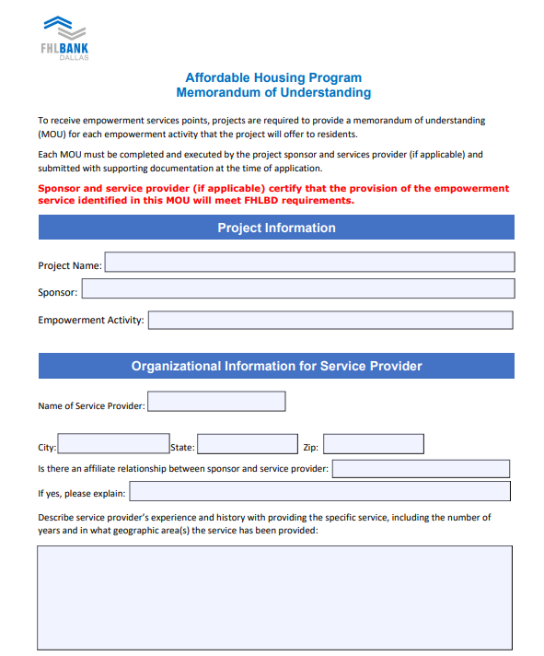
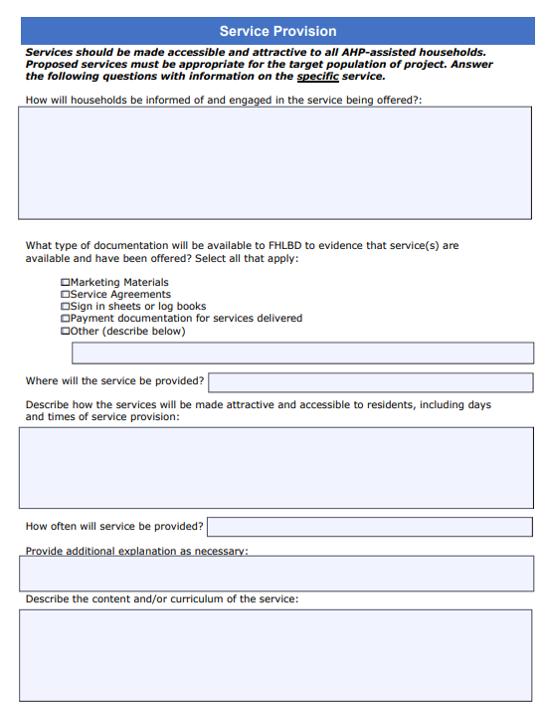
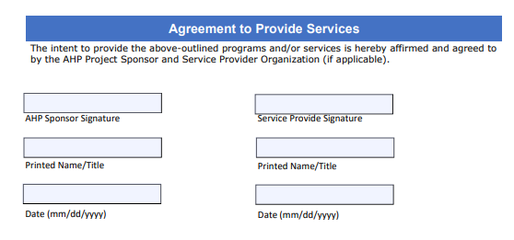
Creating Economic Opportunity - MOU

Slide 23
Underserved Communities and Populations
Special Needs Housing- 5 pts
Households with elderly
Persons with disabilities
Persons recovering from physical/alcohol/drug abuse
Persons with HIV/AIDS
Formerly incarcerated persons
Victims of domestic/dating violence/sexual assault
Unaccompanied youth
Special Needs points
20% to 29% = 1 pt.
30% to 39% = 2 pts
40% to 49% = 3 pts
50% to 59% = 4 pts
> 60%= 5 pts
Rural Housing – 5 pts
An area eligible for USDA Rural Development housing programs.
USDA property eligibility can be found here
Rural Points
Variable points - number of units located in a rural area divided by total number of units
For special needs please ensure your supporting documents show how the project will qualify someone meeting CID’s definition.
FHLB Dallas template now available

Slide 24
Community Stability
Adaptive Reuse - Converting an existing non-housing structure into housing
New Construction - Project is 100% new construction
Rehabilitating Properties - 50% of the units or square footage are vacant, abandoned or foreclosed and are being rehabilitated
Demo of Properties - 20% of the units are new construction in place of demolished structures (do not include ancillary structures)
Projects can receive points for 3 of the top 4 categories for 3 points each (totaling 9)

Slide 25
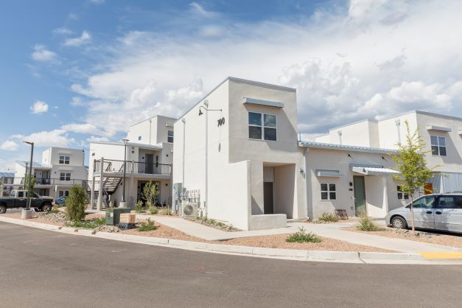
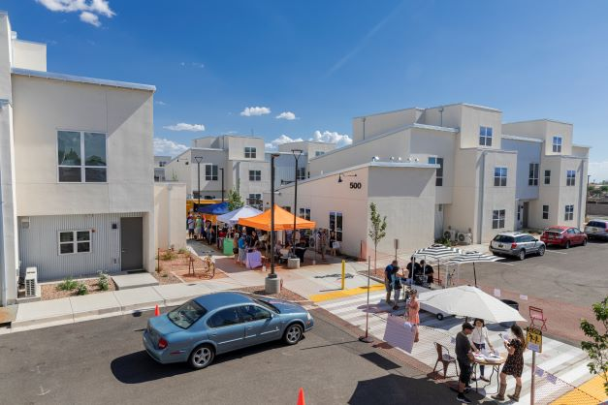
Bank District Priority
First-time homebuyers - 5 pts
50% - 2.5 pts
100% - 5 pts
Units located within District - 8 pts
Units located in Arkansas/New Mexico – 8 pts
Units located in Louisiana/Mississippi/Texas – 5 pts
Units located out of district – 0 pts
For multi-state scattered site projects:
(Louisiana units + Mississippi units + Texas units/total units * 5) + (Arkansas + New Mexico units/total units)* 8
Climate Resilient Building Standards- 7 pts
Subsidy Per Targeted Unit – 5 pts
Native Housing Projects – 5 pts

Slide 26
Bank District Priority – Cont’d
Climate Resilient & Green Housing
Scoring based on the type of resilient housing certification achieved. Emphasis on constructing units that will better withstand potential natural disasters as well as conserve energy and use sustainable materials as required by achieving one of the designations below:
FORTIFIED: Multifamily, Gold (7 Pts)
FORTIFIED: Silver
Enterprise Green Communities Criteria
Leadership in Energy and Environmental Design (LEED)
ICC/ASHRAE ‐ 700 National Green Building Standard (NGBS)
HERS Rating: 65 or less for Rehab; 55 or less for New Construction
FORTIFIED: Roof
Energy Star Certified Home/Building (3 Pts)
(5 Pts)

Slide 27
GrantConnect
GrantConnect is the home of the AHP application

Slide 28
GrantConnect
What is GrantConnect?
The online portal where applications are completed and submitted for consideration for an AHP subsidy as well as HELP, SNAP and DRA request.
Key Points
GrantConnect is the place where sponsors/consultants must have a User ID and password.
It requires first-time users to register before being able to complete an application.
AHP Application Open from March 31st - April 30th

Slide 29
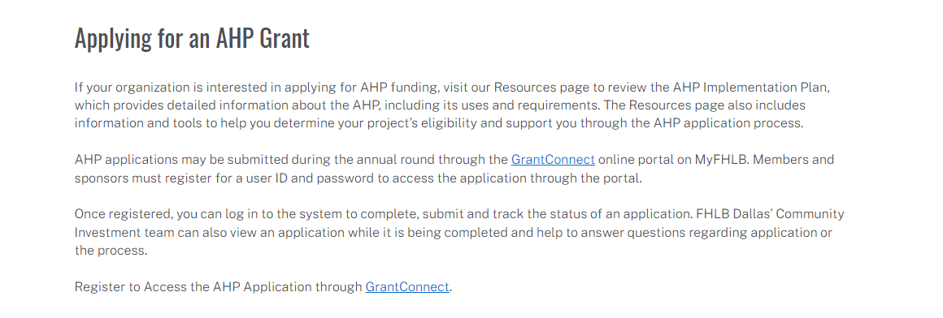
Registration and Access
*GrantConnect is the home of the AHP application
*Go to https://app.fhlb.com/grantconnect to begin

Slide 30
Register through GrantConnect – Key Points
All Users
Need a username/profile
All users and their profiles need to be affiliated with an organization in our system
It is imperative that all users are affiliated with the correct organization
Sponsors
First time users will create a User ID/Password and affiliate with a new or existing organization
If you created a User ID or used AHP Online in previous AHP rounds, do not create a new User ID. Call FHLB Dallas first
Consultant
Non-Sponsor = Consultant
All first-time non-sponsors users will create a User ID/Password and affiliate with a new or existing organization
If you created a non-sponsor User ID or used AHP Online in previous AHP rounds, do not create a new User ID. Call FHLB Dallas first
All non-sponsors need to be affiliated with their own organization distinct from the sponsor
Members
Must have a user ID and password
Cannot access application without PIN
After registering, log in to the system with your user ID and password during the application round.
The initiator will create the application PIN.
The application PIN will need to be shared with each party to complete, submit and track the status of the application.
The member, sponsor and FHLB Dallas’ Community Investment department can view an application at the same time while it is being completed online.

Slide 31
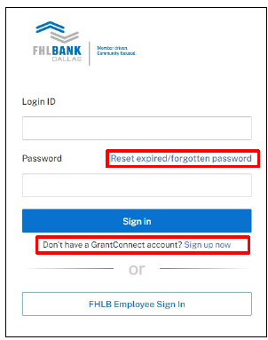
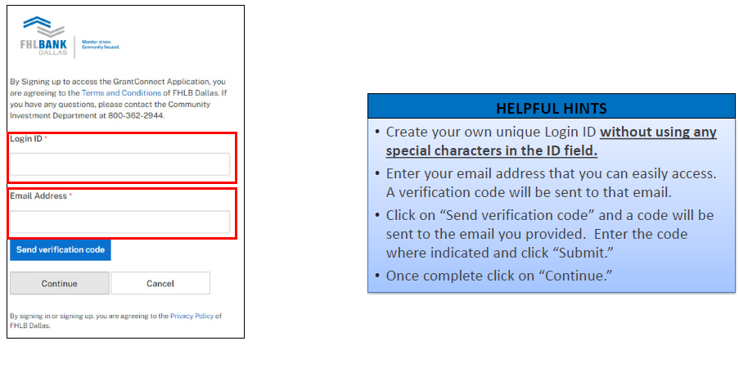
Registering as a Sponsor/Consultant
Use Chrome or Edge Browser
GrantConnect requires multifactor authentication using either a direct-dial phone line phone (cannot be an extension), cell or an authenticator app on your phone.
Registration approval can take up to 24 hours
Call 1-800-362-2944

Slide 32
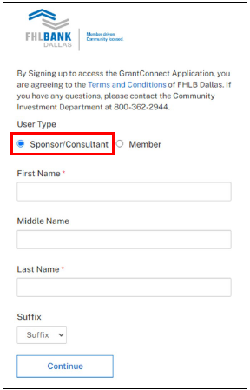
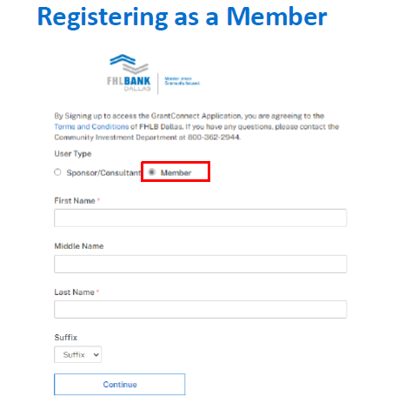
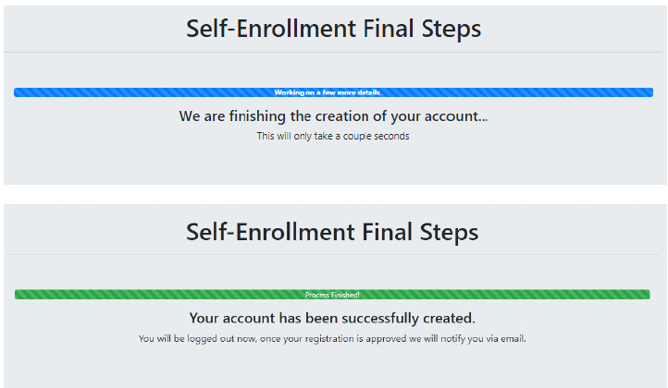
GrantConnect Registration -

Slide 33

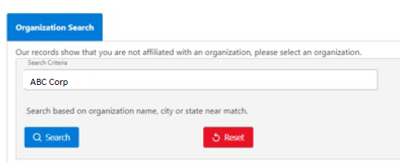
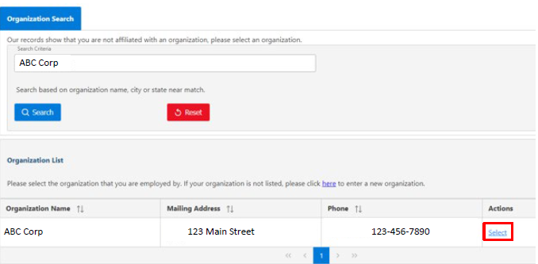
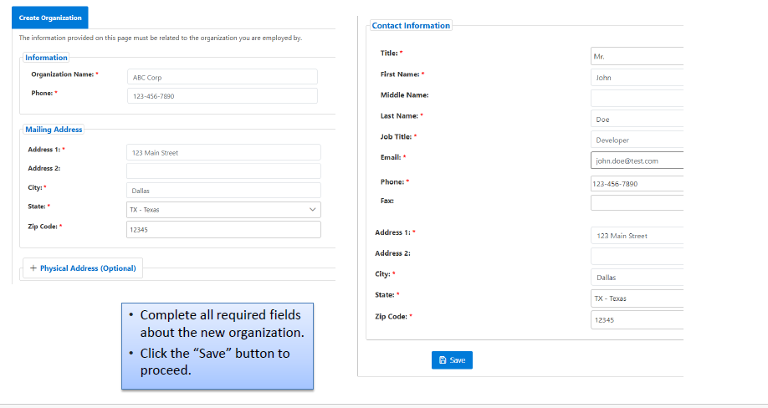
Registering as a Sponsor/Consultant
1-2 business days for processing. Notified Via Email upon completion

Slide 34
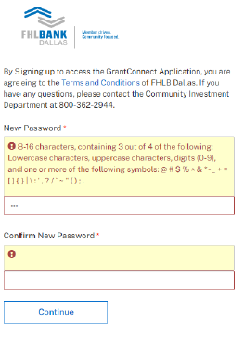
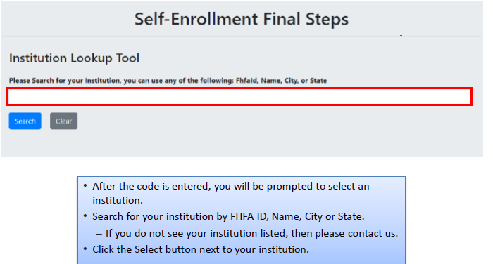
Member Registration
1-2 business days for processing. Notified Via Email upon completion

Slide 35
GrantConnect Program Access
Members
AHP General Fund
HELP
SNAP
DRA
Sponsors, Consultants, Intermediaries
AHP General Fund

Slide 36
GrantConnect - Recap
Consultant
AHP applications created by a consultant will need to be approved by the sponsor
Non-Sponsor = Consultant
All non-sponsors need to register as well
Sponsors
First time users will create a User ID/Password and affiliate with a new or existing organization
If you created a User ID or used AHP Online in previous AHP Rounds, do not create a new User ID call us first
Members
Must have a user ID and password to access the application through the GrantConnect portal.
Everyone
Once you have registered, log on to the system with your user ID and password during the application round. You may use the application PIN to complete, submit and track the status of your application.

Slide 37


2026 Homebuyer Equity Leverage Partnership (HELP)
Application Window Opens January 2, 2026
Notes:
Good Morning, my name is Diane Sell with Federal Home Loan Banks Community Investment Dept.
I would like to thank you for joining our 2026 Homebuyer Equity Leverage Partnership webinar today.
As we go through this presentation, we will offer you the opportunity to place your questions in the chat. We have staff on hand to answers these questions as they come up.
We will also be offering these slides upon request, so please send us an email at ahp@fhlb.com requesting a copy to be emailed to you.
This recorded presentation will also be available to you on our website in the upcoming weeks.

Slide 38
2026 Program Specifics
Provides down payment & closing cost assistance for qualified, first-time homebuyers on a first-come, first-served basis. All U.S. property locations are eligible.
Program Allocations:
2026 Allocation: $17 Million available
Until exhausted or December 31, 2026
2026 Allocation Offerings
20% of the allocation available per offering:
January 2nd
April 6th
May 4th
June 15th
September 8th
Individual Caps:
$20,000 per household - AR, LA, MS and outside FHLB Dallas District
$25,000 per household - NM and Texas
Member Caps:
Member Cap: $150,000 per offering
Annual out of district cap: $375,000
New in 2026: First Mortgage must be originated by member institution, wholly-owned subsidiary of member, a government entity, or 501c3 Non-profit organization (Habitat, etc.).
Notes:
The Member cap will be 150K per offering and it will not roll over into subsequent offerings.
Funding will be available on a first-come, first-served basis at the beginning of each allocation offering,.

Slide 39
Borrower Eligibility Requirements:
First-Time Homebuyer
Household gross Income is below 80% Area Median Income
At Least $500 Homebuyer Contribution
Completed Homebuyer Counseling Course
Applies to and must be signed by all borrowers listed on closing disclosure
Homebuyers $500 Contribution must come from borrowers own funds.
Homebuyer is not allowed to receive “cash back” at closing.
HELP Funds cannot be used to paydown debts.

Slide 40
Required Documents and Review Process

Slide 41
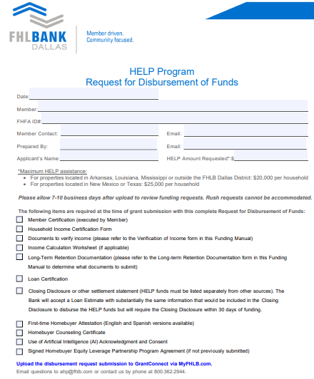
Requested amount must match the amount listed on the Loan Estimate or Closing Disclosure
Please Note:
The 7-10 business day review times depend on completeness of request.
We cannot guarantee the turnaround time if the request is missing required documentation or has significant deficiencies.
Required
Artificial Intelligence (AI) Acknowledgement and Consent Form

Slide 42
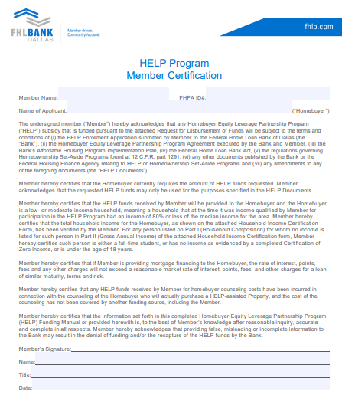
Member signer must have AHP or Advances Authorization

Slide 43
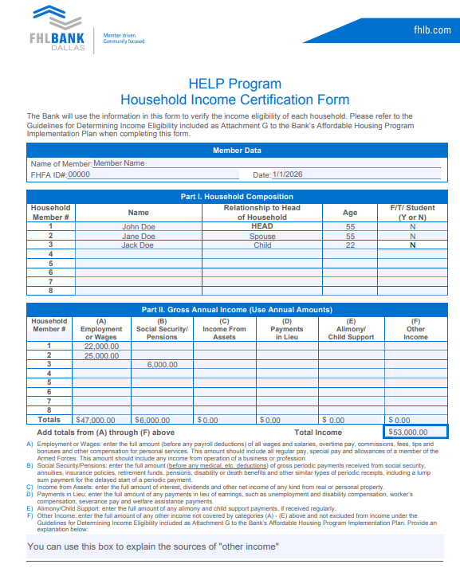
All individuals who will be permanent residents of the household must be included on this form
(AI) Acknowledgement and Consent form adults (18+)
There must be income documents supporting all adults (18+) listed who are not full-time students
The Household Income Certification Form is a required document for all FHLB Owner Occupied related programs

Slide 44
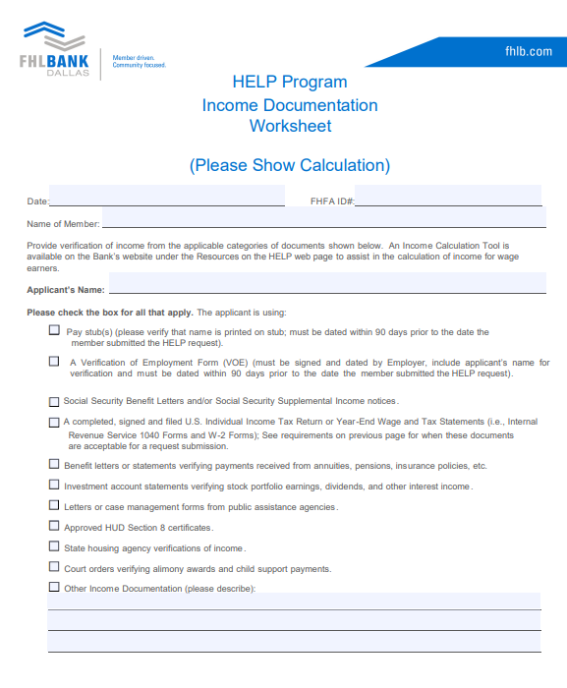
This form highlights the income documentation for each person living in the home
Submit the associated income documentation for us to cross-reference
The Income Documentation Worksheet is a required document for all FHLB Owner Occupied related programs

Slide 45
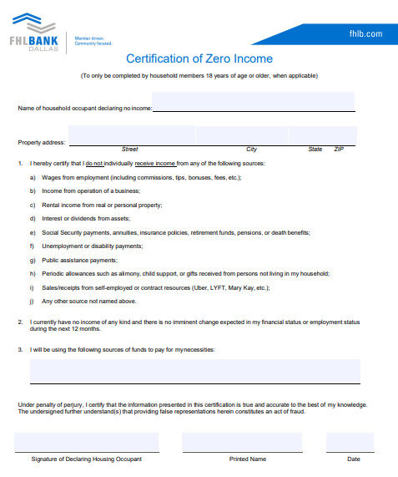
Certification of Zero Income
Submit the fully completed document for each household member with zero income as outlined below:
Individuals of the household:
18 years and older who are not a full-time student.
That have no source of income as outlined on form.
Funding Manual includes a version of the document in Spanish

Slide 46
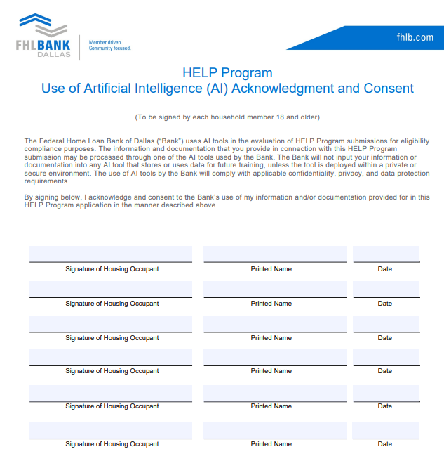
REQUIRED
Authorizes AI in the processing of applications
Unable to review until received
All Individuals listed on HIC and who will provide documents pertaining to the submission
Adults 18+
Notes:
or the 2026 funding cycle, the program is using AI technology to assist with reading and reviewing application documents. This update introduced a new compliance requirement:
AI Acknowledgment and Consent Form Each HELP application must include a signed Artificial Intelligence (AI) Acknowledgment and Consent Form from all adult household members. This form authorizes the use of AI in pr

Slide 47
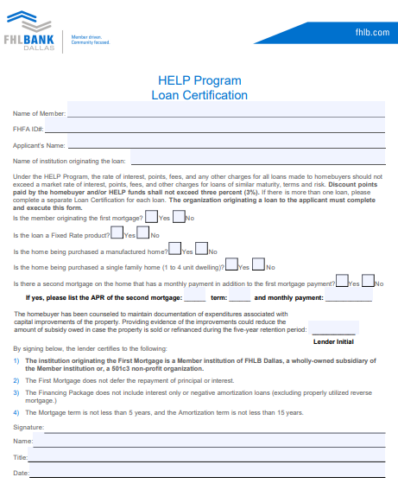
This form should be filled out and signed by a representative from the originating institution.
First Mortgage must be originated by member institution, wholly-owned subsidiary of member, or 501c3 Non-profit organization (Habitat, etc.)
Discount Points shall not exceed (3%)
Please read each line and check the appropriate boxes.
Check “Yes” and fill out the applicable information related to a second mortgage only if the second mortgage has a monthly payment in addition to the first mortgage payment.
Ensure the lender initials are filled out and signed below.

Slide 48
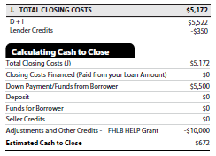
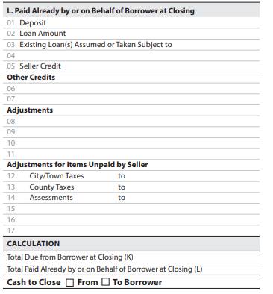
Draft Closing Disclosure/Loan Estimate
Loan Estimate
Closing Disclosure
$107,925.99
$97,700
FHLB HELP Grant
$10,000
01/01/23 08/31/23
$225.99
The FHLB HELP Grant and amount must be clearly labeled
Include all other grants and loans (terms of loans must be included on Loan Certification)
$108,597.80
$107,925.99
X
$671.81
Homebuyer cannot receive cashback at closing
Homebuyer contribution must be at least $500

Slide 49
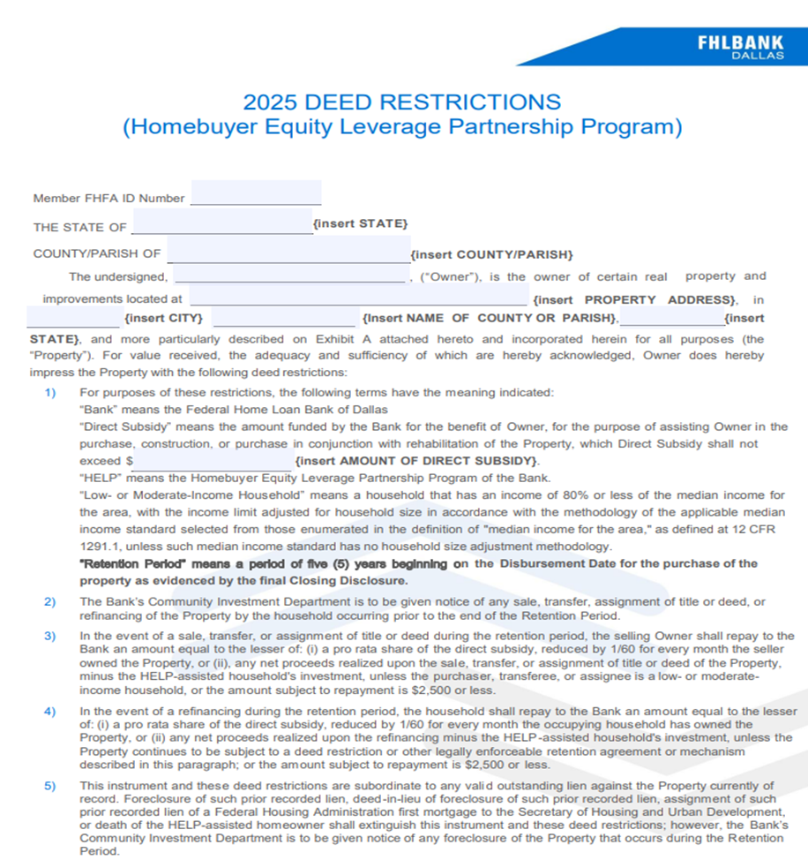
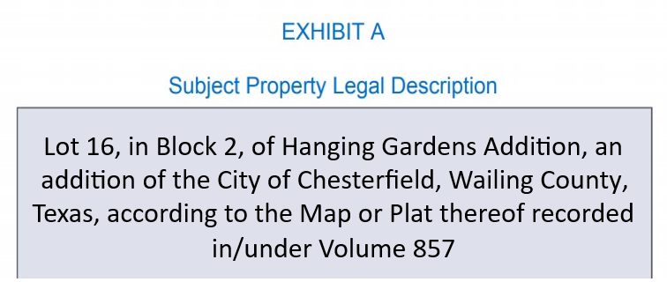
Please use the current year deed restriction document.
All fields and the Exhibit A should be filled in at the time of request.
The retention period will begin on the loan disbursement date of the purchased property.
Do not record prior to receiving the grant
***Submit the Draft with the funding request***
Households should maintain all documentation of any capital home improvements during the length of the retention period.
Notes:
prior to closing.

Slide 50
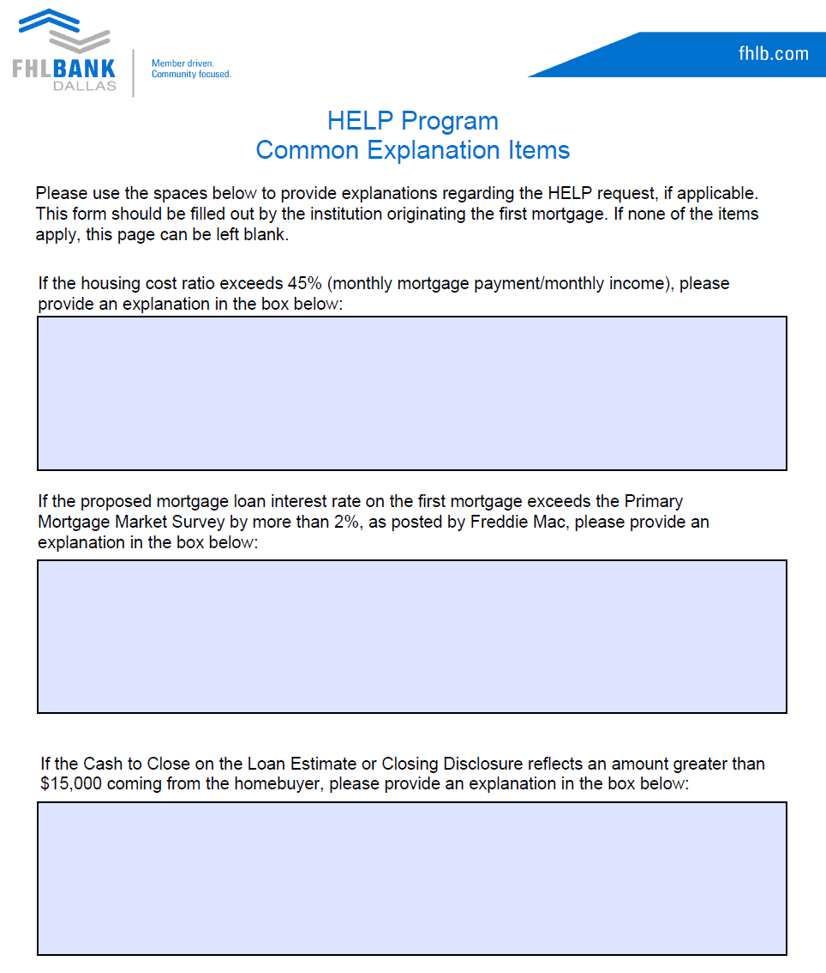
If any criteria are applicable, please provide an explanation with the submitted request.
“They are currently paying a similar amount in rent”
“They have no debt, and the homebuyer is comfortable with the amount”
“The homebuyer has been saving specifically for this purchase
Higher rate due to borrower credit score
Primary Mortgage Market Survey can be found at www.freddiemac.com/pmms
“Cash to Close” greater than $15,000 and not paid by another source
Borrower savings

Slide 51
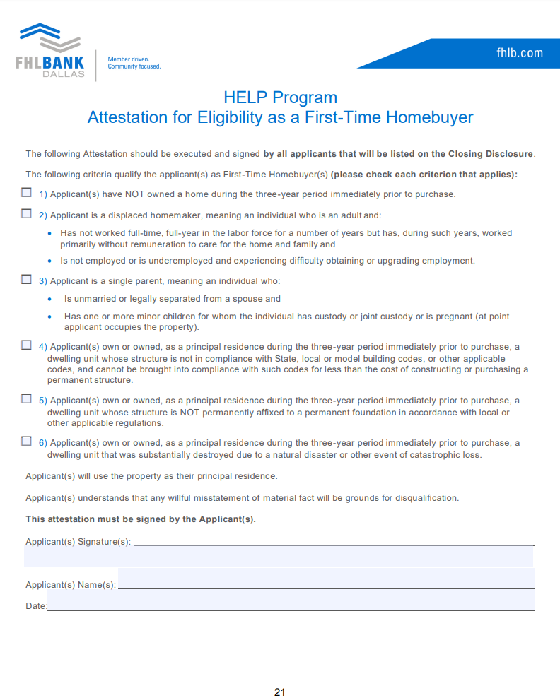
Please ensure at least one of the applicable criteria is checked, and the form is signed and dated.
All applicants who are listed on the Closing Disclosure must meet at least one of the criteria and sign this document.
Spanish version also available. You can submit the version the borrower is most comfortable with.

Slide 52
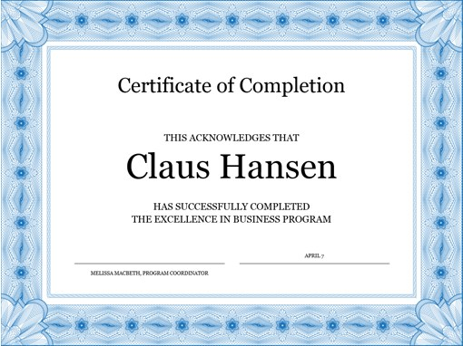
Homeownership Counseling Certificate
Must provide a copy of a homeowner counseling completion certificate from
an industry- accepted curriculum provider
FHLB does not have a preferred counseling program
Please refer to HUD’s approved listing of courses for guidance
Up to $500 of HELP funds may be used for counseling cost
Members can reimburse nonprofits who are providing the counseling
Should be listed on the Closing Disclosure
Up to $500 of HELP funds may be used for counseling costs
Members can reimburse nonprofits who are providing the counseling
Should be listed on the Closing Disclosure
Billy Thompson
HAS SUCCESSFULLY COMPLETED HOMEOWNERSHIP EDUCATION

Slide 53
HELP Final Documents
We require two documents to be submitted after the disbursement of funds and closing of the home
Signed Final Closing Disclosure:
Recorded Deed Restriction:
Due within 30 days of the disbursement of HELP funds to the member's DDA
Due within 60 days of the disbursement of HELP funds to the member's DDA
The HELP Grant and amount must be clearly labeled
The deed restriction must be entirely filled out, including the Legal Description of the property.
No cash back to the borrower(s)
The deed restriction must be recorded with the county officials where the property is located
Grant funds cannot be used to paydown or payoff any outside debts.
Evidence of recording must be included on the submitted document
Homebuyer contribution must be at least $500 (cash to close, as a deposit or buyers closing cost POCs)
Any errors included on the recorded document will require correction where additional cost will be incurred by the member or responsible party.
Must include Disbursement Date of the loan
Notes:
.

Slide 54
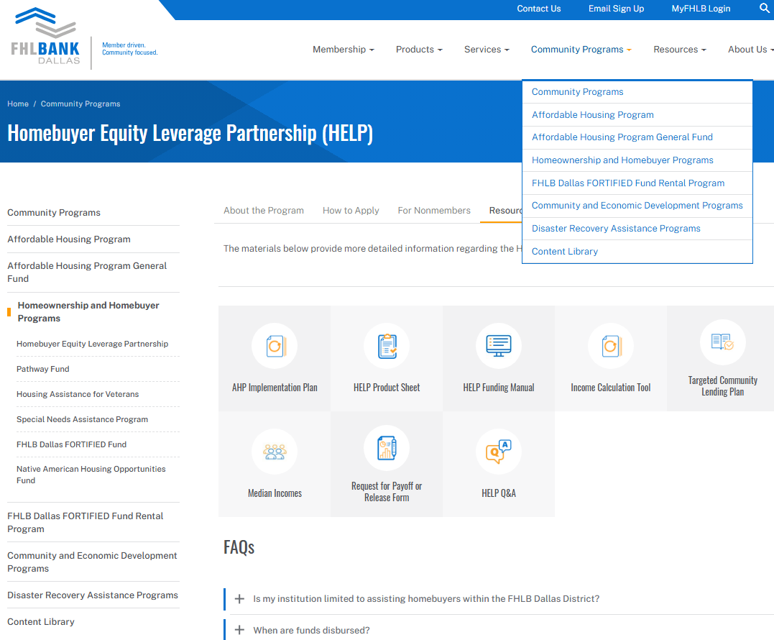
2026 Key Documents and Resources
The 2026 Funding Manuals can be found on fhlb.com
Frequently Asked Questions
Q&A
HELP
SNAP
Full recorded webinars available on each program page
DRA

Slide 55
HELP Summary on Successful File Submissions
Funding available January, April, May, June, September
Conduct an internal 2nd reviewer of a completed funding request prior to submitting. Ensure the checklist found on page 9 is utilized
Upload fully executed Funding Manual with all supporting documentation to GrantConnect
Executed Use of Artificial Intelligence (AI) Acknowledgment and Consent Form (18+)
Funds get disbursed to the Member’s DDA with FHLB Dallas
Within 30 days post-funding, upload the Final CD**
Within 60 days post-funding, upload a copy of recorded Deed Restriction with legal description**
Record the Deed Restriction as a separate & single document. If not, the document will need to be corrected, and additional fees will incur.
**Failure to provide final documents within approximately 30 and 60 days may delay future funding requests.
Notes:
If you are not sure if you are enrolled, please email us at ahp@fhlb.com to confirm

Slide 56
Income Calculation

Slide 57
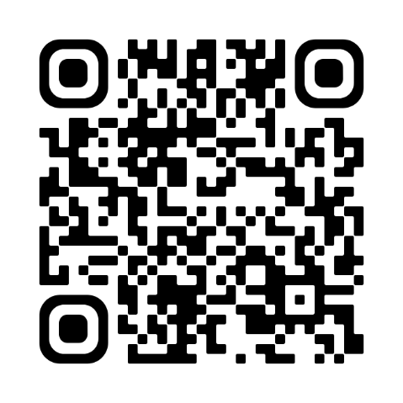

Income Calculations / Training Presentation link
1. Obtain current applicable income documentation
2. Calculate annual household income
3. Validate that the Area median total household income Is = or < 80% AMI
Access this QR code to review a complete training presentation on income calculation for all our grant programs:
Or access the video on our website:
Go to FHLB.com
Resources
Video Library
Webinars and Tutorials
Income Calculation Tool
Understanding AMI calculations is a key element of participation in all grant programs.

Slide 58
Questions?

Slide 59
FORTIFIED Fund 2026 Grant Program

Slide 60

Program Overview
FHLB Dallas supports the replacement of FORTIFIED Roofs through a $10,000,000 allocation to the FORTIFIED Fund
FORTIFIED Standards are resilient building codes developed by the Insurance Institute for Business & Home Safety (IBHS)
Grant amounts (maximum):
$17,000/household for existing roof replacements
Household requirements:
Owner-occupied
At or below 120% of the Area Median Income
In FHLB Dallas’ District: AR, LA, NM, MS, TX

Slide 61
Program Updates for 2026
Application size: Requests of up to $500,000 for a minimum of 5 up to 50 households per application
Contractors: As of November 1, 2025, IBHS requires contractors be FORTIFIED certified. Evidence of the contractor certification will be required as part of the disbursement request.
Intermediaries: Definition has been updated for 2026.
Household: Rehab of existing roofs only in 2026, amount available per household increased to $17,000.

Slide 62
Intermediaries
Intermediary organizations can assist Members in the sourcing & coordination of applications.
Intermediary means an IRS-established 501(c)(3) nonprofit organization, government entity, or tribal entity that works with a member institution to facilitate grant applications for the Bank’s Homeownership Set-Aside programs and applicable Voluntary programs. The Intermediary must be current on filing and paid all tax obligations to participate in any program.
FHLB Dallas reserves the right to request a copy of the 501c3 letter and/or additional supporting documentation related to the intermediary.
Intermediaries can receive a maximum fee of $1,000/household
$1,000 counts towards the $17,000/household maximum
*All information required for the application must be verified by the Member Institution. Members are responsible for ensuring intermediaries follow program guidelines*

Slide 63

FORTIFIED Fund Grant Programs – Evaluators
FORTIFIED Evaluators are trained and certified professionals that submit required documentation to IBHS to obtain a FORTIFIED designation.
Evaluator/Inspection Fees
Fees vary based on home size, scope of work, and factors like travel costs
A portion of the grant may be used to pay for these fees
Evaluators can be found by Googling “Fortified Evaluators” or by visiting this direct link: https://ibhs.my.site.com/s/find-a-provider

Slide 64

Offerings & Application Size
Applications will be accepted over two offerings in 2026 with $5 million available per offering:
January 26 (first offering funding is exhausted)
July 1 through December 31
Or until funds are exhausted
Application size:
Up to $500,000 of requested funds
Minimum of 5, up to maximum of 50 households

Slide 65
Caps
2026 annual limit per Member: $1,000,000
If a Member self-facilitates an application with no Intermediary, the Member may only have one “active” application at a time. Each application must be completed with all FORTIFIED Certificates received before submitting a new application.
If a member is working with multiple Intermediaries, the member may have multiple Intermediary-facilitated applications at the same time.
2026 annual limit per Intermediary: $1,000,000
Intermediaries may only have one “active” application at a time. Each application must be completed with all FORTIFIED Certificates received before submitting a new application.
An intermediary may work with multiple members but, may only have one “active” application at a time – an application through one member must be completed with all certificates received before submitting a new application through a different member.
Key Takeaway: The facilitator of the application may only have one active application at a time.

Slide 66
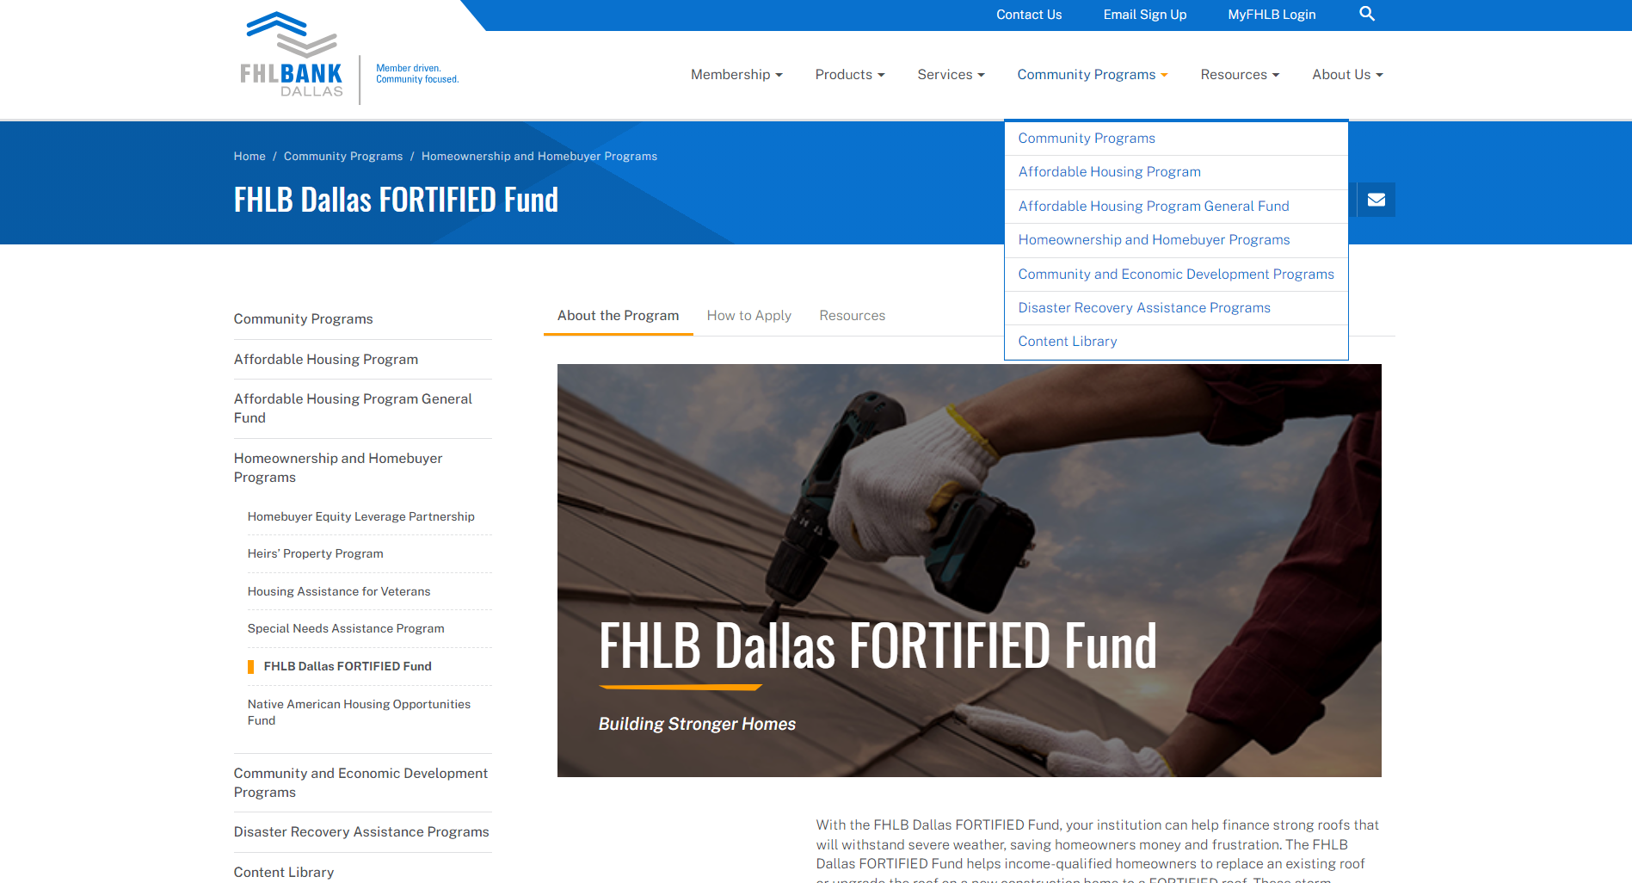
Application Materials
Materials can be found on FHLB.com
Select Community Programs > Homeownership and Homebuyer Programs > FHLB Dallas FORTIFIED Fund > Resources

Slide 67
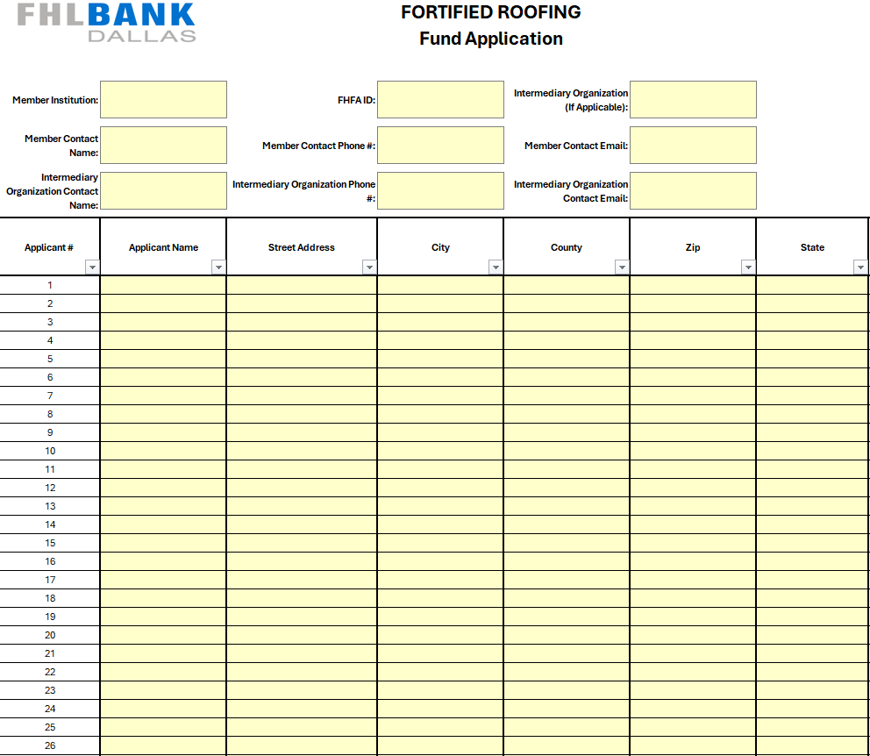

Slide 68
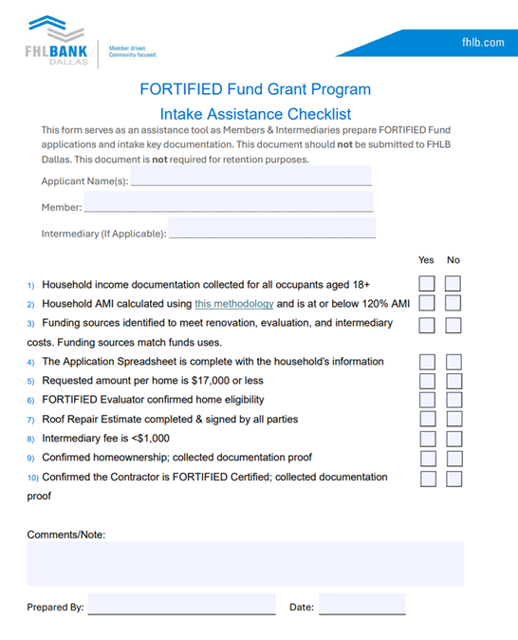
Filling Out the User Guide
The User Guide must be filled out for each household and documentation must be retained by the member for two years. Please do not submit the User Guides with the application spreadsheet. FHLB Dallas will request a sample of households from the spreadsheet. Completed User Guides for the sampled households will be submitted at that time.
Intake Assistance Checklist:
This document provides a snapshot of key information
Use the checklist items to ensure application completion

Slide 69
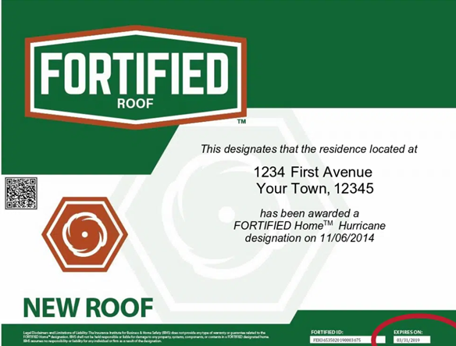
Program Process
Identify and verify applicants
Collect documentation
Fill out and submit the FORTIFIED Fund Application Spreadsheet
Review & fund
FHLB Dallas will send an AdobeSign agreement and request a sample of households to review
Facilitate renovation
Collect FORTIFIED Certifications
Submit final documents upon project completion
Review & close out application

Slide 70
Questions?
You can find additional information & grant programs at fhlb.com
Contact Us!
By Email:
fortifiedfund@fhlb.com
By Phone:
800.362.2944

Slide 71
2026 Partnership Grant Program

Slide 72
Program Overview
Developed in 1996 to provide funding for the operational needs of community-based organizations (CBOs) in our five-state District of Arkansas, Louisiana, Mississippi, New Mexico and Texas
Designed to complement the development activities currently fostered by the Affordable Housing Program (AHP), Community Investment Program (CIP) and Economic Development Program (EDP)
CBOs must be involved with affordable housing, stimulating small business development or providing small business technical assistance
$1,500,000 has been allocated for the 30-year anniversary (2026) of the Partnership Grant Program.
Notes:
27 years ago, FHLB Dallas created the Partnership Grant Program to support community-based organizations in our district. The FHLB Dallas district includes the states of Arkansas, Louisiana, Mississippi, New Mexico and Texas. The Partnership grant program is intended to complement the types of activities supported by the Bank’s Affordable Housing Program and community advance programs. Through the bank’s affordable housing program or AHP, we subsidize the costs for the acquisition, rehabilitation, or construction of housing for low-to-moderate income households. However, the AHP cannot be used to pay for the operational needs of community-based organizations that develop such housing or provide related services. Instead of the AHP, members can apply for these organizations to receive assistance for their operating and administrative needs through the Partnership Grant program. To qualify, the organization must be involved with affordable housing or economic development, like stimulating small businesses or providing small businesses technical assistance. The Bank has allocated $400,000 for the program this year.

Slide 73
Grant Amount
5:1 match of the member’s cash contribution of $500 - $5,000 to the CBO.
FHLB Dallas will grant up to $25,000 to any one member/CBO application.
The maximum FHLB Dallas contribution to any one CBO is $50,000.
CBOs may partner with multiple members and members are allowed to support multiple CBOs.
2026 PGP Allocation is $1,500,000
Member contribution must be made in 2026. At the time of application, FHLB Dallas will accept a commitment from the member.
Notes:
FHLB will triple member contributions up to $12,000 per application. For example, a member contribution of $1,000 can be matched up to $3,000 which would provide a total of $4,000 to the CBO. If the member contributes MORE than $4,000, just know that the maximum FHLB can contribute is $12,000 per member/cbo application. Sometimes multiple members will contribute to the same organization. We welcome this and love to see multiple members come together through this program to support an organization in their community. The maximum any single CBO can receive when multiple members submit applications on their behalf is $24,000. In all cases, the most a single CBO can receive through the Partnership Grant is $60,000. Some of you may recall that we did a special PGP offering in response to the COVID-19 pandemic in 2020. Any Partnership grants that the CBO received during 2020 will not count towards this lifetime cap. If you aren’t sure about how much an organization has received, then please reach out to us and we’ll be happy to research that for you. All contributions must be made in the 2023 calendar year. Commitments from the member are acceptable at the time of application if the contribution has not been made yet.

Slide 74
Benefits to Members
Positive Community Relations
Achieve Community Investment Goals & CRA Outcomes
Strengthen the Relationship with Partner CBOs
Assist Underserved Communities
Maximize FHLB Dallas Membership
Notes:
This program provides many benefits to members. At the center, it helps to strengthen the member’s relationship with partner non-profit organizations in the community. The PGP is a matching grant program, so it provides a way for members to multiply their charitable contributions to make a larger impact and do good. This is great for community relations of course. If your application is selected for the grant, then our communications group can work with you and your marketing team to get the word out. This is achieved through press releases, check presentations, and media advisories, among other means of advertisement. These activities help to deepen the connection between your institution, the CBO and community. By financially supporting CBOs through the PGP, your institution will help to expand services and economic opportunity to underserved communities. Participation in the PGP can be used to achieve your institution’s CRA objectives. In short, please use this opportunity to maximize your membership with FHLB Dallas and support eligible CBOs.

Slide 75
CBO Eligibility Requirements
Nonprofit Organizations or Native American Tribes
Demonstrated through an IRS 501 (c)(3) designation
Located in the FHLB Dallas District
For federally recognized tribes (TDHEs), demonstrated via an IRS determination letter that your organization is a tribal government entity or Tribal Resolution
Involved with Affordable Housing or Economic Development
The CBO must be involved in affordable housing, stimulating small business development or providing small business technical assistance
AR, LA, MS, NM, or TX
Total Revenue < $1,000,000
FY2025 tax return (990) preferred
If they have not filed their FY2025 tax return, then we will accept audited financials or a compilation of revenue
Projected revenues for 2026 should not exceed this threshold
Some examples of ineligible CBOs: Food Pantries, Animal Shelters, Municipalities, etc.
Notes:
To qualify, the organization must be legally recognized as a 501(c)3 or tribal entity located in the Dallas district. The services that they provide must be involved with affordable housing or economic development. For example, organizations that rehabilitate homes for the low-income or elderly qualify. Organizations that provide supportive services to the homeless qualify. Organizations that provide first time home buyer education or financial literacy services qualify. Organizations that support Main Street revitalization efforts qualify. Organizations that provide training and business planning services to entrepreneurs qualify. The types of organizations that do not qualify would include food banks, athletic teams or other recreational groups, rotary clubs, girl or boy scouts, and so on. You get the idea. In addition, the total revenues for the organization cannot exceed $600,000. This is evaluated using a combination of the organization’s 2022 actual information and the proposed budget for 2023. We need to see evidence of their 2022 actual revenues. In leiu of the tax return, we can accept audited financials or an unaudited compilation of revenue for 2022. Additionally, projected revenues for 2023 should not exceed the $600,000 threshold.

Slide 76
Use of Funds
Organizational Capacity Building – to offset operation and administration expenses
Assistance in Applying for Grants or other Funding Sources
Research and Studies – for marketing, feasibility and planning studies for affordable housing projects and economic development
Contractual Services – A&E (pre-development costs); legal, accounting and administrative costs (program operating expenses.)
Social Services – to offset costs associated with providing aid and meeting needs of the community such as economic and rental assistance, temporary shelter and housing, and job training.
Notes:
Note: PGP funds may not be used to purchase land or pay for construction materials or construction labor costs.

Slide 77
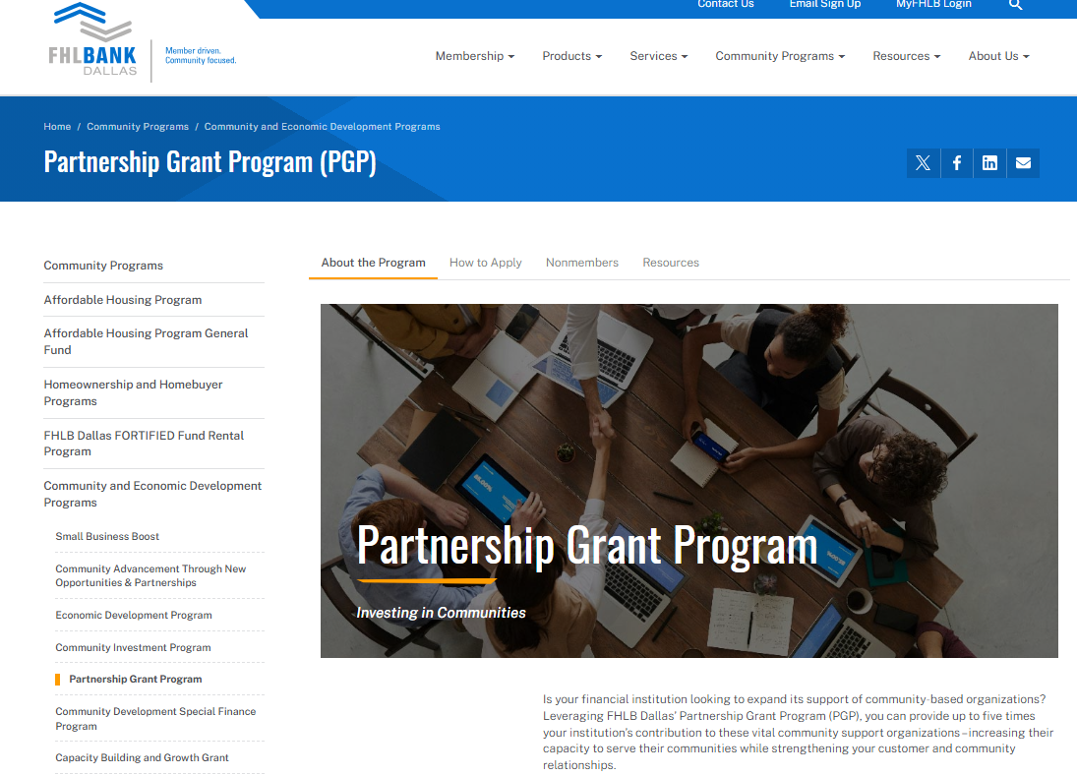
2026 Application
The 2026 PGP Application can be found on fhlb.com

Slide 78
Application Process
Application submission window: April 1 – April 24, 2026
Applications submitted after April 24th will not be considered
Members must submit the application(s) via email to pgp@fhlb.com
Attend our PGP webinar: March 10, 2026
Notes:
Read slide.
Applications from the community-based organization will not be accepted.

Slide 79
For More Information
Questions?
Contact Us!
By Phone: 800.362.2944
By Email: fortifiedfund@fhlb.com
pgp@fhlb.com
Additional information is available online at fhlb.com
Notes:
Please utilize the Community Investment department analysts.
We can see your application as soon as it is in the online portal.

Slide 80

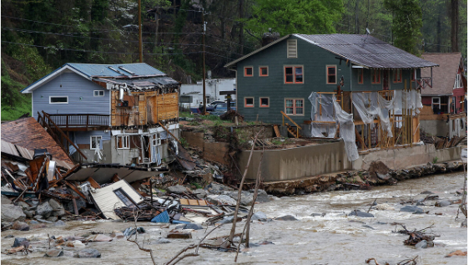
Disaster Rebuilding Assistance (DRA)
First Offering Application Window February 2nd and Second Offering August 3rd

Slide 81
Program Specifics
Provides funding for the repair, rehabilitation, and reconstruction of owner-occupied housing affected by a federally declared disaster for individual assistance
Household at or below 80% AMI
Program Allocation
2026 Allocation:
$3.5 Million
Funds available until exhausted or
Nov. 15, 2026
Two offerings:
February 2 & August 3
Each Homeowner
can receive up to $15,000
Each Member may request $262,500/
Offering*
The property must be in:
AR, LA, MS, NM, TX
*Applications can be submitted from 8am CST on the first day of the offering

Slide 82
Program Updates for 2026
FEMA Disaster Date: Eligible disasters must have been declared since
January 1, 2022
Roof Replacement: If the request is for a roof, a FORTIFIED roof is required unless the structure of the home cannot support a FORTIFIED roof.
DRA funds can be used to pay for evaluator fees for the FORTIFIED roof.
Intermediaries: Definition has been updated for 2026 (both DRA and SNAP).
Member Cap: Unused member cap funds from the first offering will not rollover to the second offering.

Slide 83
Intermediary & Inspection Fees (DRA and SNAP)
New definition in 2026: Intermediary means an IRS established 501c3 nonprofit organization, government entity or tribal entity that works with a member institution to facilitate applications for the Bank’s Homeownership Set-Aside programs and applicable Voluntary programs. The Intermediary must be current on filing and paid all tax obligations to participate in any program.
Intermediary Fee:
Intermediaries can take a fee up to $750/request
Intermediaries serving as the project contractor cannot take an Intermediary fee*
Member institutions cannot take Intermediary fees*
Inspections:
DRA & SNAP funds can cover pre- and post-inspection costs
The 3rd party inspector must be selected by the Member
Contractor invoice required after work is completed

Slide 84
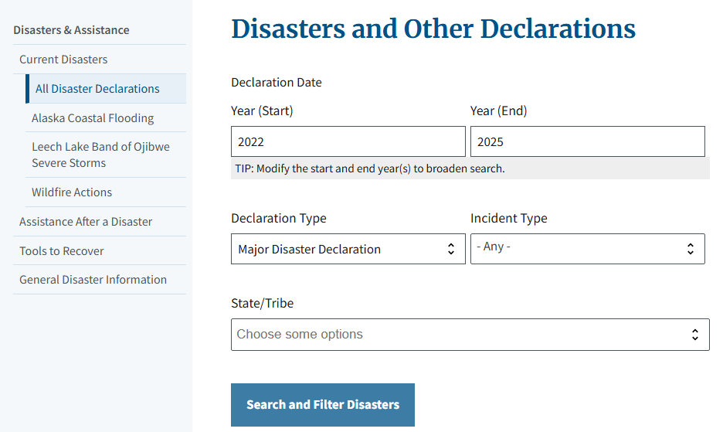
Determining Eligible Disasters
Go to FEMA’s website found here: https://www.fema.gov/disaster/declarations
Choose “Major Disaster Declaration” under Declaration Type and select the appropriate state
Click “Search and Filter Disasters”
Notes:
To determine if the owner occupied property is located in a FEMA Declared disaster area. You can go to FEMAS Website. Fema.gov/disaster/declarations
Choose major disaster declaration and then under declaration type, select the state where the property is located and then select the search and filer disasters button

Slide 85
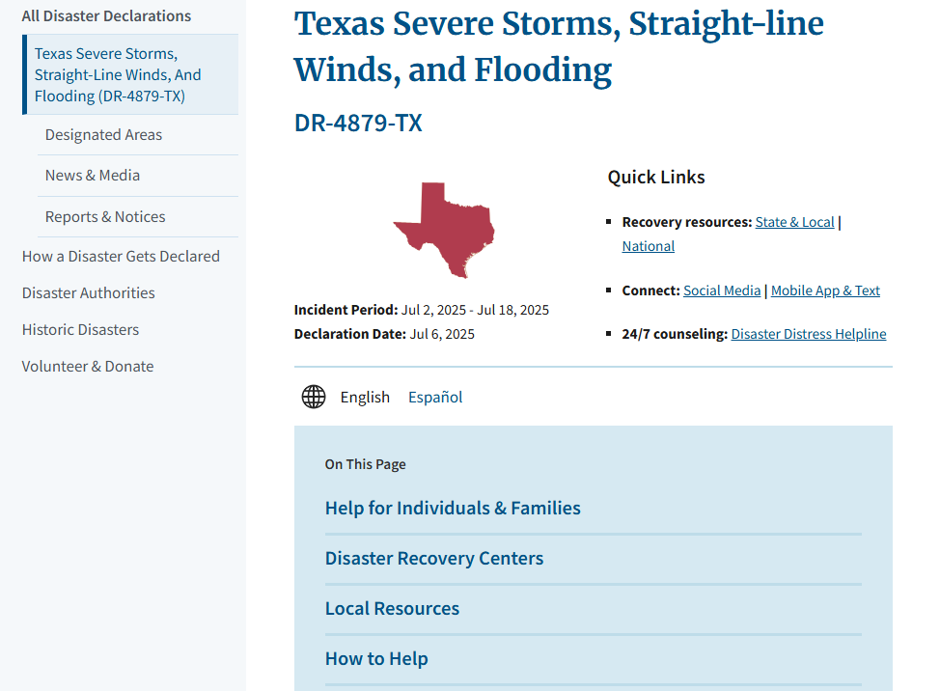
Determining Eligible Disasters - Continued
4. Select the disaster that caused the damage
5. Click on “Designated Areas”
Notes:
You will then select the disaster that caused the damage- then select the designated areas tab to the left

Slide 86
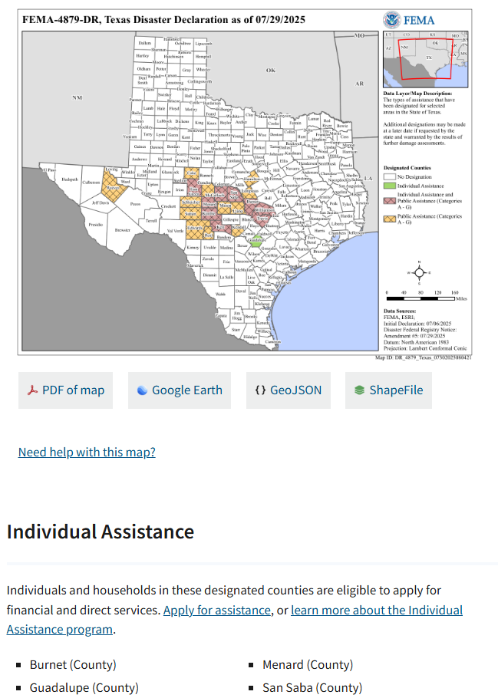
Determining Eligible Disasters - Continued
6. Homes in counties designated for “Individual Assistance” are eligible under the DRA Grant Program
Requested repairs must be related to damages caused by the disaster
Evidence of those repairs must be captured on the pre inspection reports and photos for each submission
Notes:
The owner-occupied properties that are located in the counties designated for ‘Individual Assistance are eligible under our DRA Program!
Please NOTE the requested repairs must be related to damages that are caused by the disaster!

Slide 87
Required Documents and Review Process

Slide 88
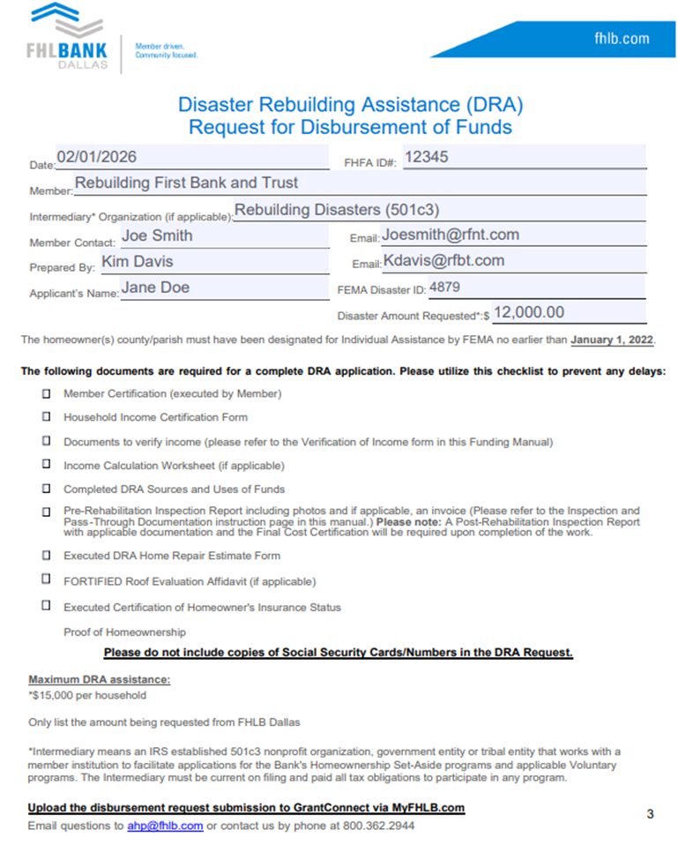
DRA Request for Disbursement of Funds
Please fully execute the Request for Disbursement of Funds. Include the Intermediary Organization, if applicable.
Include the FEMA Disaster ID associated with the request:
https://www.fema.gov/disaster/declarations
Following the checklist will assist in submitting a completed application
*If an Intermediary fee is included in the request, there should be an Intermediary listed on the Request page.
Notes:
A fully executed DRA request for the disbursement of funds form is needed- This form will include a few more items than the HELP Disbursement request.
This disbursement request form is also a checklist for the documents necessary to complete the submission.
It includes date/member bank/ include the intermediary if applicable /Member Contact/who it was prepared by/ The applicant’s name and FEMA disaster ID.
If there is developer fee included in this request, there will need to be an intermediary.
The Cunty or parish must have been designated for individual assistance by FEMA no earlier than January 1, 2019. You can locate the FEMA ID at fema.gov.
The disaster amount requested is only the amount requested by us- The bottom of the form can be utilized as a checklist when submitting the application
Maximum of $15,000
*** Please do not include copies of social security cards and/or numbers on the documentation you submit.
We do not require that confidential information***

Slide 89
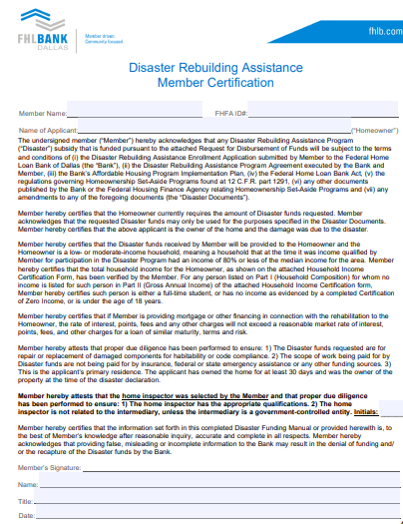
Same language applies to SNAP Member Certification
This must be signed by a member representative with AHP or Advances Authorization
Confirms that the member has reviewed information included in the application, it is complete and accurate
Be sure to initial in the box to confirm the inspector was selected by the Member
“Member hereby attests that the home inspector was selected by the member, and the proper due diligence has been performed”

Slide 90
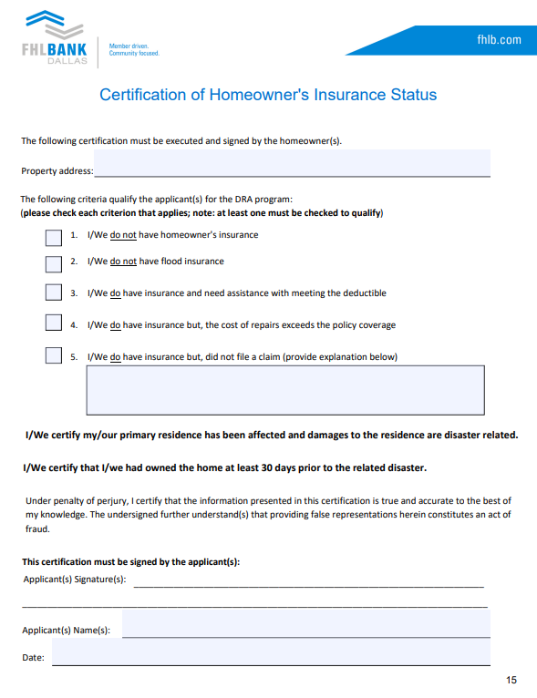
Please ensure the applicant checks the appropriate box/boxes, signs and dates the form.
Please Note:
The rehab work must be directly related to damages caused by the specific natural disaster event.
The homeowner(s) must have owned the home at least 30 days prior to the occurrence of the disaster.
If the applicant had insurance and did not file a claim, they must provide a valid reason. Disaster assistance typically fills gaps not covered by insurance.

Slide 91

2026 Special Needs Assistance Program (SNAP)
First Offering Application Window March 4-5 and Second Offering July 15-16

Slide 92


2026 Program Specifics
SNAP provides subsidies for the repair and rehabilitation of owner-occupied housing of eligible, special-needs households at or below 80% AMI
Program Allocations:
2026 Allocation:
$1.8 Million
2026 Rounds:
March 4-5
July 15-16
Each Homeowner can receive up to $10,000
Each member can submit a maximum of
6 Applications for 2026
Each member can submit a maximum of $20,000/Offering
Each intermediary can submit a maximum of $40,000/Offering
*Applications can be submitted from 8am CST on the first day of the offering until 5pm CST on the final day of the offering

Slide 93
SNAP Eligibility Requirements
At least one Permanent occupant of the household must meet at least one of the special needs criteria.
Eligibility Criteria:
Income at or below 80% AMI
Special needs: households with elderly (55+), persons with disabilities, persons recovering from physical abuse, alcohol, or drug abuse, or persons with HIV/AIDS
Owner-occupied primary residence
In FHLB Dallas’s district: AR, LA, MS, NM, TX
All submissions must be submitted by member financial institutions via GrantConnect

Slide 94
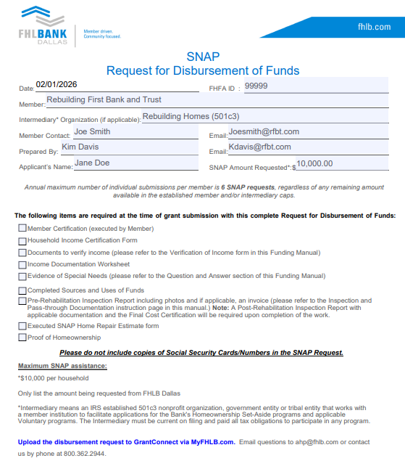
SNAP Request for Disbursement of Funds
Please fully execute the Request for Disbursement of Funds. Include the Intermediary Organization, if applicable*.
Intermediary Organization
Following the checklist will assist in submitting a completed application
Please do not include Social Security Cards/Numbers
*If an Intermediary fee is included in the request, there should be an Intermediary listed on the Request page

Slide 95

Special Needs Documentation
Driver’s License/State ID
Proof of age (55+)
Social Security Letter
Indicating age and/or disability
Executed Verification of Special Needs
Found in SNAP Funding Manual
Should be executed by an applicable professional (Doctor, etc.)
Should not be executed by an employee of the member institution
Only one method of verification is required

Slide 96

2026 Eligible Repair List
Please double check that the submitted repairs are eligible according to this list. Substitutions will not be permitted.

Slide 97
Documentation Requirements - SNAP & DRA

Slide 98

Proof of Homeownership - Required for DRA and SNAP request
*If proof of homeownership cannot be provided, the request will be considered ineligible for SNAP/DRA
*DRA:
Must be dated at least 30 days prior to FEMA Declared Disaster

Slide 99


Sources and Uses of Funds
Include all sources of funds including FHLB funds in the Sources section
Various values must match up:
FHLB Funds in Sources, Total Cost of Funds in the Uses section, and the request amount on the request for Disbursement must match
Total Sources must match Total UsesTotal Rehabilitation in Uses must match with the total on the Home Repair Estimate
The Intermediary Fee may not exceed $750

Slide 100

Home Repair Estimate
Frequent problems that cause delays include:
Ensure that all parties have signed in the designated areas
The Total Cost must correspond with the total rehab cost in the Sources & Uses document
Specify the units or quantities of materials
For roof replacement, detail the quantity of shingles (squares, bundles, rolls, sheets, etc.)
Separate costs for materials and labor
Allow ample time before the bid expires to facilitate review and for FHLB Dallas to process disbursement
Contractor Signature
Homeowner Signature
*When multiple contractors are involved, an executed Home Repair Estimate is required for each contractor.*
2/15/2026
Member Signature
2/15/2026

Slide 101
Pre-Inspections
Pre-rehab inspections and “before” photos are required to disburse funds
Inspection report must specify eligible items requiring modification/rehab
Photos must show the need for rehabilitation (SNAP) and/or damages as a result of the natural disaster (DRA)
If applicable, inspection invoice should be included, and the amount listed on the Uses of Funds should be supported by the invoice
Inspections to be conducted by an independent 3rd party
Approved by member institution
Must not be related to intermediary, unless the intermediary is a governmental entity
For SNAP: If not submitted in the original request, pre-inspections are due 45 days after the close of the SNAP window
For DRA: Pre-inspections and photos are due prior to disbursement
If the DRA request is for roof replacement, the new roof must be a FORTIFIED Roof unless the structure of the home cannot support a FORTIFIED Roof. Evidence will need to be provided if the structure cannot support a FORTIFIED Roof.
Items required for a FORTIFIED Roof:
Evaluation Affidavit (included in the Funding Manual)
Evidence the Contractor is FORTIFIED certified
Final FORTIFIED Certificate issued by IBHS must be submitted with the final documents

Slide 102
Final Documentation - SNAP & DRA

Slide 103
Inspection and Pass-Through Documentation
Required evidence of the subsidy passing through from the Member for the benefit of the household.
SNAP/DRA final documentation is required 60 days post-disbursement.
Post Rehabilitation Documentation:
Fully Executed Final Cost Certification(s) - signed and dated by all three parties
Final Rehab work Invoice(s) - listing final cost, date and homeowner address
Post-Rehabilitation Inspection Report with “After” Photos and final invoice
If a pre-inspection invoice was included with the original request and a cost for inspections was included on the Uses of Funds, a post-inspection invoice is required.
**Contractor/Dates/Address/Costs should match with the original request unless a change order was requested and approved by FHLB Dallas**

Slide 104

Final Cost Certification
Final documents are due within 60 days of the disbursement of funds
1) Final Cost Certification:
Various signatures required
The rehabilitation completion date will be compared to dates on other final documents
The Cost of Rehab will be compared to final invoices
2) Final Invoice from Contractor:
Include:
Home address
Date (on or after the final cost cert completion date)
Total cost that aligns with Final Cost Certification
3) Final Inspection:
Include:
Home address
Date (on or after the final cost cert completion date)
Images of completed repair items
Inspection invoice, if applicable
*All repairs, contractors, amounts, and other information must match initial application unless a change order was requested & approved by FHLB Dallas*

Slide 105

Final Invoice
A final invoice is required upon completion of the repairs.
The invoice should include:
Date
Contractor information
Homeowner name and address
Listing of modifications/repairs
Multiple contractors requires multiple invoices/Multiple Final Cost Certifications
Final amount should equal or exceed the SNAP/DRA rehab amount as listed on the Sources and Uses of Funds and match the Final Cost Certification
FINAL
1
2
3
4
Matches Final Cost Cert
Notes:
*If there are multiple contractors, an invoice is required for each one.

Slide 106


Post-Rehab Inspection Report and Invoice
The final inspection should occur after all rehab work is completed and must confirm that the original scope of work was completed in an acceptable manner.
The report should include:
Confirmation that the work/original scope was completed
Homeowner name
Property address
Photos of completed repairs
Invoice (if applicable)
04/01/2026
4/01/2026
Pre and Post Inspections should be completed by the same inspector/company to the greatest extent possible. If the Post-Inspection cannot be completed by the same inspector, contact FHLB to request approval of change.

Slide 107


Pre and Post Inspection Photos
Pre-inspection photos:
Capture clear photos of specific items that require modifications or rehab work to be completed.
Photos should align with the Home Repair Estimate and Pre-Inspection Report.
Post-inspection photos:
Photos of work completed validating that the repairs have been made as noted on the Home Repair Estimate/Final Invoice and Post-Inspection Report.
“After” photos should align with “Before” photos.

Slide 108
Funding Process
Complete requests must be submitted through the member institution via GrantConnect
HELP & DRA: 7-10 business days to review and fund requests
SNAP: Variable - most within 3 months from the close of the window
Funding is disbursed to the member institution’s account with FHLB
Member uploads final documentation via GrantConnect
HELP: Final CD – 30 days, Recorded Deed – 60 days
SNAP & DRA: 60 days
HELP: It's recommended to schedule closings at least 15-30 days after submissions to avoid any potential closing delays.

Slide 109
Questions?

Slide 110
Program Enrollment and Application Submission Process

Slide 111
Member Enrollment Agreement
HELP/SNAP/DRA participation requires a one-time enrollment for member financial institutions to participate
First-Time Participants:
Returning Participants:
Member enrollment must be completed prior to submitting applications
Request enrollment documents via email: AHP@fhlb.com
The enrollment package will be sent via AdobeSign
The enrollment package must be completed by a member representative with Advances Authorization
Member enrollments are valid indefinitely; re-enrollment is not required for 2026
To check your institution’s enrollment status, you can email AHP@fhlb.com
Members may opt to be added to a participating Member list accessible on our website by potential homeowners and intermediary organizations

Slide 112
Submitting Request and Documents via GrantConnect
GrantConnect is the system used to accept and process HELP/SNAP/DRA applications from members.
Registration Required: User registration for portal access is restricted to individuals employed by member institutions; only applicants meeting this criterion will be approved.
How to Register:
1.
Go to https://app.fhlb.com/GrantConnect
2.
You can create an account by choosing "Sign up now" under the "Sign in" Button
3.
Follow the prompts to create a Login ID* and provide other details we need. Register as a member*
4.
Connect your account to your organization & submit
5.
FHLB will review and send an approval email to new user
*Please do not use special characters in your Login ID
Notes:
We do have a “how to” document that we can email the new user. Important notation (i.e. When registering, please make sure to select the "Member" option. This is crucial as it will prevent any potential access issues.)

Slide 113


GrantConnect & Authorizations
Usage and visibility in GrantConnect varies by level of “authorization”
Non-AHP/Non-Advances
GrantConnect Access Only*
AHP/Advances
*Limited Access
Advances Authorization:
AHP Usage code Authorization:
Provides access to all FHLB financial products outside of Community Investment
Aside from the one-time program enrollment, Advances is not required in the DRA process
Obtained via email from someone at the organization with Advances Authorization
Allows the individual to sign off on the Member Certification document
Notes:
Once an application is uploaded, it can’t be deleted or edited by any user with Advances or AHP
.
Advances authority can view. edit, upload or delete applications submitted from their organization
AHP authority will only be able to see, edit, upload or delete applications that they only initiate, pending and submission in Grant Connect.
If you have a user in your organization that you would like to be assigned the AHP usage code (column 2) a person with advances authority can request that via email to ahp@fhlb.com

Slide 114



GrantConnect - Create New Disbursement Request
Log in, select current round and new request

Slide 115

GrantConnect - Upload Management
Log in
Select Round
Able to review a summary of all file status information
Upload New Request
$750,000
Permission Levels:
View and upload for all applications
Advances signature card authority
AHP Usage Code
Limited Access
GrantConnect - Can only view their submitted applications to FHLB
Depending on the application status, different actions will be available
Notes:
Once an application is uploaded, it can’t be deleted or edited by any user with Advances or AHP
.
Advances authority can view. edit, upload or delete applications submitted from their organization
AHP authority will only be able to see, edit, upload or delete applications that they only initiate, pending and submission in Grant Connect.
If you have a user in your organization that you would like to be assigned the AHP usage code (column 2) a person with advances authority can request that via email to ahp@fhlb.com

Slide 116

GrantConnect- Create New Disbursement Request
Log in, select current round and new request.
Create Disbursement Request :
Able to verify total submitted to date to measure Member Cap
Project ID and Member will auto populate
Enter data in all required fields
Click Save to move to next screen

Slide 117

Create New Disbursement
Enter applicant information
26DR12345
homeowner’s
physical address
12345- ABC Bank
Able to verify total submitted to date to measure Member Cap
Project ID and Member will auto populate
Enter data in all required fields
Click Save to move to next screen
The appearance of GrantConnect has been updated for 2026, all functionality remains the same.
Notes:
.

Slide 118


GrantConnect- Document Upload and Submit Request
Choose the documents to upload from your saved file location.
Click on the “Upload” button.
Uploaded documents, will be displayed in document list box.
Click the “Submit Request” button to submit the request to FHLB
Once submitted, you will not be able to delete the request.
Please contact FHLB if you need to withdraw or cancel any request.
$750,000
Don T Miller
The appearance of GrantConnect has been updated for 2026, all functionality remains the same.
Notes:
Once an application is uploaded, it can’t be deleted or edited by any user with Advances or AHP
.

Slide 119

Questions?
Contact Us!
By Phone: 800.362.2944
By Email: ahp@fhlb.com
Thank you for being a valued member of FHLBank Dallas!

